Slide 1
Diversifying Funding to Prevent and Reduce Homelessness​
Presented by: Homebase

Slide 2
Agenda
Leveraging Funding
Examples
Planning
An Overview
Workforce, Housing, Healthcare
What Are Your Next Steps?

Slide 3






PRESENTERS
Nicole McCray-Dickerson
Mary Simons
Jean Field
Kenya Rawls
Senior Directing Analyst
Director, Policy and Implementation
Senior Directing Analyst
Directing Analyst

Slide 4
Leveraging Funding Sources in the Community: An Overview

Slide 5
Diversifying Funds to Address Homelessness
CoC funds are one source of funding. CoC resources alone will not end homelessness in most communities.
Tapping into non-traditional funding sources can help an organization to increase funding.
Partnering with others who are aligned in the work can increase access to resources.

Slide 6
Homelessness Response System
Health/ Behavioral Health System
Youth System
First Responders/ Criminal Legal System
VA System
Housing System
Workforce System
Older-Aging Adults
Philanthropy/ - Faith partners
Collaboration
As systems work together, each functions more effectively for the benefit of vulnerable populations by providing access to housing and services through a coordinated care model

Slide 7
Homelessness Assistance Grants
To Assist Homeless Individuals and Families through the Department of Housing and Urban Development (HUD)
Continuum of Care (CoC)
Permanent Supportive Housing (PSH)
Rapid Rehousing (RRH)
Transitional Housing (TH)
Supportive Services Only (SSO, SSO-SO, SSO-CE)
HMIS
Emergency Solutions Grant
Homelessness Prevention
Shelter and Housing Navigation
Rapid Rehousing and Housing Stabilization
HMIS

Slide 8
Resources for Youth and Young Adults Under 25
Youth Homelessness Demonstration Program (YHDP) & Youth Homelessness System Improvement (YHSI): Department of Housing and Urban Development
Runaway and Homeless Youth Act Programs (RHY): Family and Youth Services Bureau (FYSB) under the Administration for Children and Families (ACF)
Specialized Rental Assistance Vouchers for youth aging out of foster care
Family Unification Program Voucher (FUP)
Foster Youth to Independence Voucher (FYI)
Notes:
Administered by the U.S. Department of Housing and Urban Development (HUD), these are the primary federal initiatives. YHDP funds housing and supportive services, while YHDP and YHSI regularly release funding notices (such as multi-million dollar competitive NOFO cycles) to build coordinated community responses. [1, 2]
Runaway and Homeless Youth Act Programs (RHY): Family and Youth Services Bureau (FYSB) under the Administration for Children and Families (ACF) key programs include the Basic Center Program (shelter and counseling for youth under 18), Transitional Living Program (TLP) (longer-term support and housing skills), and the Street Outreach Program. [1, 2, 3, 4]

Slide 9
Resources for Veterans
To Assist Individuals and Families with an Eligible Homeless Veteran in the Household
VASH Vouchers (Department of Veterans Affairs administered by Public Housing Authorities)
Supportive Services for Veteran Families (SSVF): Department of Veteran Affairs)
Homeless Veteran Community Employment Services (HVCES): Department of Veteran Affairs connected to VA Medical Centers
Homeless Veterans' Reintegration Program (HVRP): Department of Labor
Notes:
Created by the VA, this program places Community Employment Coordinators at most VA medical centers. They connect veterans with local employers, pre-screen job skills, and help with onboarding. You can learn more through the VA HVCES Information Page. [1]
HVCES: Created by the VA, this program places Community Employment Coordinators at most VA medical centers. They connect veterans with local employers, pre-screen job skills, and help with onboarding. You can learn more through the VA HVCES Information Page. [1]
this is the only federal grant program that focuses completely on helping homeless veterans find competitive jobs. It provides career training, job search help, and support services. Visit the DOL HVRP Overview to see how it works. [1]

Slide 10
Philanthropy
Tell Your Story
Local Business
Volunteerism
Donations
Faith Partners
Volunteerism
Donations
Transportation Assistance
Local Philanthropy
United Way
Community Foundation
Rotary Club and other service organizations

Slide 11
Health Resources
To Assist Homeless Individuals and Families
Primary Healthcare
Healthcare for the Homeless (Federally Qualified Health Centers): Health Resources Services Administration (HRSA)
Medicaid Waiver options in certain states: centers for Medicare and Medicaid Services (CMS)
Behavioral Healthcare
Projects for Assistance in Transition from Homelessness (PATH): Substance Abuse and Mental Health Services Administration (SAMHSA)
Cooperative Agreements to Benefit Homeless Individuals (CABHI): Substance Abuse and Mental Health Services Administration (SAMHSA)
Notes:
PATH:Provides formula grants to states for community outreach, mental health and addiction treatment, case management, and basic housing services. [1, 2]
CABHI: Funds local and state efforts to connect people experiencing chronic homelessness or veteran homelessness with permanent supportive housing and treatment. [1]

Slide 12
Voucher Programs
Rental Assistance
State or Local Government
HOME Investment Partnership Program (HOME)- time limited
Some Medicaid funded transitional rent programs- Section 1115 Demonstration Waiver- time limited- currently limited to Arizona, California, Oregon, Vermont, New York; some other states provide housing navigation and tenancy services to assist eligible recipients to obtain and maintain housing
Public Housing Authority
Housing Choice Voucher Program
Mainstream Voucher Program- People with Disabilities
VASH- Veterans

Slide 13
Options for Housing Development
Partner with a Housing Developer or Build Local Nonprofit Capacity
Low Income Housing Development Tax Credits (LIHTC)
CoC Builds- Permanent Supportive Housing
Home Investment Partnership Program (HOME)
Affordable Housing Trust Fund
Community Development Block Grant (CDBG)
Federal Home Loan Bank Affordable Housing Program (AHP)

Slide 14
Workforce Development
Workforce Innovation and Opportunity Act (WIOA): Department of Labor- distributed by formula to provide education and workforce opportunities for youth and dislocated adult workers
Vocational Rehabilitation (Voc-Rehab): Rehabilitation Services Administration under Department of Education- distributed to states by formula to increase workforce opportunities for people with disabilities
Reentry Workforce Development (REO)- Department of Labor- grants to provide job training and case management for justice involved individuals

Slide 15
Leveraging
Workforce Development
Resources​

Slide 16



Employment Pathway Initiative
A CoC communitywide collaboration with a concentrated effort to serve the Homeless Prevention System (HPS) and Rapid-Rehousing (RRH) communities by developing new pathways to living-wage careers and helping more people achieve long-term housing stability, ultimately reducing homelessness at large.
City and County stakeholders
Funded and non-funded CoC housing agencies
HMIS system admin
Workforce Development/Vocational Partners
Community Resource Agencies
Local Employer Partners
Biweekly CoC meetings w/
Workforce Development & County
RRH/HPS Case Managers
Direct Service Trainings
Resource Sharing
WRA = Client
Access
Rapid- Employment
Rapid- Job Training (2-11 weeks)

Slide 17
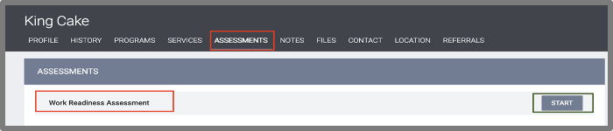
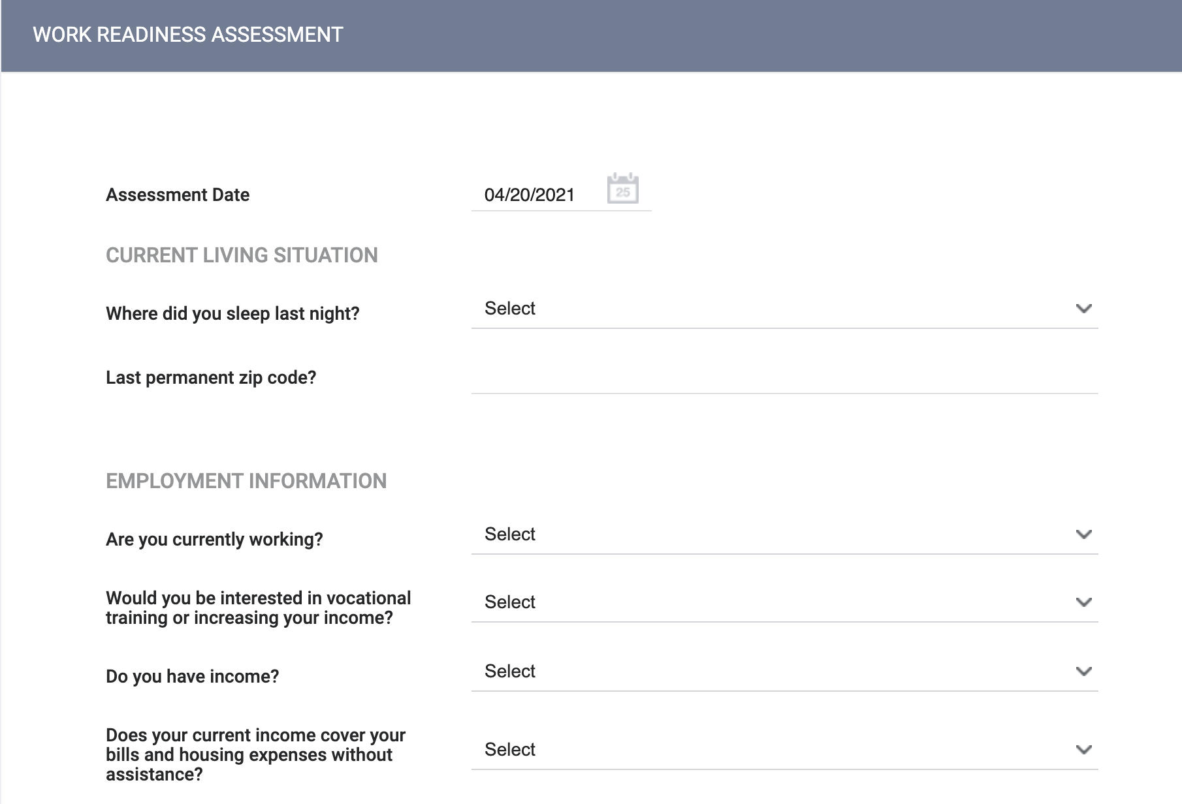
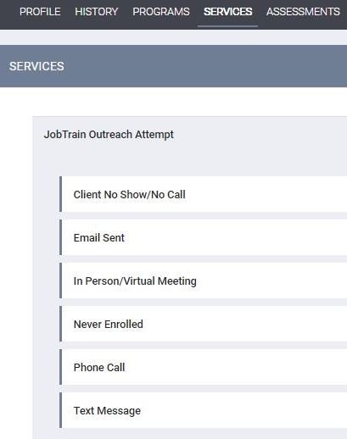
HMIS Work Readiness Assessment Example
All CoC Housing/Service Agencies
Workforce Service Agencies Only
Mirrors Housing Que (HPS/RRH)
Wraparound Services Communication
Data sharing Housing w/ Employment
PDF Sample of a WRA

Slide 18



The Work Readiness Road to Economic Mobility
HMIS
WRA
Work Readiness Assessment
Housing case manager conducts assessment via HMIS, workforce development staff receives WRA as digital referral, completes intake/employment plan, identifies/removes barriers, connects client to either training or employment.
Get “A”Job
Follow the ABCs →
Getting A job, a Better job, and a Career. Creating accountability while removing barriers, including developing a housing stability plan that mirrors the employment plan (low-income apt. apps.).
Get a “Better” Job
Get a
“Career”
Leverage “A” to get “B” →
Economic Mobility
This may include a skills upgrade course or short-term training, revamping resume and utilizing employer partnership to secure a living-wage job.
Possible training graduation or new skill set to leverage. All major barriers removed, and new income matches new rent requirement.

Slide 19

What do you think were the Top 5 Employment Barriers?
Criminal
History
No GED or Vocational Trade
Child Care Services
Assessment Discovery
Transportation
Undocumented Workers

Slide 20


HOW?
Creative Supportive Services Funding that lasts for 6 months or more for employment retention.
Strong Community Partnerships and Resource Connection.
Under the Workforce Innovation and Opportunity Act (WIOA), the Employment Service offices are co-located with the approximately 2,300 American Job Centers nationwide.
Nationwide vocational rehabilitation services are managed at the federal level by the Rehabilitation Services Administration and delivered locally through individual state agencies via Vocational Rehabilitation services.

Slide 21
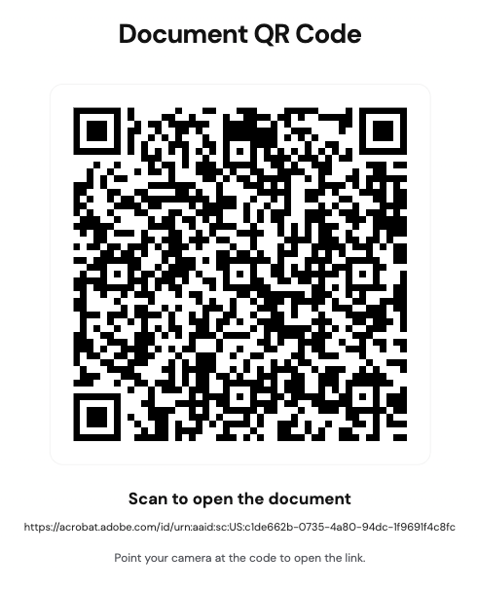
Scan Here to Access Workbook!

Slide 22
Workforce Development Resources:
WIOA American Job Centers nationwide: https://www.careeronestop.org/LocalHelp/AmericanJobCenters/find-american-job-centers.aspx
Nationwide vocational rehabilitation services: https://rsa.ed./agovbout/states
HMIS Work Readiness Assessment Example: https://acrobat.adobe.com/id/urn:aaid:sc:US:b5350cbd-485b-42c2-9a8d-1fef5aac9464

Slide 23
Leveraging
Public Housing Authority
Resources​

Slide 24



Key Public Housing Collaboration
Subsidies
Affordable Housing
Connection

Slide 25
Subsidies
Government–funded financial supports
Operating Subsidies
Capital Funds
Housing Choice Vouchers (Section 8)
Special Purpose Vouchers –
VASH, Stability Vouchers, EHV

Slide 26
Affordable Housing
Public Housing: PHA-owned apartments buildings and townhomes where rent is usually set at about 30% of adjusted gross income
Housing Choice Voucher: Rental Assistance used with private landlords who accept government-backed subsidies.
Projected-based Vouchers – Rental subsidy attached to a specific housing unit or building through contract with the property owner.
RAD Conversion Supportive Services & PHA Community Centers

Slide 27
Connection
Connect to the resources and services that are needed for families
Health Care
Employment Services
Other Supportive Services (Case Management, Education, Recreation, Food Pantries, Civic Engagement, Transit, Financial Knowledge, etc.)
Supportive Services & PHA Community Centers

Slide 28
Helpful Hints
The Public Housing Authority can be your colleague!
Be familiar with your shared housing goals
Be knowledgeable of the PHA policies
  Administrative Plan
  Admissions and Continued Occupancy Policy
Engage in conversations with PHA Leadership

Slide 29
Other Local Collaboration Partners
Community Development Corporations: local, nonprofit, 501(c)(3) organization created to revitalize underserved, low-income neighborhoods through housing, economic development and social programs.
Office of Housing and Community Development: provide safe, stable and affordable housing while strengthening the social and economic fabric of local or state level community.

Slide 30
PHA Resources:
What is Public Housing Program:
https://www.hud.gov/helping-americans/public-housing
HUD State Information:
https://www.hud.gov/states
HUD Offices Local Locations:
https://www.huduser.gov/portal/regions/Regional.html
Public Housing Agency Plans:
https://www.hud.gov/helping-americans/public-indian-housing-pha-plans

Slide 31
HEALTHCARE AND BEHAVIORAL HEALTH SYSTEMS

Slide 32
Why Partner With Healthcare?
High need: Homeless people are exposed to many communicable diseases, infections, malnutrition, stress, and exposure - areas that healthcare partners can address
Homelessness makes existing conditions worse: Living on the street aggravates medical conditions, chronic and infectious disease and co-occurring disorders, and prevents basic care, including hygiene and medication
Low access to treatment: People on the streets, in shelter, or unstably housed are often unable to access treatment – even when insured.
Mortality: Mortality is 3 to 4 times higher than for the general population = significantly lower life expectancies

Slide 33
Shared Clients, Disconnected Systems
Shared clients: People in the homeless system of care often interact with or need connection to the behavioral healthcare and/or medical systems of care
Disconnected Systems: Most systems of care don’t communicate about shared treatment or interactions with shared clients
Result:
Missing information about people’s history, needs, whereabouts
Costly duplication of efforts and failed interventions
Failure to connect people to multiple resources – interventions often depend on where people enter the system

Slide 34
Who: Key Health System Collaborators
Health Centers
Health Plans
Hospitals
Street Medicine
Behavioral Health Agencies

Slide 35
Health Centers
Key Collaboration Opportunities
  Facilitate access to primary and specialty care and ensure adequate followup care
  Explore on-site health care services at shelters or housing programs
  Co-developing/running PSH and interim housing
Federally Qualified Health Centers (FHQCs) or Health Care for the Homeless (HCH) Programs
Serve high-need communities designated as Medically Underserved Area (MUAs) or Population (MUPs)
Provide all required primary, preventive, and additional health services to meet the needs of the populations they serve – sometimes function as a hub formany services

Slide 36
Health Plans
Key Collaboration Opportunities
  Ensure enrollment of CoC participants in Medicaid and referral to benefits and services for which they’re eligible
  Leverage housing and supportive services to improve members’ health outcomes
Managed Care Plans (MCP), Managed Care Organizations (MCO), Coordinated Care Organizations (CCO)
Cover Medicaid benefits or other health coverage
Managed Care = health care delivery system organized to manage quality, utilization, and costs.
  In Medicaid managed care, health plans receive a set per member per month (PMPM) payment for all covered services
  Incentivizes efficient improvements in member health outcomes
  Depending on state, may provide payments for housing- and/or medical recovery-related costs

Slide 37
Hospitals
Key Collaboration Opportunities
  Identify and track homeless patients
  Connect hospital discharge planning process to CoC/Coordinated Entry access points (via protocols, co-located staff, etc.)
  Explore recuperative care/medical respite programs
Emergency departments (EDs) are often the only health care provider for homelessness people + complex health conditions mean some people are frequently admitted to the hospital
No safe places to recover = longer lengths of stay & re-admissions
Hospitals may not be reimbursed
Providing care to people who repeatedly return for preventable or treatable condition impacts hospital staff morale

Slide 38
Street Medicine
Key Collaboration Opportunities
  Support outreach, engagement, and trust-building
  Facilitate referrals and connections to CoC/Coordinated Entry
Delivery of medical care to homeless people in or near where they reside.
  Street/Backpack Medicine: providers go directly to person (e.g., at their tent, in their car)
  Mobile clinics/Mobile medicine: Mini-clinics that can park nearby
  May be connected to a hospital, university/medical school, or FQHC/HCH program
Most common services: wound care, basic medicine administration
  May also connect people to primary and specialty care + housing resources

Slide 39
Behavioral Health Agencies
County-based behavioral health services provide mental health and substance services to 75% of U.S. population (23 states)
Behavioral health agencies use federal (HHS, SAMHSA, Medicaid, state, and local funding, and work with MCPs
Accessing behavioral health and other provided services varies by region – important to understand your partners
Key Collaboration Opportunities
  Aligned outreach and eligibility assessments
  Explore on-site care services at shelters or housing programs
  Identify shared clients and refer for housing/services

Slide 40
How: Working together
Outreach, engagement, assessment
Identifying shared clients
Housing: Planning, funding, obtaining, supporting
Making systems stronger

Slide 41
Areas for Collaboration and Alignment
Outreach and engagement: Homeless outreach with street medicine, housing and healthcare assessment and navigators, behavioral health eligibility assessment;
Support referral processes: Consolidate and lower barriers to multiple eligibility and documentation requirements
Inreach and support: Bring healthcare and behavioral healthcare to shelters and housing providers; create on-call consultation for people in crisis
Sharing information – through HMIS, informal case conferencing or more formal data sharing – to better serve people and reduce duplication of effort

Slide 42
More Areas for Collaboration
Housing planning and navigation – Using coordinated entry, case conferencing, flexible funds to ensure aligned housing navigation from a range of funding sources
Braiding funding for shelter and housing - Healthcare organizations partner with housing developers and operators to create housing opportunities
Supporting housing stability through providing services and expertise
System alignment and change – working together to identify gaps, needed resources and opportunities for optimization

Slide 43
Getting Started
Find a Health Center: https://findahealthcenter.hrsa.gov/
Health Care for the Homeless Grantee Directory: https://nhchc.org/grantee-directory/
National Association of Rural Health Clinics: https://www.narhc.org/
Find your State Medicaid Agency: https://www.medicaid.gov/about-us/where-can-people-get-help-medicaid-chip
Talk to your participants about their specific health needs and challenges, if and where they access care, and providers they like
Make sure participants are enrolled in Medicaid and that you understand resources available through your state’s Medicaid benefits and waivers
Think about how to pitch your CoC or agency
Don’t just be ready with asks, but also with ideas and offers
Find your local health care partners and reach out with an invitation

Slide 44
Questions
Planning

