Slide 1


Discussing Data
Notes:
Please add your name, community, and role in the chat

Slide 2

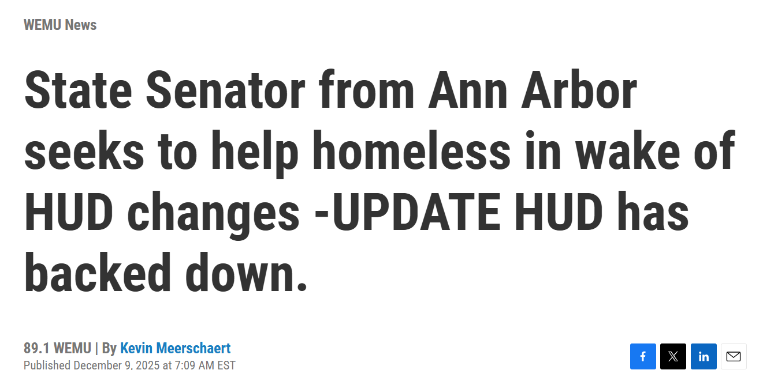
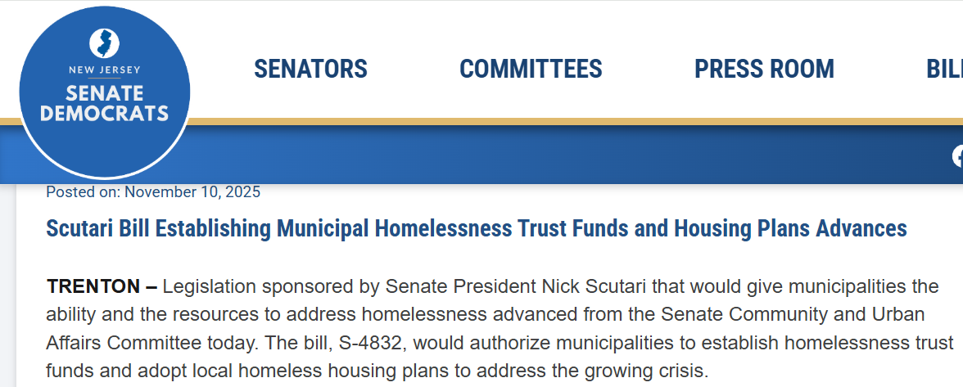
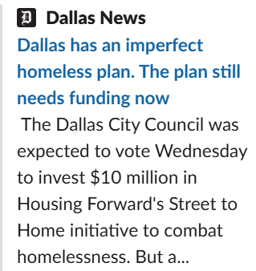
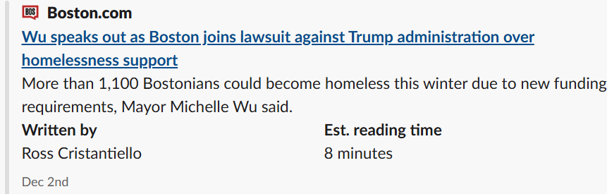
How Communities are responding
Notes:
CS is tuning into comms across the country - sharing a few from places as diverse as Dallas, Ann Arbor, Boston, and Maryland
Getting activated and getting creative

Slide 3

Taking a Moment
Take three generous breaths with an audible exhale

Slide 4
Background.
HUD’s Continuum of Care program has involved a competitive process since 2012. Decisions are made using a variety of data sources :
Point in Time / Housing Inventory Count
System Performance Measures
Longitudinal Systems Analysis
HMIS system and program data
APR and grant draws
COMMUNITY INPUT
} Big 4 reports
24 CFR 578.21

Slide 5
Business as Usual vs. Significant Changes
This year’s NOFO involves a mix of business as usual elements and significant shifts:
Consolidated Application (Community-wide)
CoC Coordination & Engagement
Project Capacity, Review, & Ranking
System Performance
Project Application
Project specific regs
Notes:
Less about how points are allocated in the NOFO and more about what it signals re: policy priorities and how we as communities respond
E.g. Data Sharing w/ local and state governments
E.g. Data on whether folks are moving into subsidized units
E.g. Enhanced partnering with behavioral health and peer-based recovery programming
E.g. any concerns re: data security and privacy

Slide 6

Reflection
Where are you feeling pretty strong about your data approach?
Where are you feeling stuck?

Slide 7

Community Share Out
What do you have?
What did you need?
What did you learn?

Slide 8
One thing you can do
Before we head back to the main room:
Exchange contact info with one person whose ideas / approach resonated with you

