Slide 1


No One Left Behind SYSTEM WIDE QUALITY DATA
Notes:
Tia slides 1-12
Day: Thursday
Time:
Length: 1 hr.
Section 1: 20m
Section 2: 5m
Section 3: 25m
Prep:
Stickies and sharpies on table
Flip charts prepped with SCON questions

Slide 2



PRESENTERS .
DAWN MOSKOWITZ .
TIA LURIE
JANE MOY
Notes:
Tia

Slide 3

Creating a lasting end to homelessness that leaves no one behind
1
2
3
Starting with Subpopulation Quality Data Learning
Moving to System Wide Data in Action
Discussion: Exploring how your community tracks System Wide Data for All and Unsheltered
Notes:
Tia Big goal - End homelessness for all Via - subpopulation level goals But what if - system level goals instead First - background and the whymThen - what could this look like Finally - how - SCON
Today’s session is focused on our learning from the strategies we have implemented in service of Community Solutions’ mission to create a lasting end to homelessness that leaves no one behind. Our methodology, which all of you are likely very familiar with has largely focused on looking at subpopulation quality data and implementing system improvements to drive reductions in homelessness. We’ll dive into our learnings from that work and how those learnings have brought us to the discussion around looking at system wide data to drive change and see improvements. We’ll share some examples of how this is being done currently and then turn to small group discussions to learn more together.

Slide 4
Group Breakouts - Unsheltered and System Wide data
Strengths:
What are you doing now to report all and unsheltered?
reporting monthly/quarterly active for all?
regular tracking for unsheltered?
currently doing, even if not beyond PIT
Opportunities:
What are you interested in doing but haven’t tried yet?
ideas you’d like to explore or expand?
Challenges:
What barriers do you face to report all and unsheltered?
don’t know what to track/data not entered
don’t know if it’s good data - different numbers being shared by others (e.g. mayor)
difficulties reporting inflow and outflow
Needs
What areas do you know you need support in?
knowing when data is good enough
assessing system wide data
reporting from outside HMIS
tracking within HMIS
Notes:
Tia For those of us that like to see the big picture up front, we will be asking you all to think through your community’s strengths, opportunities, challenges and needs as it relates to tracking unsheltered and system wide data. We’ll do a small group discussion that will cover these four topics for the second half of this session.

Slide 5
NO ONE LEFT BEHIND SYSTEM WIDE QUALITY DATA
1
1
SUBPOPULATION QUALITY DATA LEARNING JOURNEY
Notes:
Tia But first, let’s talk talk more about how we got here.

Slide 6
Quality Data Backstory
Where we started
Communities developed comprehensive by-name lists based on specific subpopulations and populations that connected people’s characteristics to targeted resources such as: housing subsidies, housing units, services and programs
Enabling communities to effectively + efficiently drive reductions in homelessness by providing targeted support
Notes:
Tia Our work with communities has focused on developing subpopulation and population based quality by name data that support system improvement work and drive reductions.
Why did we think comprehensive BNLs were important? Why did they need to be tied to specific sub populations?

Slide 7
NO ONE LEFT BEHIND SYSTEM WIDE QUALITY DATA
1
SO THAT
we could replicate and scale system improvements to
reduce and solve
homelessness for all
Notes:
Tia Our So That focused on the idea that those improvements and reductions at the subpopulation level can then be replicated and scaled to a wider system focus to reduce and solve homelessness for all

Slide 8
Quality Data Learnings from Communities
What we learned
Scorecards and Data Reliability Standards help to establish comprehensive, accurate, and up to date by-name lists
Defining what “good enough” looks like
Consistent tracking of client status (active, inactive, housed) creates clear visibility across the system
Monthly metrics reveal inflow/outflow trends that are actionable
Notes:
Tia Through this work we’ve learned a lot -
The standards we’ve established with the scorecard and data reliability measure are helpful in the development of a quality by name list
We’ve learned that it doesn’t serve anyone for the standard to be too high, and so we’ve come to understand what “good enough” looks like in the context of quality data
We’ve learned with communities that understanding how people move through and out of the system helps to understand what impact we do have.

Slide 9
Quality Data Culture in Communities has…
Created a credible, shared picture of homelessness among Veterans, Chronically homeless, and Youth/Young Adults locally
Built confidence in the data, enabling coordinated decision-making
Strengthened data culture, practices, and infrastructure across partners
Shifted conversations from “how many?” to “what’s working?” and “what can we try to improve?”
Notes:
Tia In communities we’ve seen improved data culture, specifically when it comes to work in the Veteran, Chronic, and YOuth and young Adult spaces.
We’ve seen increased confidence in using and sharing data with partners
And we’ve seen the conversation move from just looking at the numbers to creating actionable plans to improve the system.

Slide 10
With Quality Data, Communities have Improved Systems
Improvements in provider buy-in, relationships, and workflows
Using monthly data for improvement planning
Data automations that save time
Enhanced case conferencing practices
Notes:
Tia We’ve seen this model work to drive improvements and reductions at the subpopulation level across communities, some system improvements that stand out are:
Provider buy-in, relationships, and workflows for consistent, timely data entry have been strengthened
Monthly data has been utilized for goal setting, gap identification, improvement testing, and progress measurement
Increased us of automated reports for monthly metrics
Case conferencing practices have been enhanced to coordinate resources, resolve bottlenecks, and accelerate housing placements
AND We’ve seen the subpopulation veteran focus scale nationally with the recent VA Announcement launching the VAMC BNL

Slide 11
NO ONE LEFT BEHIND SYSTEM WIDE QUALITY DATA
1
OUTCOME: BFZ Communities have driven progress—reducing homelessness for Veterans and making gains for people experiencing chronic homelessness, youth and young adults.
Notes:
Tia
All of this work yielded a really important outcome - BFZ communities have reduced homelessness and driven many other system improvements for veterans, chronically homeless, youth and more.
Dawn will take us back to our So That… that we covered earlier.

Slide 12
NO ONE LEFT BEHIND SYSTEM WIDE QUALITY DATA
1
SO THAT?
we can replicate and scale system improvements to
reduce and solve
homelessness for all
Notes:
10:40 Dawn Slides 12-19
As Communities make progress and we learn what gains are possible with quality data, we return to reflect on how that translates to our ‘so that’ (the STUDY part of our PDSA’s)

Slide 13
Challenges with Scaling
Subpopulation (Veteran and chronic) team models don’t easily translate to other populations
Youth, young adult, and family efforts require new partnerships and relationships
Scaling to single adults is constrained by system factors
Systems to account for all unsheltered people in real time are still underdeveloped
Milestones for small populations have limited impact on bigger picture
Notes:
Dawn - And we see that there are some substantive challenges we face with scaling

Slide 14
Changing Conditions
Housing shortages worsen
COVID-related resources expire
Unsheltered homelessness rises
Hospital and healthcare access stretched
Criminalization of homelessness
Strained public perception of homelessness
Notes:
Dawn - We also recognize limitations posed by changing conditions
Include business - local businesses struggle in the face of online shopping

Slide 15
NO ONE LEFT BEHIND SYSTEM WIDE QUALITY DATA
1
IMPACT: Conflicting public narratives, political priorities, and business pressures pull efforts in different directions, undermining
unified action on homelessness.
Notes:
Dawn

Slide 16
NO ONE LEFT BEHIND SYSTEM WIDE QUALITY DATA
1
Now What?
Notes:
Dawn

Slide 17
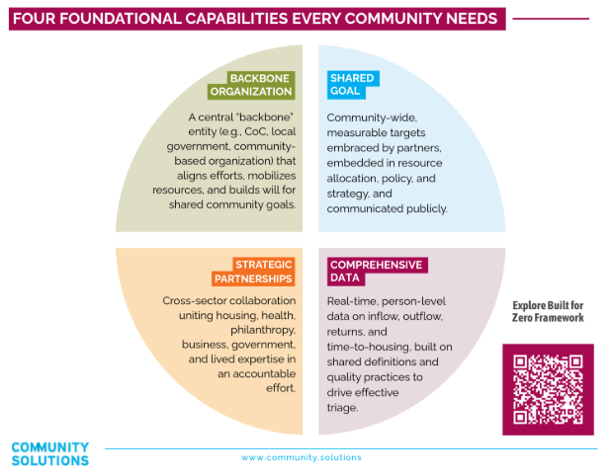
Refined BFZ Theory of Change
Much of what we have been focusing on is working!
Notes:
Dawn - A lot of what we have focused on is working -- and showing up in BFZ’s refined theory of change -- and how comprehensive data ties to developing shared goals, and effective backbone and building strategic partnerships

Slide 18
Ways of Working
To turn this framework into measurable results, communities integrate four core practices:
Person-Specific
Continuous Improvement
Use shared, disaggregated data to monitor, disparities,
close gaps, and track progress.
Test, adapt, and scale solutions quickly, guided by
shared data and evaluation.
Collaborative
Proactive
Within the backbone structure, co-develop strategies, align resources, and include lived experience.
Anticipate challenges, prioritize prevention, and act upstream using data
and community input.
Notes:
Dawn - Our learning with quality data has supported clarity around defining the core practices tied to measurable results

Slide 19
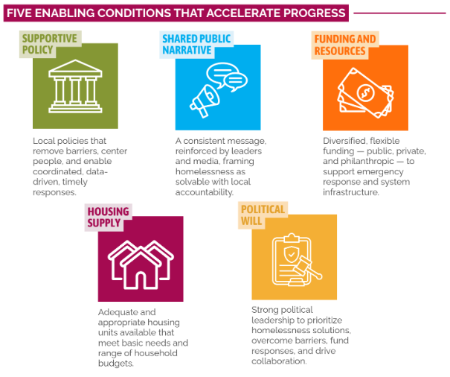
Accelerating Progress System Wide
A system wide focus supports conditions toward unified action
Notes:
Dawn - And as we gain greater insight into the conditions necessary to accelerate progress, we recognize the urgency and importance of having a systemwide focus to support enabling conditions toward unified action

Slide 20
NO ONE LEFT BEHIND SYSTEM WIDE QUALITY DATA
1
2
SYSTEM WIDE DATA IN ACTION
Notes:
By 10:45 - Tia - So that brings us to looking deeper into how BFZ tools and reporting can be applied toward all people experiencing homelessness and those who are unsheltered. We’ll also dig into what BFZ communities are currently doing to understand, track and report on all and unsheltered

Slide 21
The Full Picture….beyond the PIT Count
Reductions in all and unsheltered homelessness are still largely measured by the PIT Count, but driving solutions requires us to:
Create a clear, credible community-wide picture
Account for all people experiencing homelessness
Track progress broadly to understand the reduction impact when focusing on specific groups
Leverage learnings from subpopulation data and systems work
Address the reality and impact of unsheltered homelessness
Notes:
Tia - Most communities are currently using the PIT count to look at homelessness, and unsheltered homelessness specifically, across their system, and to understand how the landscape is changing year over year and if progress is being made
However, we know this is not sufficient for understanding what’s not working.
So if PIT Count is not sufficient, what IS necessary drive solutions - We believe that -
We need a more credible data set that accounts for all people across a system
We need to understand system changes more broadly, even when we are seeing reductions in a subpopulation
We need to understand unsheltered homelessness more deeply

Slide 22

Understanding All & Unsheltered
How can we use the tools we have?
Population and subpopulation scorecards
Monthly metrics
Notes:
Tia - So how could we use the BFZ tools to do that?

Slide 23
Elements of All Scorecards
Robust, coordinated outreach coverage
Adjacent Systems
Provider participation in data system
Data Contribution
Able to list all
Exits from foster care
Policies & Procedures
Inactive policy
Tracking without full assessment
Policy for data quality and completeness
Tracking homeless status
Unique identifier
Tracking newly identified people
Tracking returns to homelessness
Tracking outflow Tracking population based statuses
Use your data to assess for equity in system outcomes
Including voices of lived experience
Data Infrastructure
Equity
Notes:
Tia - We are digging into how the scorecards we have developed for population level quality data can be applied to all people experiencing homelessness and unsheltered homelessness.

Slide 24








Data points for improvement work
INFLOW
ACTIVELY HOMELESS
OUTFLOW
INFLOW:
Newly identified
INFLOW:
Returned from housing
INFLOW:
Returned from inactive
ACTIVE
UNSHELTERED
OUTFLOW:
Housing placements
OUTFLOW:
Moved to inactive
OUTFLOW:
No longer meets population criteria
Notes:
Tia - We are also digging into how the data framework for looking at inflow and outflow can be used for system wide data. We’re interested in talking about which data points seem MOST important and most feasible to track for all and unsheltered to have a credible, unified goal across the community and public

Slide 25
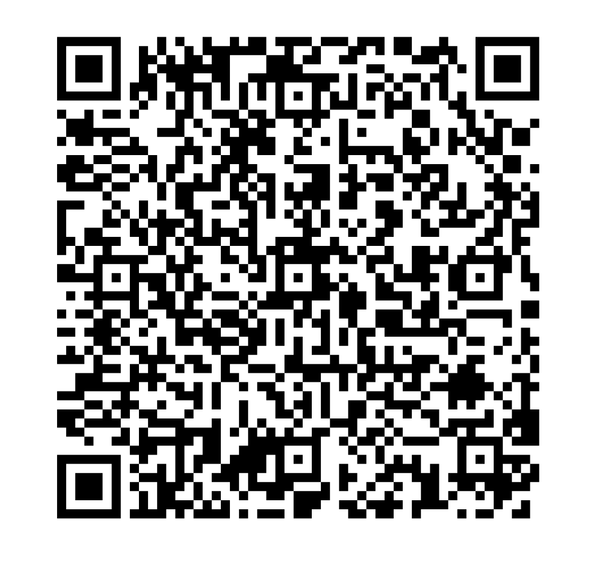
BFZ Community Examples
Reporting in the PMT:
monthly metrics for all
monthly active for all-unsheltered
Community dashboards reporting all monthly inclusive of:
Active (and household type)
Inflow/Outflow
Housing Placements
https://bit.ly/BFZswqd
Notes:
Tia - https://bit.ly/BFZswqd

Slide 26
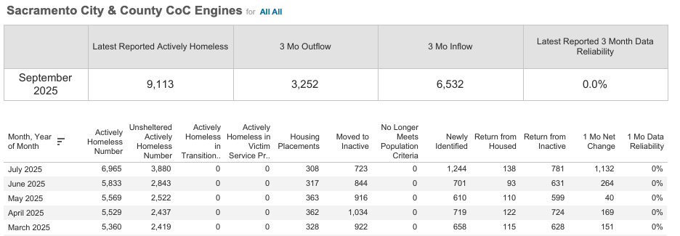
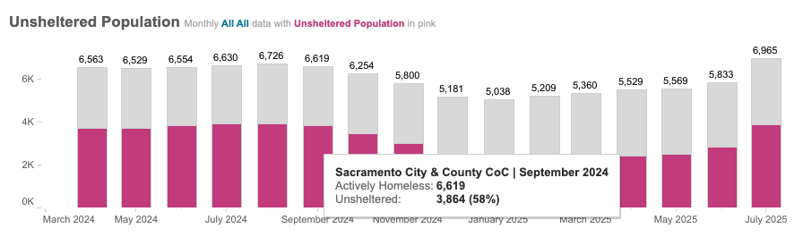
Header
Sacramento, CA

Slide 27
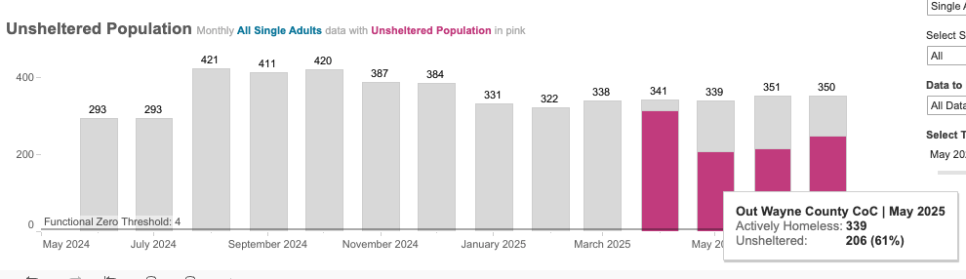
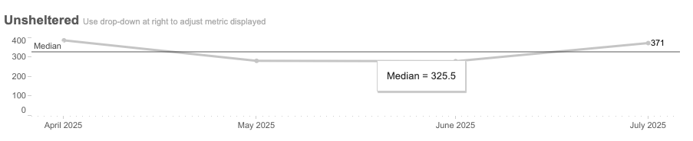
Out Wayne, MI

Slide 28
NO ONE LEFT BEHIND SYSTEM WIDE QUALITY DATA
1
3
DISCUSSION: EXPLORING YOUR COMMUNITY DATA FOR ALL + UNSHELTERED
Notes:
By 10:50 Dawn Slides 28-End

Slide 29
Early Days: Learn, Share, Co-Create
Surface learning and clarify challenges
Co-create credible system wide monthly data
Share lessons and identify needs
Notes:
Dawn - Co-creation moment
Help us shape how we collectively understand system wide data across the movement.
What are our shared challenges?
What areas are folks interested in testing?
Where do folks need support?

Slide 30
Small Groups: Who’s in the room?
GROUP 1:
Report data for all + unsheltered regularly
(more than PIT)
GROUP 2:
Not yet regularly track data for all + unsheltered, see opportunities to move in that direction
GROUP 3:
Significant limitations and major challenges to track data for all + unsheltered
Notes:
If there are more than 10 people in your group, split into 2 groups and use a separate flip chart

Slide 31
Group Breakouts
Strengths:
What are you doing now to report all and unsheltered?
reporting monthly/quarterly active for all?
regular tracking for unsheltered?
currently doing, even if not beyond PIT
Opportunities:
What are you interested in doing but haven’t tried yet?
ideas you’d like to explore or expand?
Challenges:
What barriers do you face to report all and unsheltered?
don’t know what to track/data not entered
don’t know if it’s good data - different numbers being shared by others (e.g. mayor)
difficulties reporting inflow and outflow
Needs
What areas do you know you need support in?
knowing when data is good enough
assessing system wide data
reporting from outside HMIS
tracking within HMIS
Notes:
11:00 post-its/flip charts
15-minutes to get down S, C, O, N
5-min theme

Slide 32

Share Out
Gallery Walk
Share Main Takeaways with full group
Notes:
11:15
5 min gallery walk
5 min share out
Co-creation moment
Help us shape how we collectively understand system wide data across the movement.
What are our shared challenges?
What areas are folks interested in testing?
Where do folks need support?

Slide 33
BFZ Community Examples
Reporting in the PMT:
monthly metrics for all
monthly active for all-unsheltered
Community dashboards reporting all monthly inclusive of:
Active (and household type)
Inflow/Outflow
Housing Placements
https://bit.ly/BFZswqd
Notes:
Tia - https://bit.ly/BFZswqd

Slide 34

Mentimeter: Pulse-Check
Which monthly metrics would be most feasible for you to report for all? For unsheltered?
Which monthly metrics would be most useful for you to report for all? For unsheltered?
Would doing a system wide scorecard assessment looking at all be helpful in your community?
Notes:
11:25 5 min close - which will help us co-create next steps!
https://www.mentimeter.com/app/presentation/al1qrgdfymcom9xcxh9wg4mz133q9f1y/edit?source=share-modal

Slide 35
Thank You!

