Slide 1
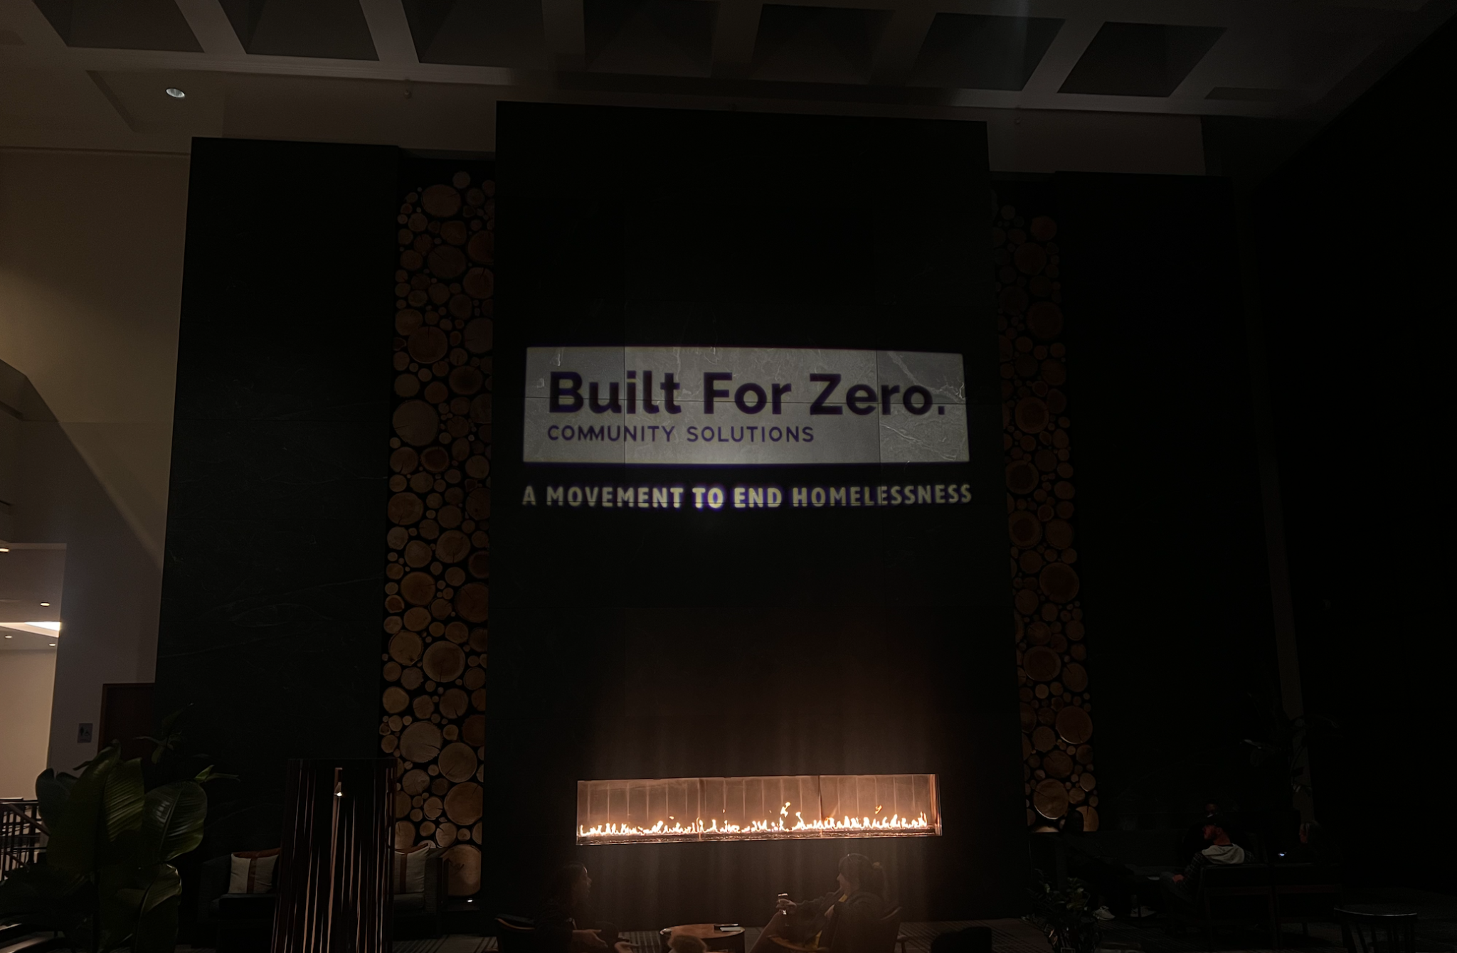

Scaling Your System for Youth
Notes:
TO FORMAT TITLE: Make sure the is a space ( ) at the beginning of each line, and a purple period (.) at the end of each line.
TO CHANGE IMAGE: Delete current image, then Insert>Image, resize it to fit slide, then Arrange>Order>Send to Back.

Slide 2




PRESENTERS .
Elisha Pritchett
(she/her) .
BFZ Data Coach.
Liz Harding Chao
(she/they) .
YYA Field Expert.
Alyssa Anten
(she/her) .
HMIS Administrator
Kent County, MI.
Brianne Robach
(she/her) .
Coordinated Entry Program Manager
Kent County, MI.

Slide 3

Agenda
1
2
3
Walk in a Young Person’s Shoes Activity A journey through a young person’s experience navigating the homelessness system
Youth Systems 101 Dive into considerations and core elements of a strong and effective youth homeless response system
How Kent County Scaled their System for Youth Learn how you can leverage your existing system infrastructure to scale support for youth

Slide 4
Objectives for Today
1
2
3
Understand the importance of a youth-specific approach
Learn how to adapt existing system infrastructure to better serve youth
Apply insights from Kent County’s successes

Slide 5
Activity,
1
1
Walk in a Young Person’s Shoes Activity
Notes:
TO FORMAT TITLE: Make sure the is a space ( ) at the beginning of each line, and a green period (.) at the end of each line.
TO CHANGE IMAGE: Delete current image, then Insert>Image, resize it to fit slide, then Arrange>Order>Send to Back.

Slide 6
Debrief

Slide 7
Youth Systems 101,
2
Youth Systems 101
Notes:
TO FORMAT TITLE: Make sure the is a space ( ) at the beginning of each line, and a blue period (.) at the end of each line.
TO CHANGE IMAGE: Delete current image, then Insert>Image, resize it to fit slide, then Arrange>Order>Send to Back.

Slide 8
Defining the Youth Population
Unaccompanied Young People = Youth (<18) and Young Adults (18-24) without a parent or guardian
Experiencing literal homelessness (HUD Category 1) or fleeing/attempting to flee (HUD Category 4)
Youth are defined as legal minors aged 17 or younger
Young adults are those aged 18-24
Includes pregnant and parenting young people
Terms we use: Unaccompanied young people, youth and young adults (YYA), youth
Notes:
Elisha

Slide 9
Considerations for Youth
Youth-specific;
Youth Engagement & Youth Action Boards (YABs)
Adjacent Systems & Provider Participation (Child Welfare, Juvenile Justice, School Systems)
Youth-specific Assessment Tools
Minor-specific Services
Notes:
Elisha

Slide 10

Youth-specific Considerations
Youth Engagement & Youth Action Boards (YABs)
Adjacent Systems & Provider Participation
Youth Assessment Tools
Minor-specific Services
YYA w/ lived experience guide system design & priorities
Shift from doing for youth to building with youth
Leads to more relevant, effective, and equitable programs
Youth homelessness is deeply connected to other systems (child welfare, juvenile justice, and school systems)
Coordination between systems prevent youth from “aging into” homelessness
Shared responsibility creates earlier pathways to stability
Adult-focused tools often under-identify youth and over-prioritize adults
Youth-tailored tools focus on safety, strengths, and supports
Leads to more equitable access to housing and services
Minors face unique legal and consent barriers
Few dedicated shelters or programs exist for under-18 youth
Specialized spaces ensure safety and early intervention
Notes:
-yabs - role shape by them not for them
-hold system accountable, ground in real exp.
-share power, know where system breaks down
-voice built in
-doesnt happen in isolation
- system output
-owns part of solution
-same yya moving through sys
-pathway to stability or preven
-assess for need
-equity gaps, unintentionally undercount
-adult focused tools under identify - chronicity
- youth need tools that center their realities
-accurate data house more
-barriers
-the reality: adult shelters - what appens
- creating minor specific programs, earlier in journey
-components
-doesn’t happen by accident, built intentionally - to meet the needs
-not about a separate system
-co-design, collaboration, tools, pathways

Slide 11
Parallels Across Systems
Youth System & Other Systems;
Improvement Team
Coordinated Entry
Outreach Coordination
Policies & Procedures
By-name Data Infrastructure:
Report Structure, Wellsky Report, Reporting Definitions
Notes:
Liz

Slide 12

Parallels Across Systems
Improvement Team
Coordinated Entry
Outreach Coordination
Policies & Procedures
By-name Data Infrastructure
Use existing improvement team structures
Embed youth-specific metrics & voices within improvement cycles
Shared learning across systems
Alighs homelessness efforts across populations
Apply CE framework, but adapt for youth consent considerations
Ensure youth-specific access points are included
Align prioritization rules with adult CE
Leverage existing outreach teams
Coordinate communication across teams
Build in a youth process to the existing outreach
Mirror adult system P&Ps but tailor procedures for youth
Promote cross-system alignment
Creates consistency and reduces confusion for providers and partners
Integrate youth data into by-name data infrastructure
Use common data standards
Utilize reporting tools such as customized reports, Wellsky Reports for the youth population

Slide 13
Effective Youth Programs
Youth & Young Adult-Specific
Host Homes
Diversion and flexible funds (low barrier)
LGBTQ+ and BIPOC-specific services + connections with grassroots and by and for organizations
Legal services
Notes:
Host homes: can be crisis through to 2 years. Can be imperfect solution (some say it saved their life - some say they had to leave for various reasons)- need good training, matching
Diversion: as low barrier as possible (12-24 without parents, at risk or already homeless), no cap on amount, centralized pot of funds, quick resolution (30 days), creativity
Young people emphasize the importance of population specific services especially in traditionally conservative communities. Work with a nonprofit called YOTO in Tucson who provides $350 cash stipends to unaccompanied youth under 18 as a reward for staying in school
Legal issues: emancipation, immigration, eviction on record ( how to prevent this and also how to remove it), getting kicked out of shelters

Slide 14
Kent County, MI,
3
How Kent County Scaled their System for Youth

Slide 15
Data Infrastructure
By Name List
Performance Management Tracker - Inflow & Outflow
Case Conferencing
Notes:
Alyssa & Brianne

Slide 16
Partnerships
Youth Action Board
Youth-Serving Organizations
Notes:
Alyssa & Brianne

Slide 17
Questions?

Slide 18
Thank You!
epritchett@community.solutions
liz@systemchangepartners.com
garrett@systemchangepartners.com
aanten@hwmuw.org
brobach@hwmuw.org

