Slide 1


Organizing for the Policies We Need

Slide 2

Moderator.
Adam Ruege
Community Solutions
Notes:
Adam sets the tone: “Homelessness is a housing issue, CS position on importance of expanding all types of housing supply as part of the solution/enabling conditions; data points e.g. family homelessness primarily economic issue

Slide 3
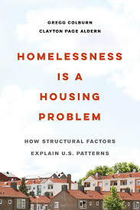
Housing drives homelessness: High rents + low vacancy = higher homelessness.
Focus on structural solutions: Build affordable housing, reduce cost burdens, improve access.
Context matters: Track housing market + individual data to guide local strategies.
Notes:
Adam sets the tone: “Homelessness is a housing issue, CS position on importance of expanding all types of housing supply as part of the solution/enabling conditions; data points e.g. family homelessness primarily economic issue

Slide 4
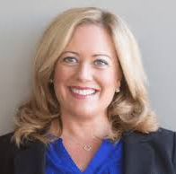


Panelist Intros .
ALI SOLIS
S3 Advisory Services.
NICK TAYLOR
Housing Action NH .
LAURA FOOTE
YIMBY Action.
Notes:
Quick panelist intro (1 minute each): your lens — federal, state, or local policy

Slide 5
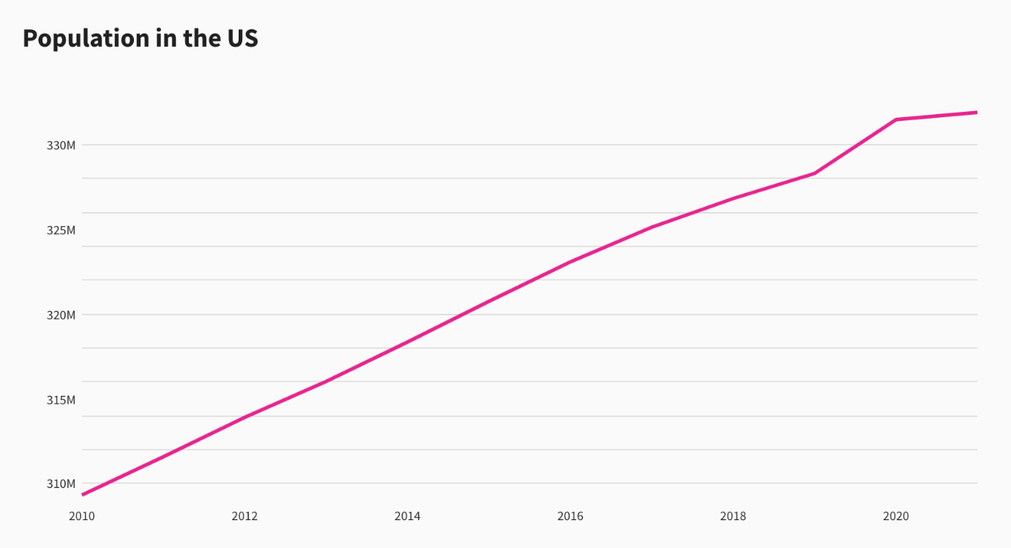
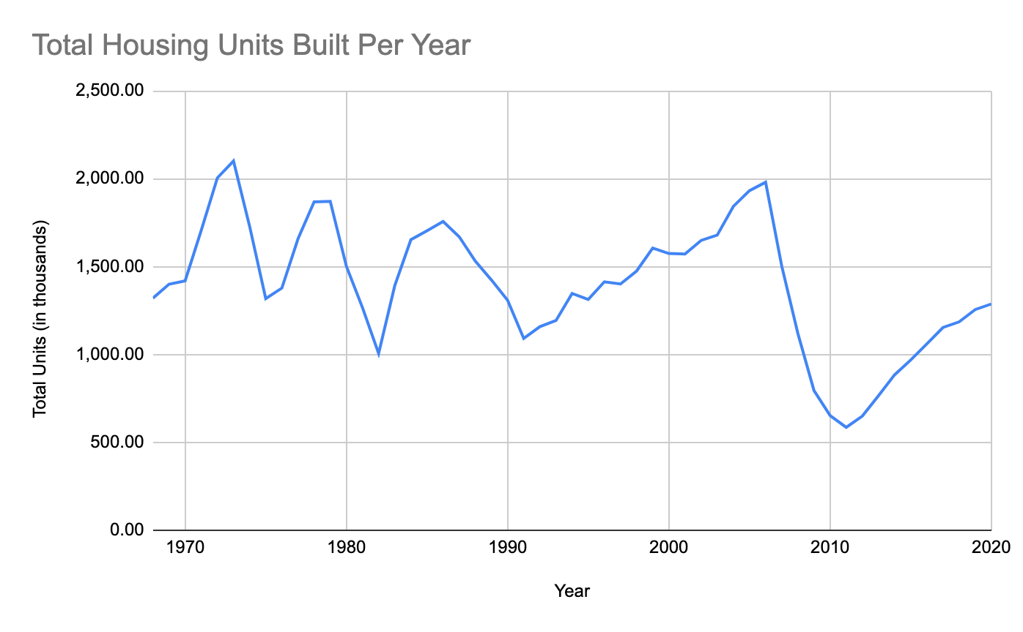

What Housing Supply Means
But the number of homes we’re building isn’t keeping up with demand.
The U.S. population AND the number of people who need homes is growing.
Notes:
12:35-12:44 (9 min) — Level Setting: What Housing Supply Means (All Panelists) “There’s a misconception that ‘housing supply’ just means market-rate development. How do each of you define housing supply — and what does it mean to build for all income levels?”

Slide 6
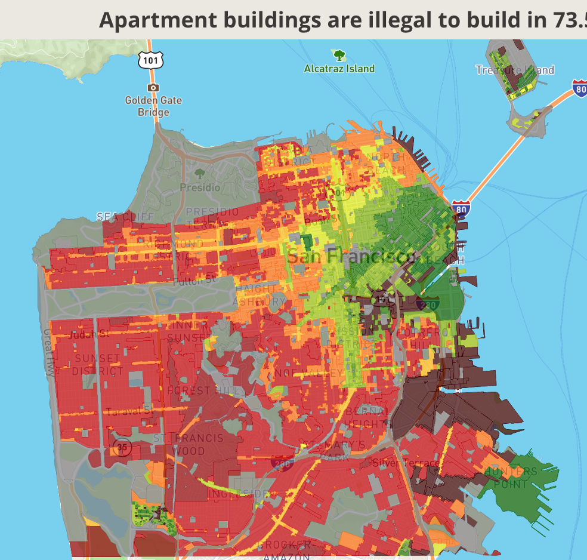
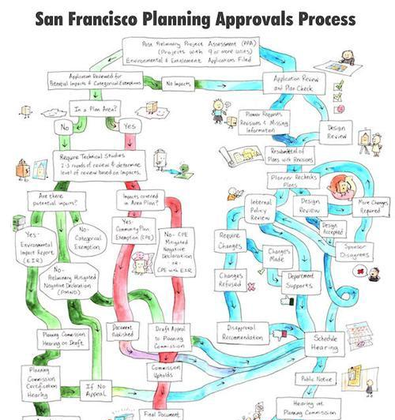
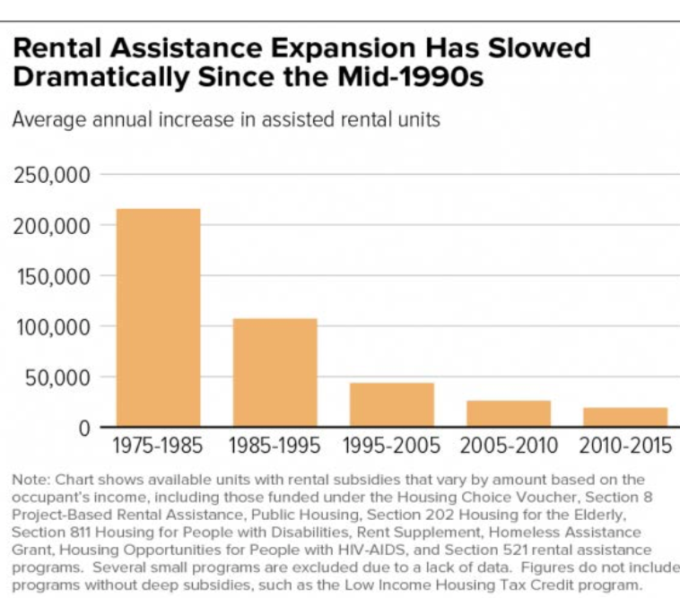
Misperceptions & Silos
How we got here: New Housing is Held Back By...
Zoning Laws
Makes Housing Illegal
2. Delays
Bureaucratic Process
NIMBYs
3. Funding Shortages
Makes Affordable Housing Cost-Prohibitive
Notes:
12:44-12:48 (4 min) — Misperceptions & Silos (All Panelists / Lightning Round)
“What’s a myth or misperception you regularly encounter — either from housing advocates or homelessness service providers — that prevents collaboration?”

Slide 7
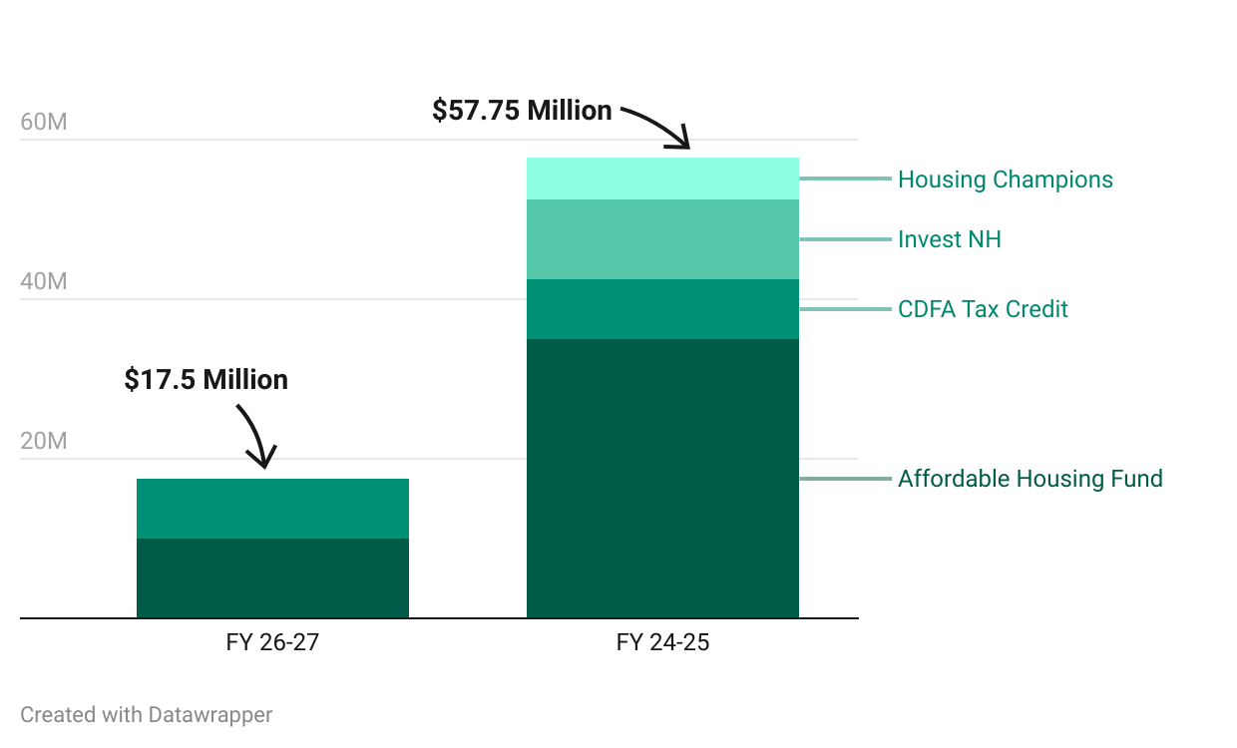
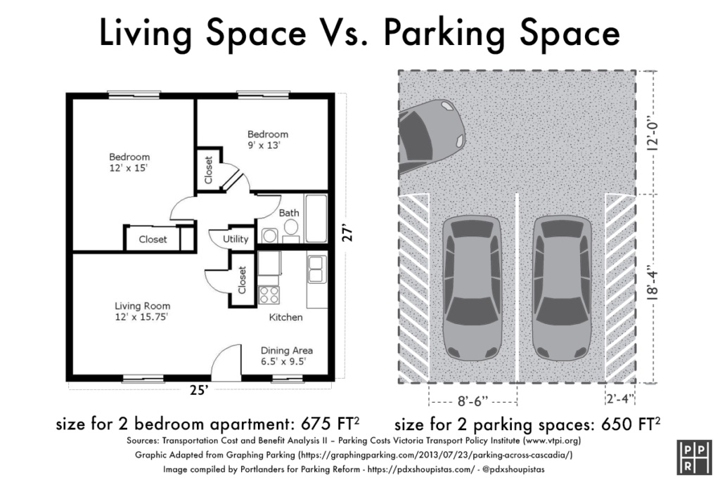
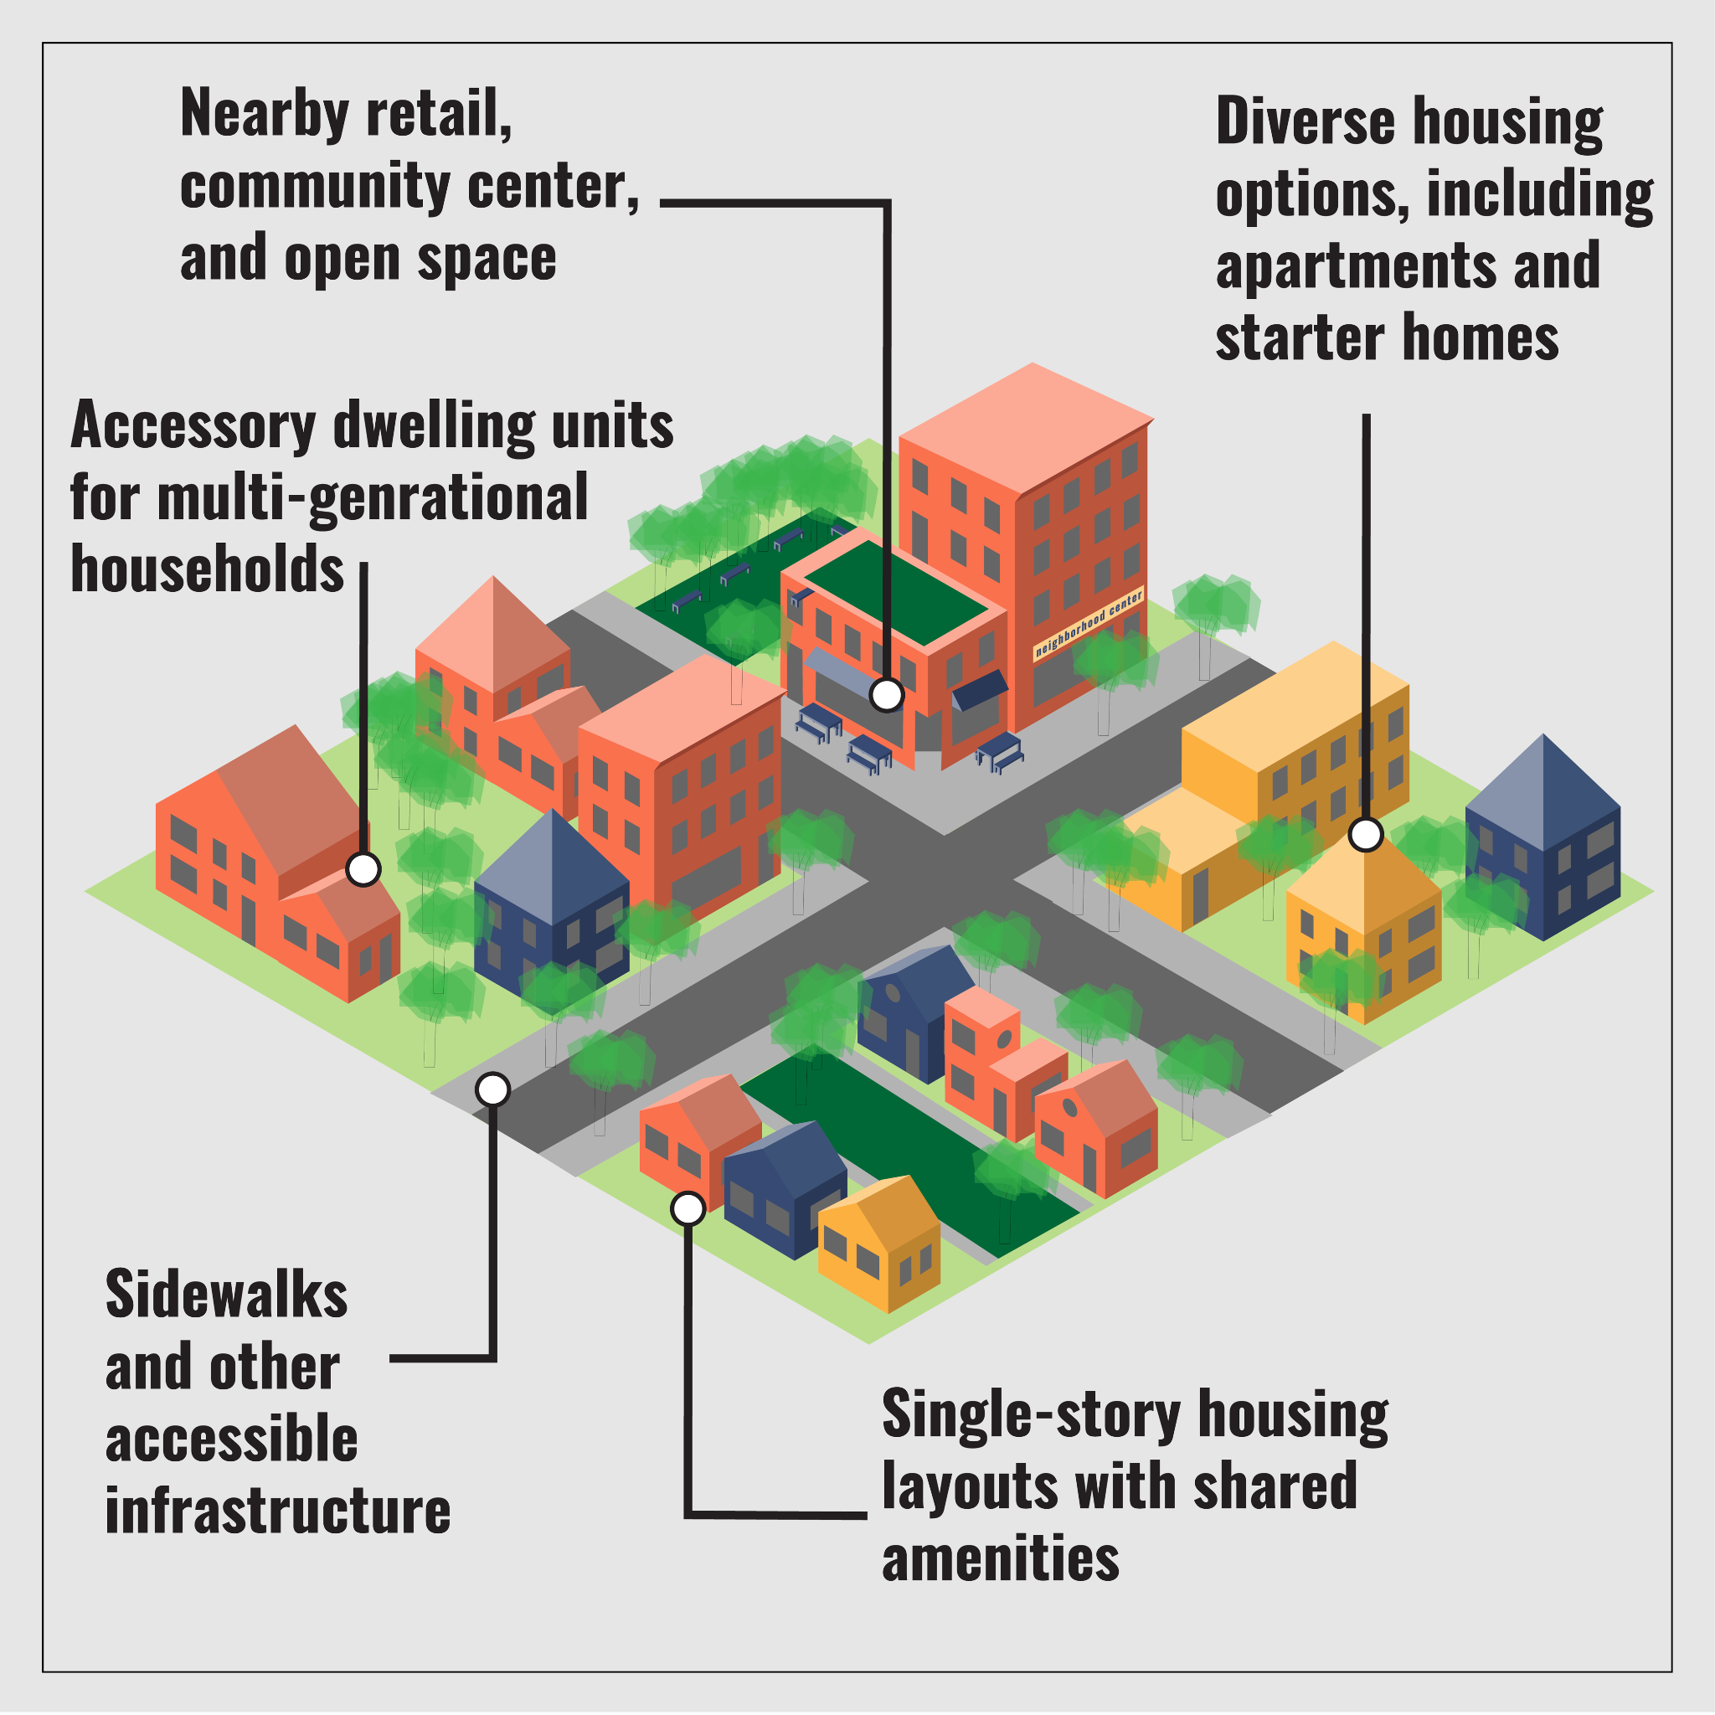
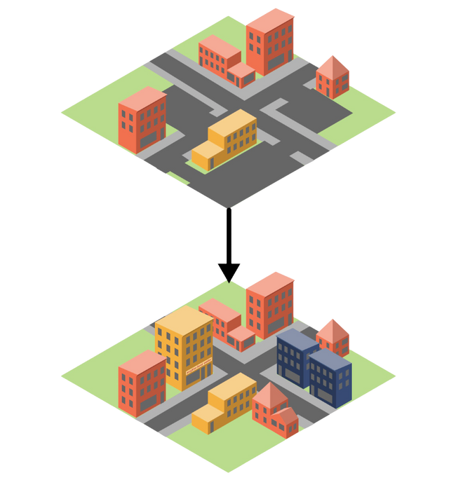
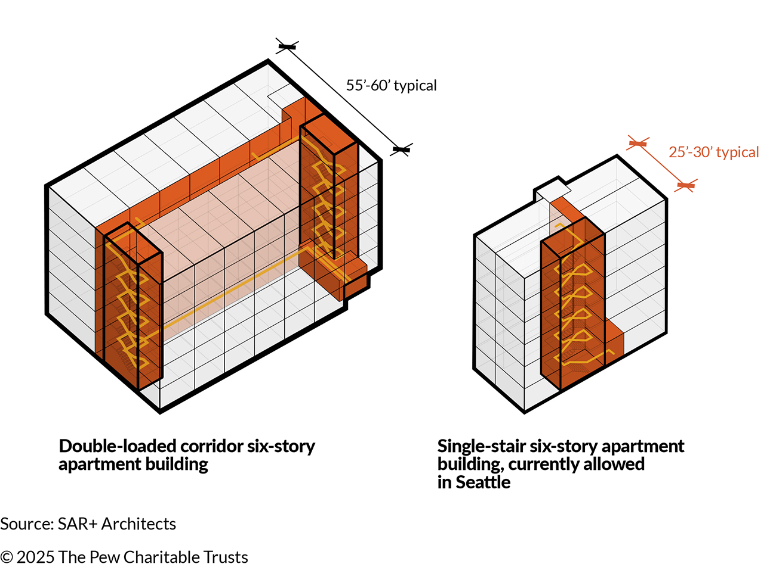
NH Laws & Lending to Change Outcomes
Notes:
12:48 - 12:53 (5 min) — Nick “What are recent state policy wins that can actually change outcomes on the ground?”
Affordable Housing Fund: Low interest loans and grants. Administered by NH Housing. $35m → $10m
Housing Champions: Incentive based program recognizing pro-housing communities. Administered by NH Department of Business and Economic Affairs (BEA). $5.25m → $0
Invest NH: Housing development grant program. Administered by NH BEA. $10m → $0

Slide 8
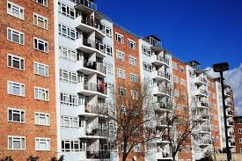
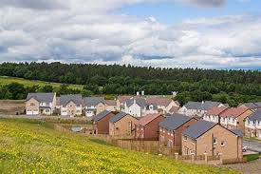
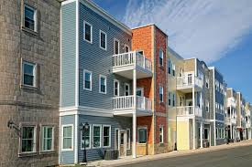
Promising Federal Policy Changes
Notes:
12:53-12:58 Ali (Federal / Funding): What federal policy changes do you see offering the most promise toward housing to support people at every stage of their lives?” Housing supply to support people at every stage of life, subsidy plus other solutions, all of the above approach

Slide 9
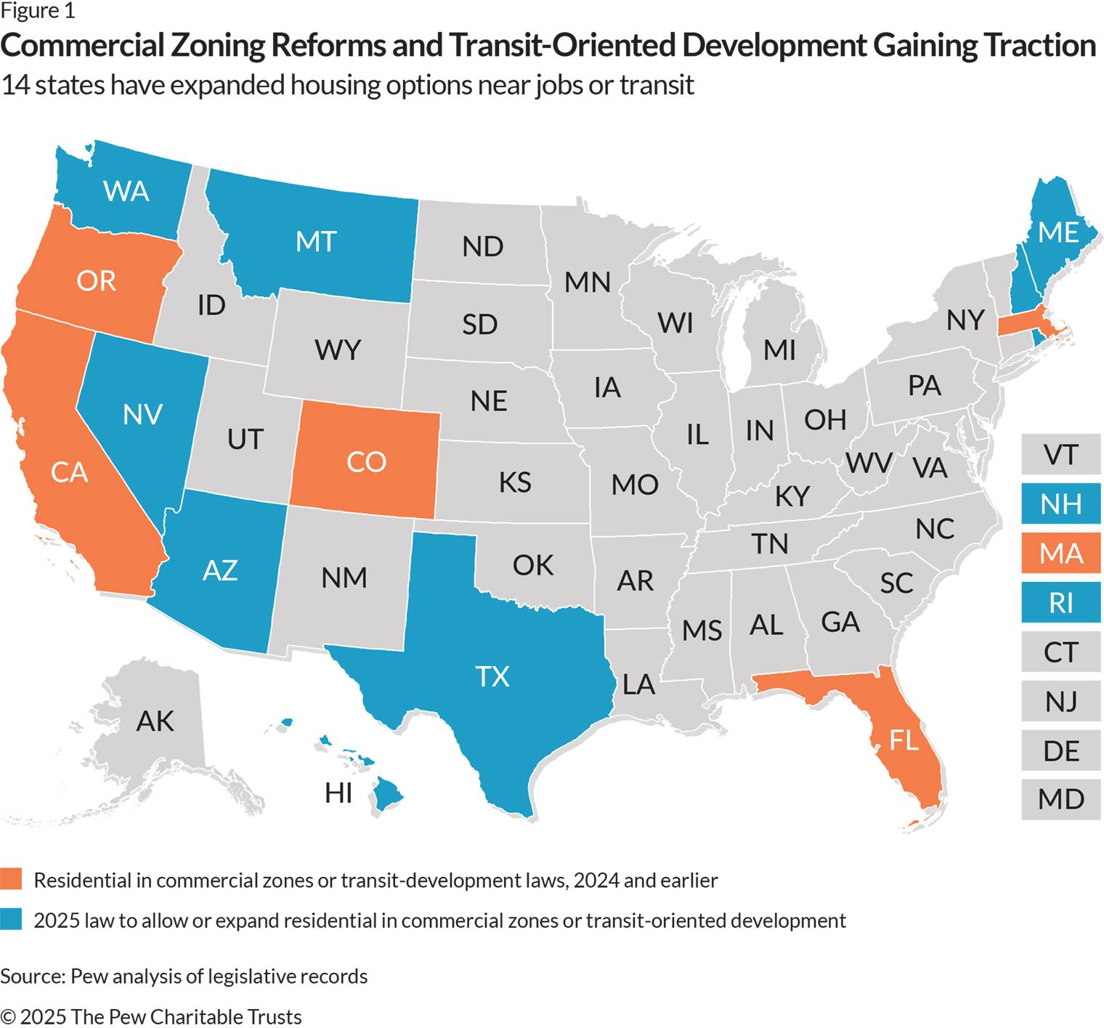
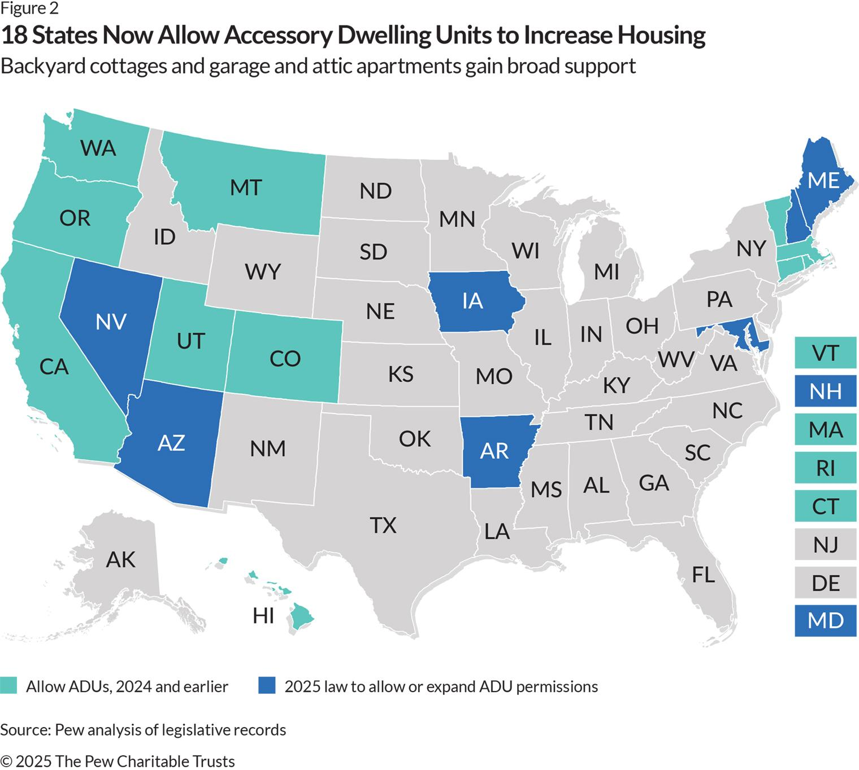
Local Organizing Wins
Notes:
12:58-1:03 Laura (Organizing for Policy Change): “What local examples do you have of organizing that has shifted a housing policy fight from impossible to passed and implemented?”
But today, the political will to fix the housing shortage is everywhere, and has resulted in many pro-housing wins at the state and local levels; as well as lower rents in cities like Oakland, Austin, most famously Minneapolis.

Slide 10
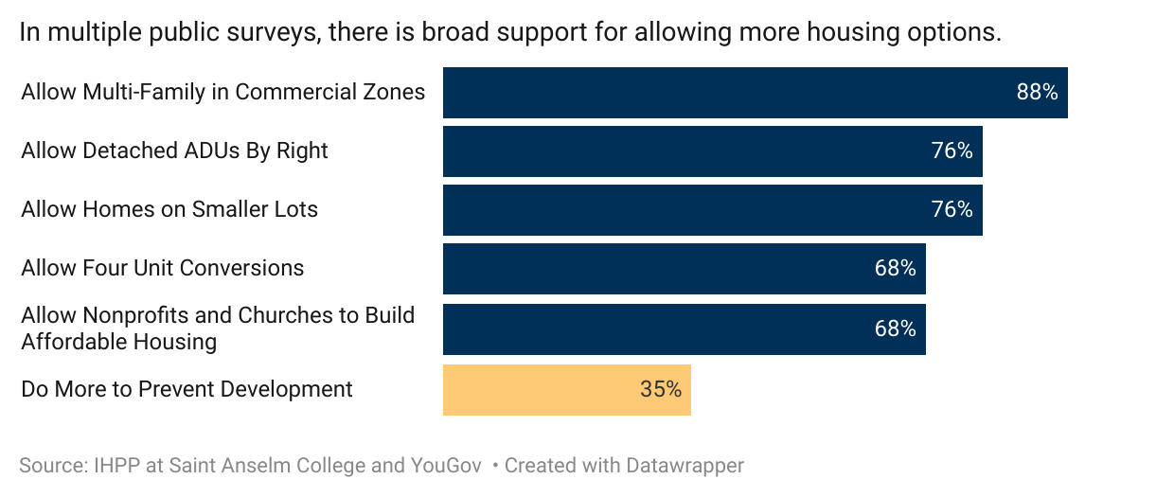
Organizing to Change Policy
Coalition-building with mission-driven homeless service providers, affordable housing advocates, housing developers, and…..
Notes:
1:03-1:12 (9 min) — Linking Organizing to Policy Change (All Panelists) “How do we better connect mission-driven homeless service providers, affordable housing advocates, and pro-housing market-rate organizers — so we’re not siloed or pitted against each other?”
Follow-up: “What’s one partnership you’d love to see more often? Who’s not at the table yet?”

Slide 11
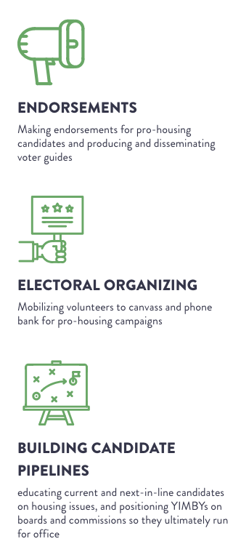
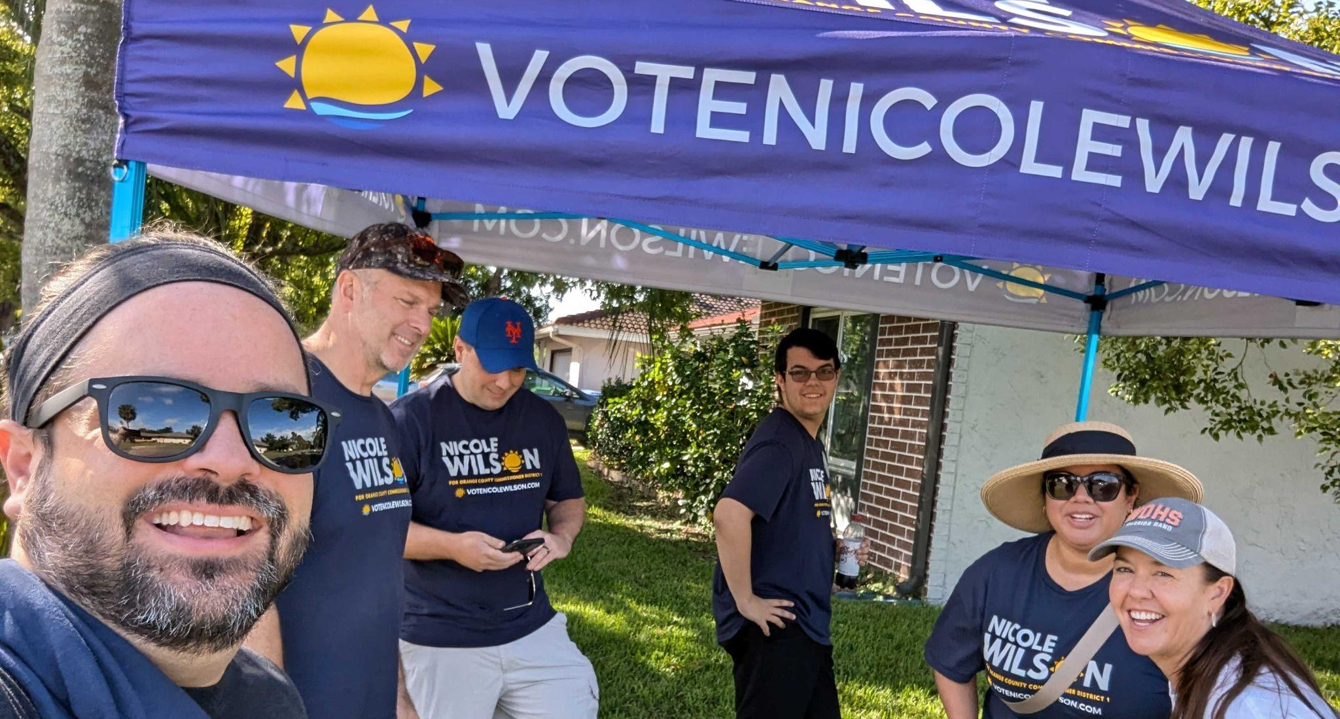


Notes:
We use visibility as a flywheel to build our power. We use visibility to build our members into a community.
Working on fewer issues also means it’s WAY easier to endorse in elections and to be part of coalitions. It means hedging against getting caught in omni-cause bullshit. There are lots of side quests. We try not to take on any of them.

Slide 12
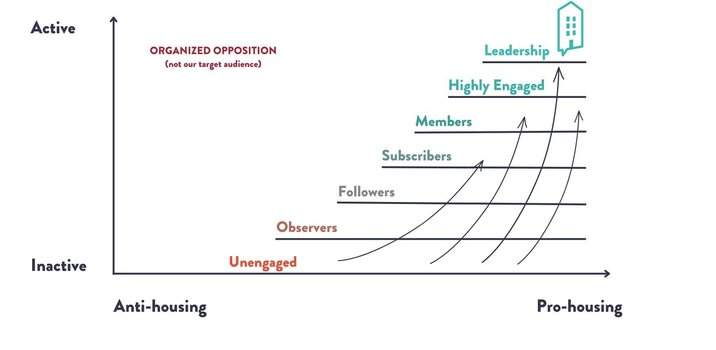
Call to Action
YIMBY Action’s Ladder of Engagement
Notes:
1:12-1:20 (8 min) — Call to Action & Closing Thoughts (All Panelists) “If someone in this room said, ‘Okay — prove it. Come help us build housing for our population — what would you say you can bring to the table?”
AND/OR
“If someone in this room only has a little time or capacity to help advance housing solutions, what is the most valuable action you would recommend they take? What’s something tangible they can do this month that makes a real difference?”
Each panelist shares concrete, actionable recommendation:

Slide 13
Questions?
Notes:
1:20-1:30 (Dawn)

