Slide 1


Team Planning Time #2
Red Rocks 8 - Group 1
Notes:
TO FORMAT TITLE: Make sure the is a space ( ) at the beginning of each line, and a purple period (.) at the end of each line.
TO CHANGE IMAGE: Delete current image, then Insert>Image, resize it to fit slide, then Arrange>Order>Send to Back.

Slide 2

Agenda
1
2
3
Community Reflection and Self assessment
Strategy review and work planning
Updated strategies and wrap-up

Slide 3
Warm Up
Where is your favorite place to vacation?
Notes:
Never-ending story: The objective of this activity is for the group to tell a single story together, each person contributing one sentence at a time. Arrange the group in a large circle and ask for a volunteer to start the activity. They say the first sentence of the story. The person next to them then contributes the next sentence until everyone has gone.

Slide 4

Partner Community
Introductions
Each community is seated next to another community- please take a few minutes to introduce yourself. Throughout this session, you will use them as a sounding board.

Slide 5



PRESENTERS .
Paul Mohr
Systems Improvement Advisor.
Rachel Walden .
Data Coach and Performance Advisor. .
Lenny Pierce .
Capacity Building Strategy Lead. .

Slide 6

Team Planning Session 2,
Activity 1
1
Reflection and Assessment
1
Notes:
TO FORMAT TITLE: Make sure the is a space ( ) at the beginning of each line, and a green period (.) at the end of each line.
TO CHANGE IMAGE: Delete current image, then Insert>Image, resize it to fit slide, then Arrange>Order>Send to Back.

Slide 7
Reflection and Assessment
Review current strategies/driver diagram
Using the Foundational Capabilities Rubric- self assess your communities current system
  Where do you land in terms of backbone org, strategic partners, shared goal, comprehensive data.
  What evidence supports this rating?
  Are there clear processes you can point to or clear gaps that support this rating?
Use the Journey Map on the backside. The journey map shows what growth looks like for each capacity over time. Use this map to reflect on your current work plans and local goals.
  How do your existing strategies align with the next steps on the map? Use this framing to identify any new aims and strategies or refine existing ones.
4. Move on to activity 2 and use the 'Strategy Review Form' as a guide for documentation

Slide 8
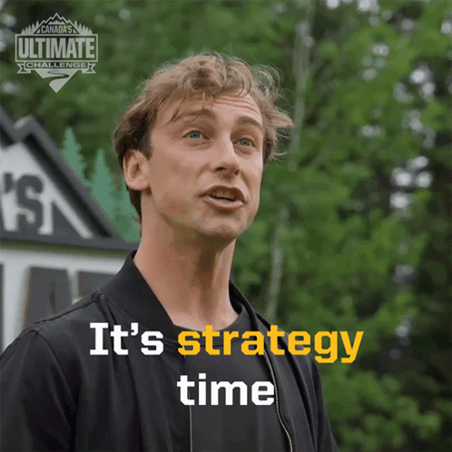
Team Planning Session 2,
Activity 2,
2
Strategy Review
Notes:
TO FORMAT TITLE: Make sure the is a space ( ) at the beginning of each line, and a blue period (.) at the end of each line.
TO CHANGE IMAGE: Delete current image, then Insert>Image, resize it to fit slide, then Arrange>Order>Send to Back.

Slide 9
Strategy Review
Looking back at your driver diagram/ current strategies, select 2-3 that are most pressing and use the Strategy Review Form to answer these questions:
  Are these still the strategies that the community should be focusing on? Why or why not?
  Where have we seen success with each strategy?" Specific examples?
  What has been getting in the way of success for each strategy?
Present your revised strategies with your partner community.

Slide 10
Team Planning Session 2,
Wrap-up
3
Next Steps
1
Notes:
TO FORMAT TITLE: Make sure the is a space ( ) at the beginning of each line, and a green period (.) at the end of each line.
TO CHANGE IMAGE: Delete current image, then Insert>Image, resize it to fit slide, then Arrange>Order>Send to Back.

Slide 11
Next Steps
Take a moment to review your updated strategies. Are they clear? Are they actionable? Do they feel like the right focus for the next six months?
In our next session, Team Planning Session #3, we will take these updated strategies and build out detailed 6-month goals and action plans.
Before you leave, Coaches will take a picture

Slide 12
Thank You!

