Slide 1
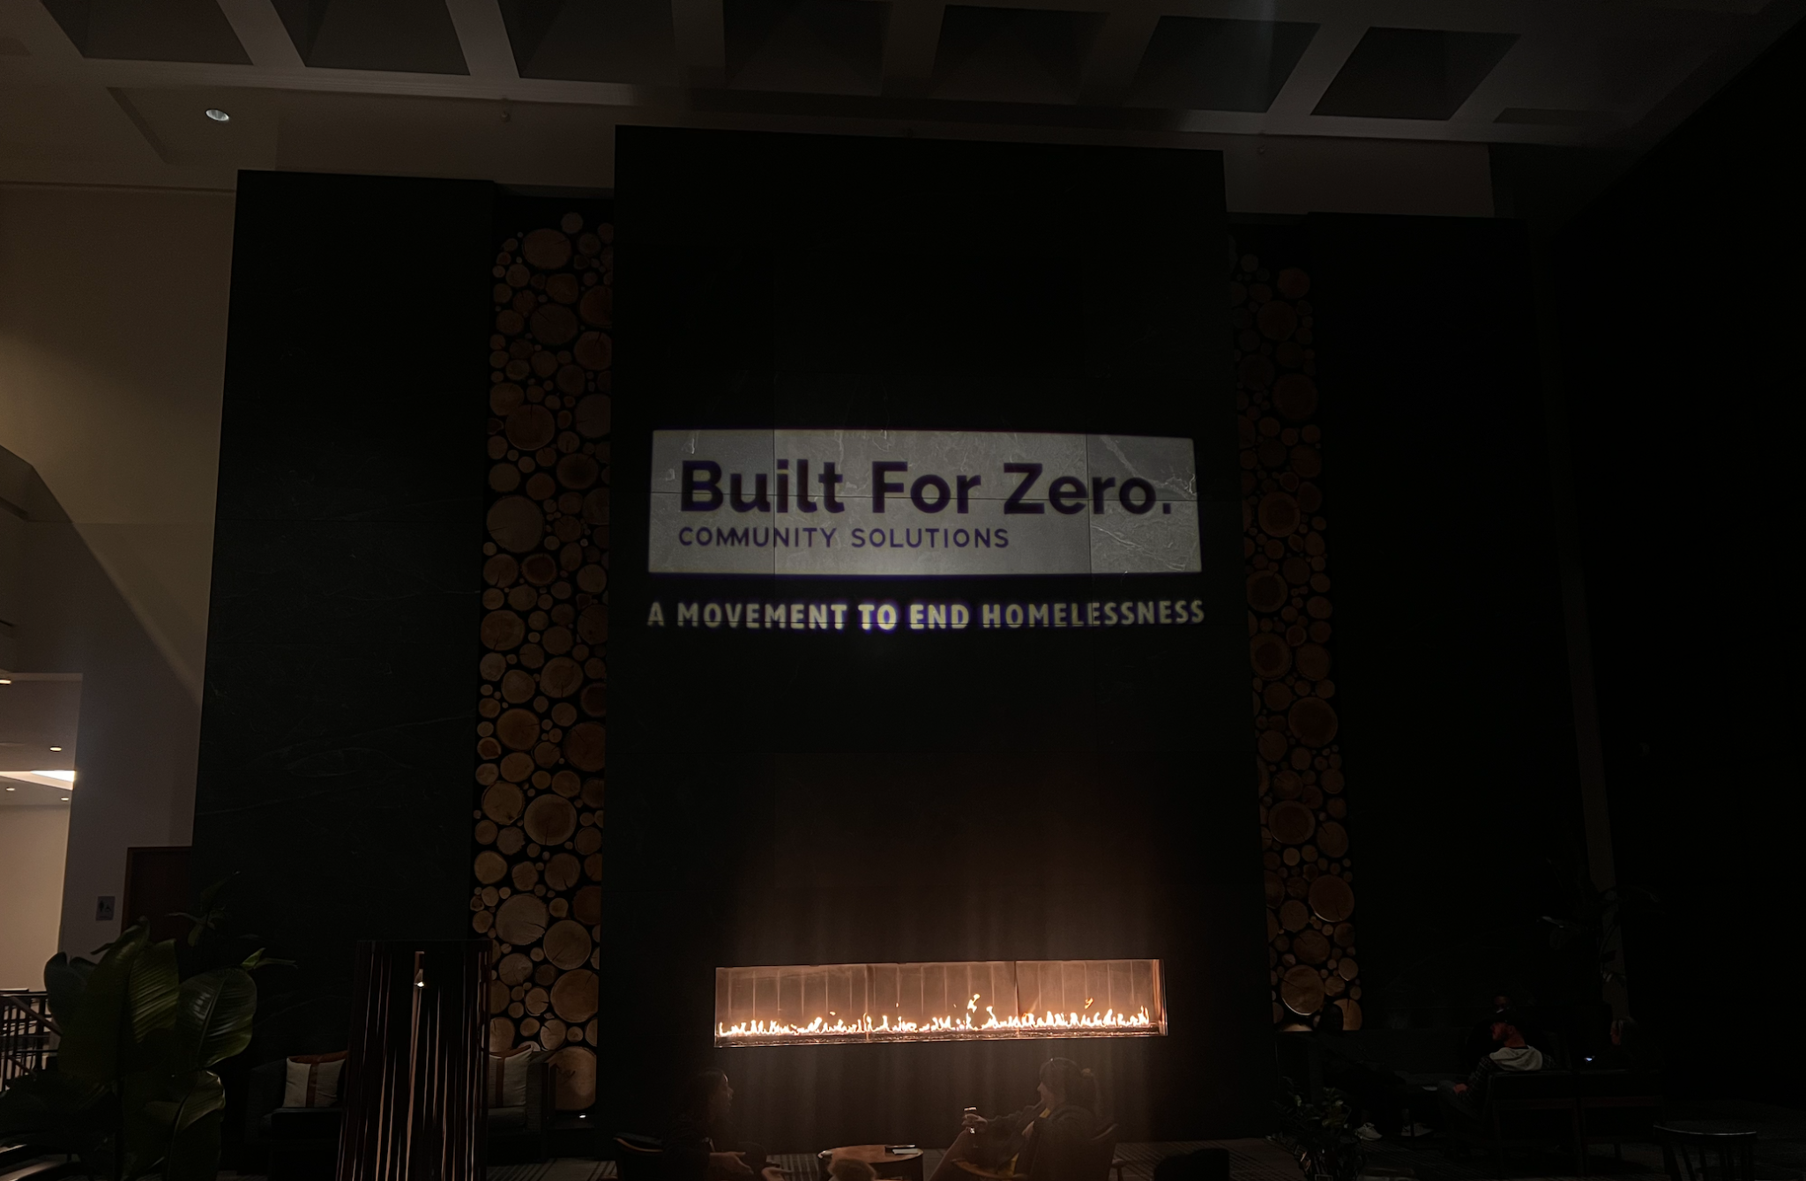

Exploring the Use of AI.
.in Our Work.
Notes:
TO FORMAT TITLE: Make sure the is a space ( ) at the beginning of each line, and a purple period (.) at the end of each line.
TO CHANGE IMAGE: Delete current image, then Insert>Image, resize it to fit slide, then Arrange>Order>Send to Back.

Slide 2

How We’ll Use Our Time Today
1
3
2
4
This session is designed to help us learn, question, and imagine how AI might shape our work.
Explore what AI is and how it works in simple, practical terms.
Share what we’ve learned so far in our work.
Look at real-world examples of how AI is being used in and beyond homelessness response.
Think through how AI might support or challenge the work we do every day.

Slide 3


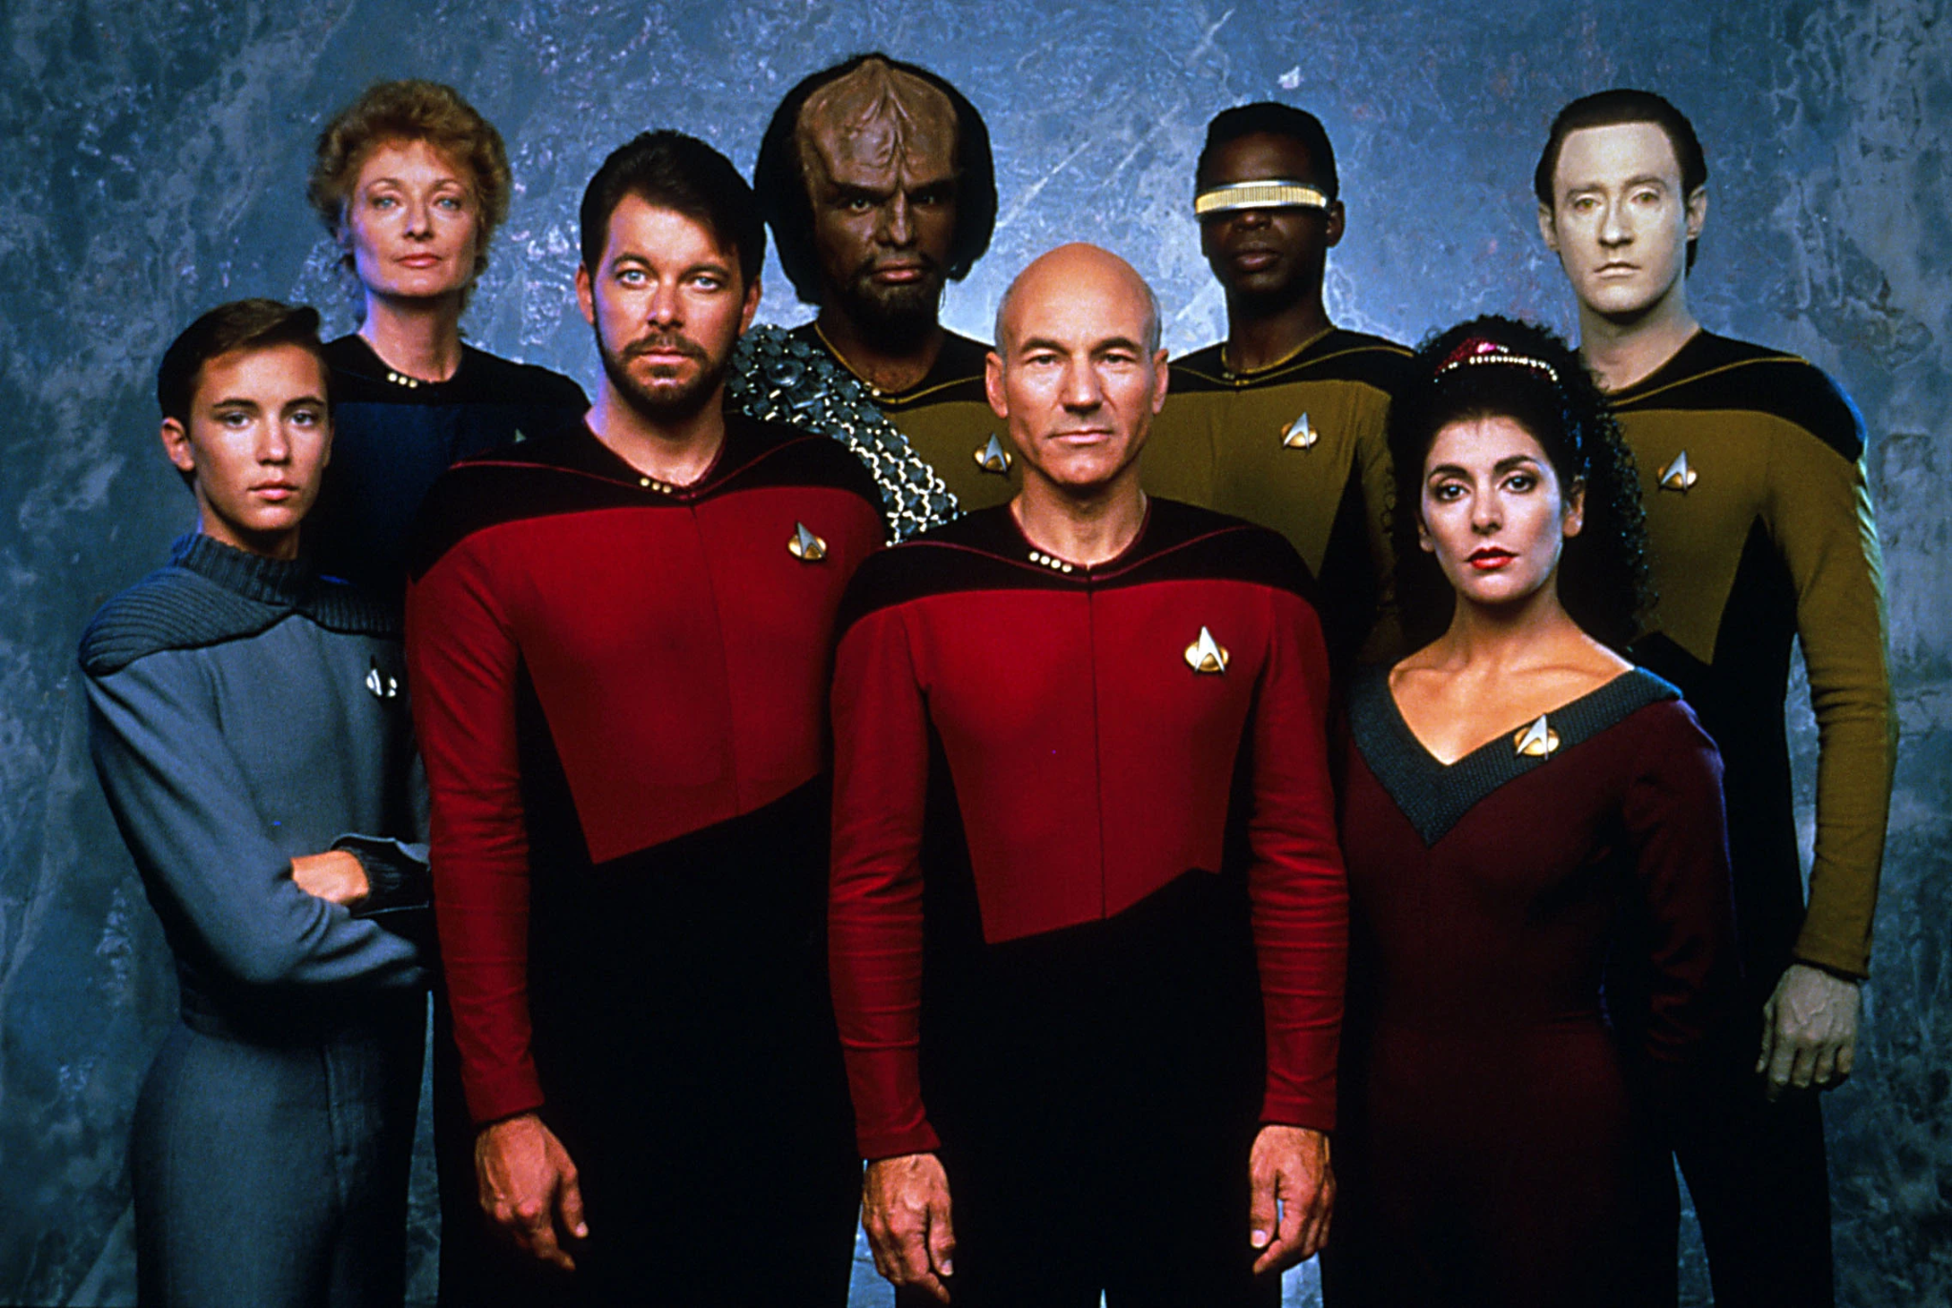
Where Do You Fall?
AI will destroy jobs, amplify harm, and break everything we care about.
(Dystopian Future / Deep Skeptic)
AI could solve big problems and free us to focus on what matters.
(Post-Scarcity Future / Cautious Optimist)
AI is helpful for silly tasks and small boosts, but it’s not magic.
(Pragmatic Realist / Lighthearted Skeptic)

Slide 4
Why This Work Matters Now
AI is no longer emerging - it is already embedded in everyday tools, decisions, and systems whether users of the technology are aware or not. That's why we should be informed and set up guardrails/governance structures, etc.
AI is advancing faster than policies can keep up, creating urgency for clear boundaries and responsible experimentation.
In our sector, AI holds the power to both transform and harm. We must engage critically and carefully.
There is currently no clear, trusted guidance for AI in homelessness and housing systems.
New technologies should complement, not replace, human judgment.

Slide 5
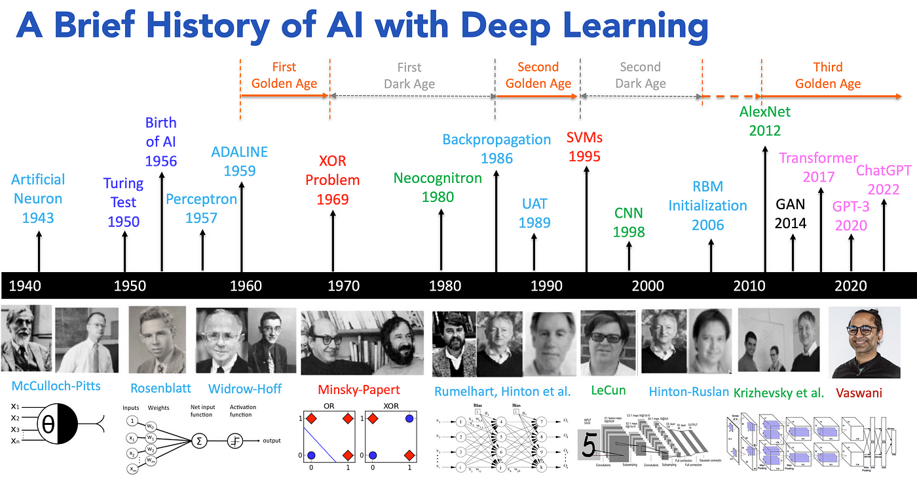
AI 101: Core Concepts
A Brief History of Artificial Neural Network
The term “Artificial Intelligence” was first coined in 1956 by John McCarthy

Slide 6
What Is AI?
AI is a computer program that contains a mathematical model.
AI/Machine Learning
The model is good at recognizing and generating data patterns.
The model’s boundaries are determined (trained) using data.
Thank you to Geoffrey Messier, University of Calgary, for use of these slides.

Slide 7
What Is ChatGPT?
Chat GPT fits in the large language model (LLM) AI family.
AI/Machine Learning
“Large” refers to the number of model boundaries/parameters.
LLMs
Language model AI is good at:
  Interpreting language in the user’s prompts.
  Generating new language based on those prompts.
ChatGPT
Gemini
Claude
Grok
Thank you to Geoffrey Messier, University of Calgary, for use of these slides.

Slide 8
How Is AI Used?
How do people use AI?
  In conversation (ie. ChatGPT style chat bots)
  Integrated into another computer system
What do people use AI for?
  Getting information/advice
  Companionship/entertainment
  Help making decisions or understanding data
Thank you to Geoffrey Messier, University of Calgary, for use of these slides.

Slide 9
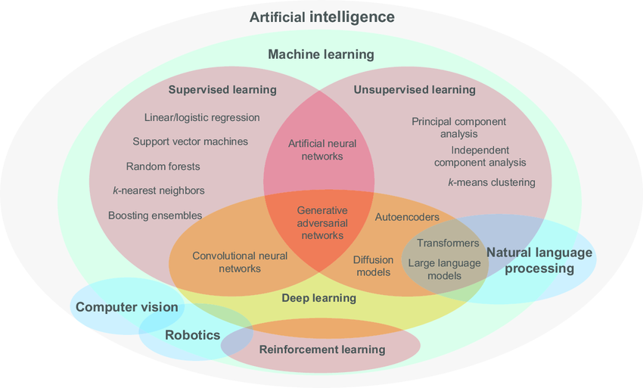
AI 101: Core Concepts
Not all AI is the same…
While it is a significant component of how we talk about AI, Generative AI (i.e., ChatGPT, Claude, Grok, Gemini models) is just one of many diverse techniques and technologies within the broader AI landscape.
ChatGPT
Source: Hanassab, Simon & Abbara, Ali & Yeung, Arthur & Voliotis, Margaritis & Tsaneva-Atanasova, Krasimira & Kelsey, Thomas & Trew, Geoffrey & Nelson, Scott & Heinis, Thomas & Dhillo, Waljit. (2024). The prospect of artificial intelligence to personalize assisted reproductive technology.

Slide 10
How AI (Specifically LLMs) Can Be Useful
AI-assisted summarization of complex government guidance, freeing up time for strategy and action rather than translating bureaucratic language.
Drafting and polishing memos, reports, and leadership briefs for a diverse set of audiences, in minutes - not hours.
Bringing together data & information from different sources into one clear, actionable view.
Fewer person-hours spent on distilling a large number of documents from multiple sources into a coherent narrative.

Slide 11
Where Large Language Models Can Miss the Mark
Chatbot avatar that claimed it could replace frontline workers
Using AI-based algorithms to predict homelessness on an individual basis
Using AI to surveil communities to identify and track individuals experiencing homelessness
Bias and discrimination when using AI models trained on data reflecting systemic bias

Slide 12
Useful Now vs. Not Yet
Useful Now | Not Yet/Proceed with Caution
Summarizing public documents and guidance | Handling client data or PII
Drafting internal reports or emails | Emotional or clinical judgment
Translating technical language into plain English | Automated decision making
Brainstorming ideas or outlines | Using AI outputs without human review

Slide 13
Our AI Journey at Community Solutions
.Curious.
→
.Cautious.
→
.Confident.
Began by exploring small, safe use cases
Saw both potential and pitfalls from real-world examples
Defining our role: exploring and advancing AI ethically and human-first.

Slide 14
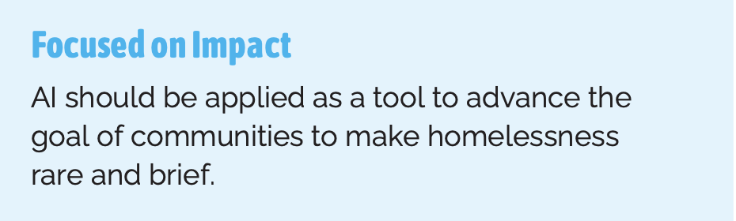
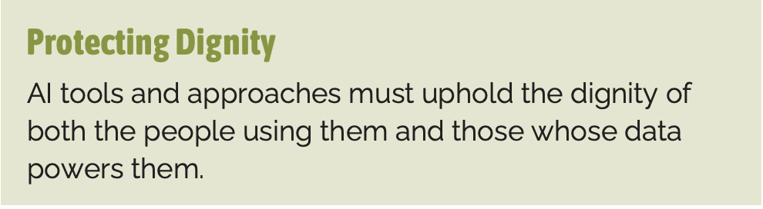
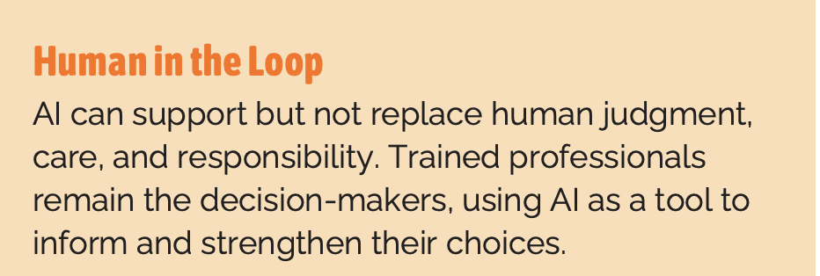
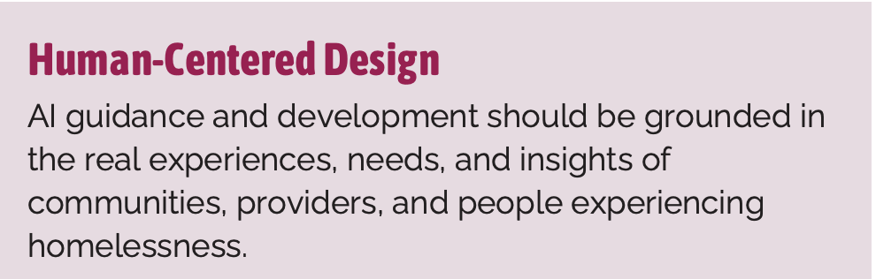
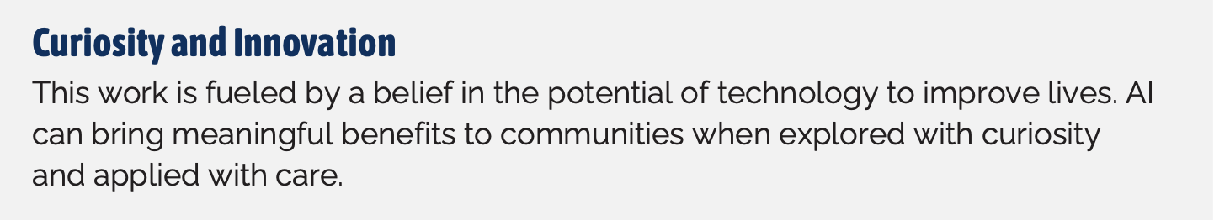
Our Guiding Values for AI

Slide 15
Our Emerging Strategy
👥 Engage Strategic Partners - Convene funders, policymakers, and those experiencing homelessness to shape the field’s direction
📢 Convene & Facilitate
Create cross-sector spaces for dialogue, knowledge, exchange, and co-design of solutions
📚 Scale & Endorse Learning
Disseminate frameworks, toolkits, etc that educate, and establish norms for AI in housing systems
🤝 Engage & Support Communities
Broker resources and funding to help communities test AI in practice
🕵️‍♀️ Identify & Scale Emerging Tools
Surface powerful new practices and technologies, and mobilize resources to expand their use

Slide 16
Interactive Mini-Cases
🟢 🟡 🔴
Scenario 1
A case manager exports client notes from their local record-keeping system, then asks ChatGPT to reformat them into a more professional summary for a grant report.

Slide 17
Interactive Mini-Cases
🟢 🟡 🔴
Scenario 2
An organization unveils Paul, an AI-powered chatbot avatar created to handle intake calls at a homeless shelter. By analyzing tone and conversation patterns, Paul can understand each client’s situation and recommend the best next course of action.

Slide 18
Interactive Mini-Cases
🟢 🟡 🔴
Scenario 3
A community team downloads a large HUD notice. They paste sections into ChatGPT to summarize the key deadlines and action items. They plan to double-check all details before sharing.

Slide 19
The AI-Adoption Compass
Be Curious – Explore low-risk uses and learn through practice. Ask the necessary questions
Stay Grounded – Verify everything
( C–C–P: Cite, Check, Polish)
Collaborate – Share what works and what doesn’t across communities

Slide 20
“
AI will undoubtedly shape our field and the future of homelessness response - but it’s up to us to make sure it does so with empathy, equity, and purpose.
”
Notes:
TO FORMAT TITLE: Make sure the is a space ( ) at the beginning of each line, and a blue period (.) at the end of each line.
TO CHANGE IMAGE: Delete current image, then Insert>Image, resize it to fit slide, then Arrange>Order>Send to Back.

Slide 21
Questions?

Slide 22
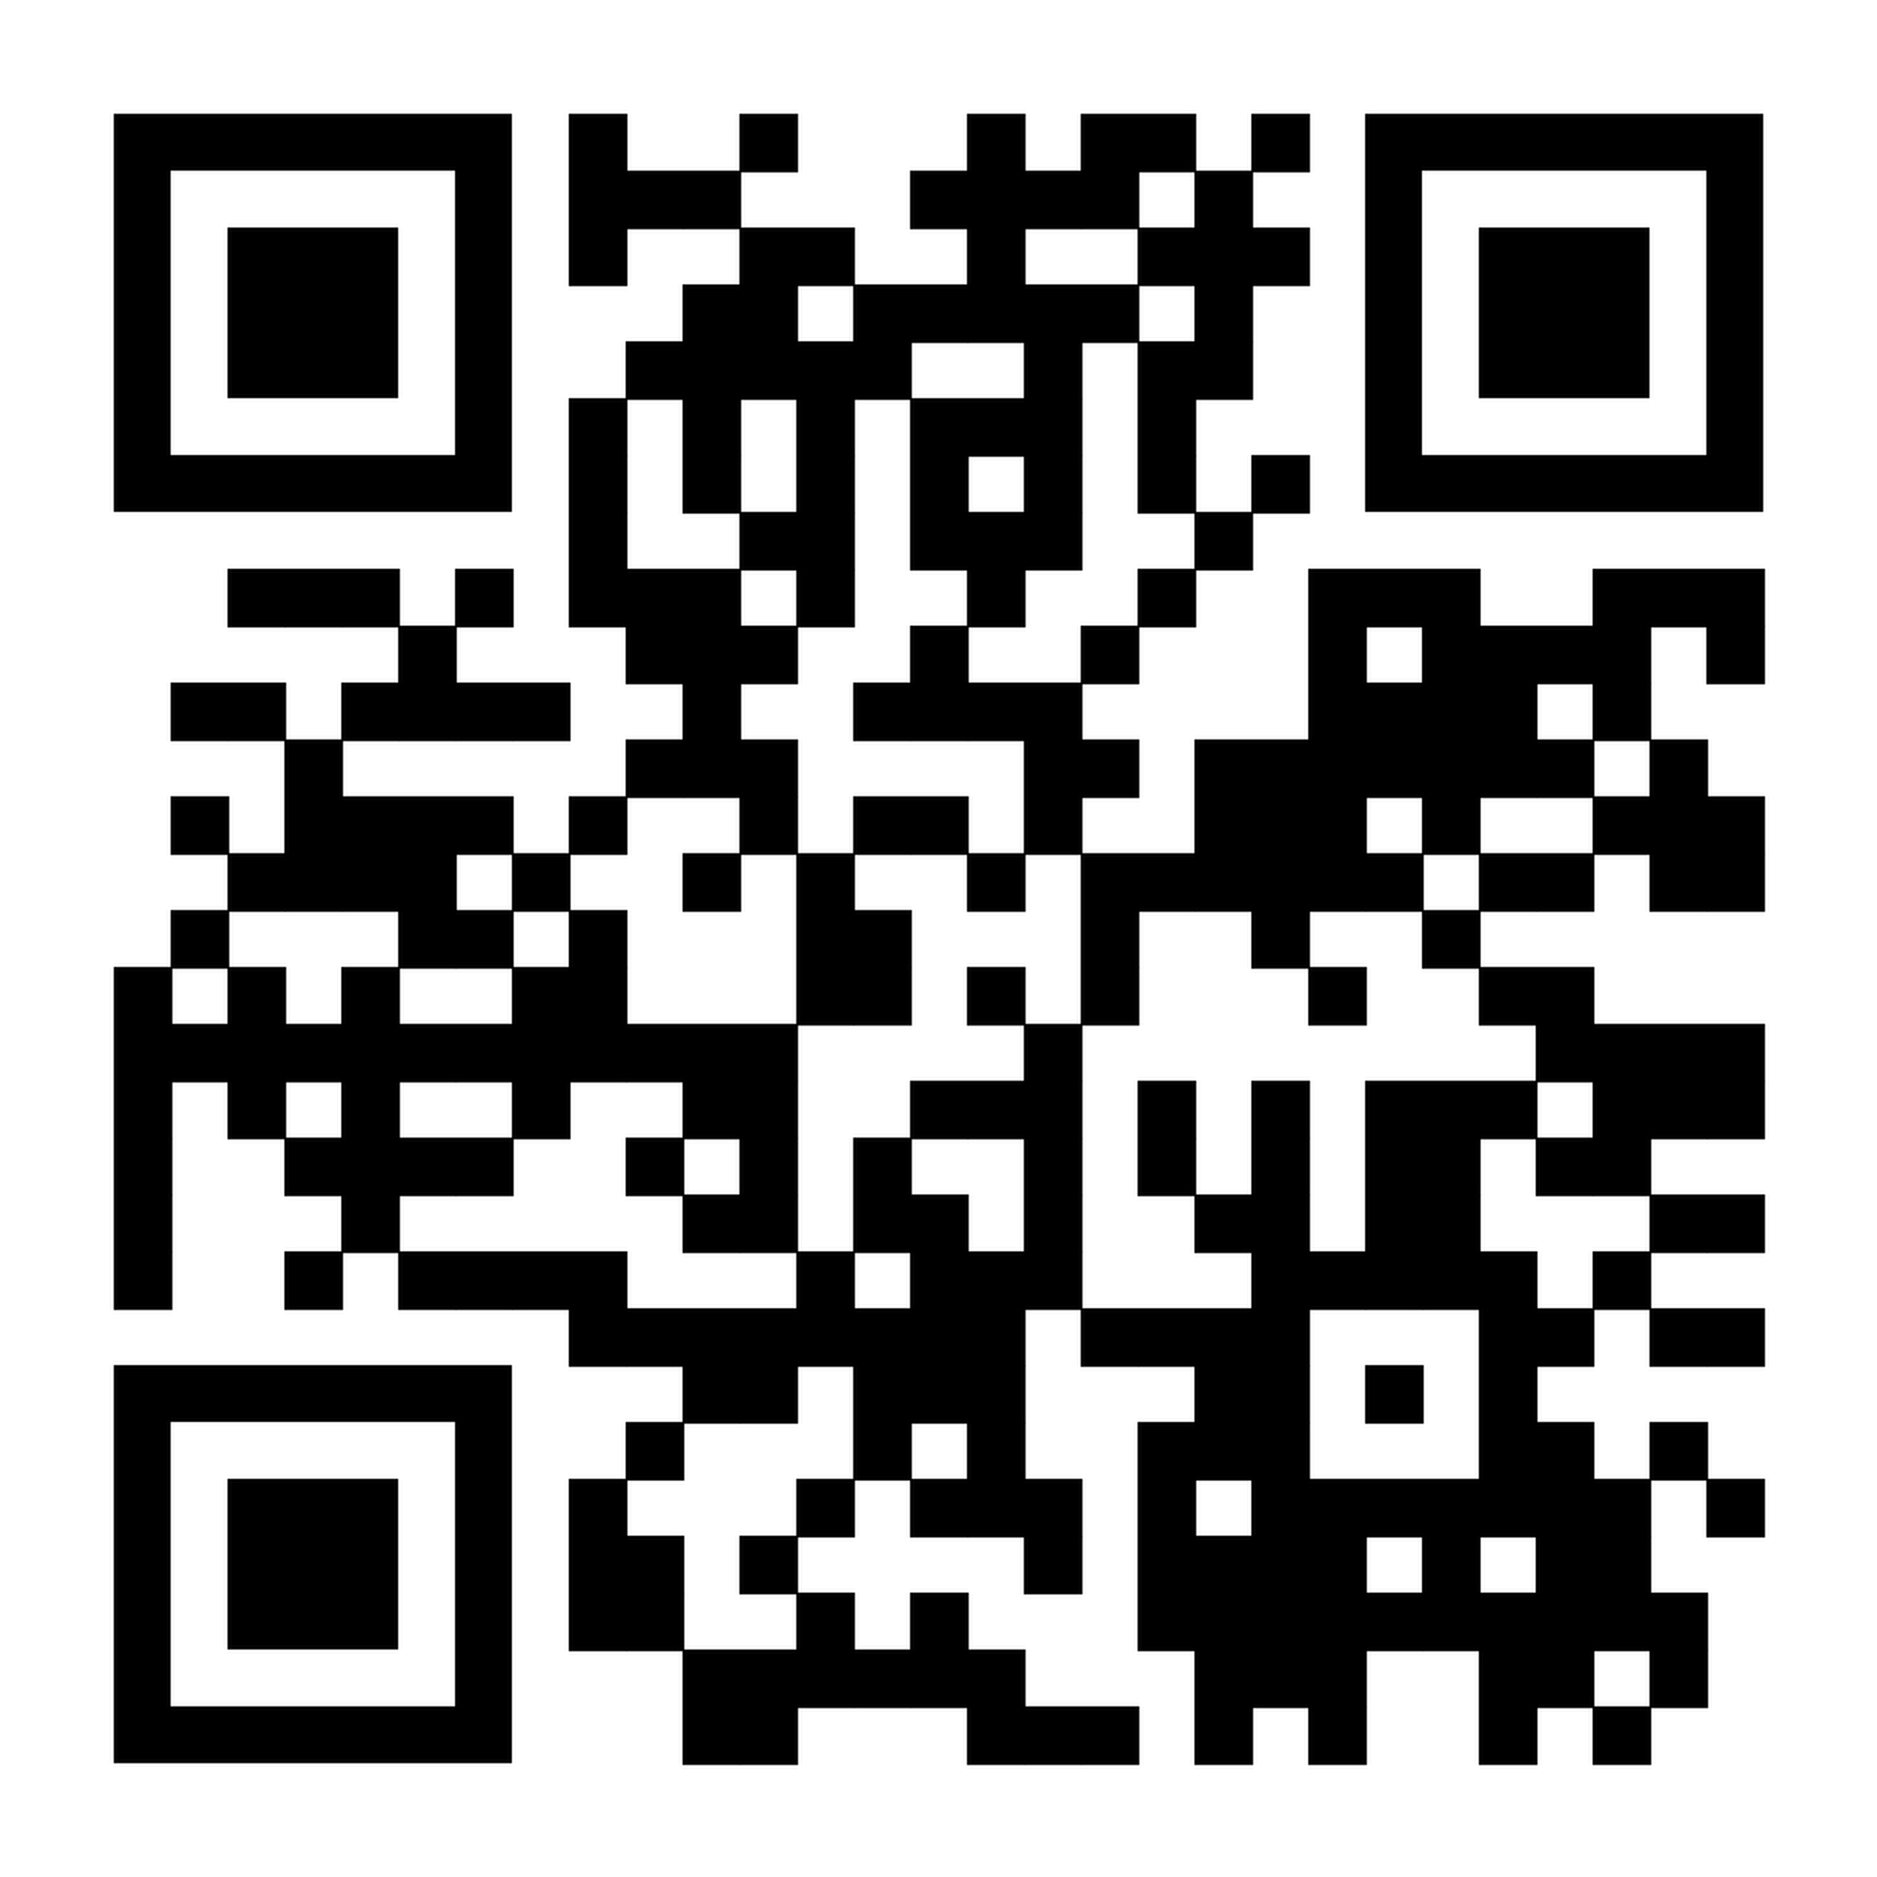
Thank You!
Read Our Report!
“Can AI Help Solve the Housing Crisis?”

