Slide 1

Designing A System For All.
November 2025

Slide 2




Who We Are.
Taj Director
Amber Strategy Lead
Elisabeth System Improvement Advisor
Tanesha
Consultant
Notes:
Amber

Slide 3
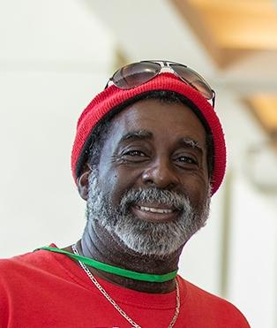
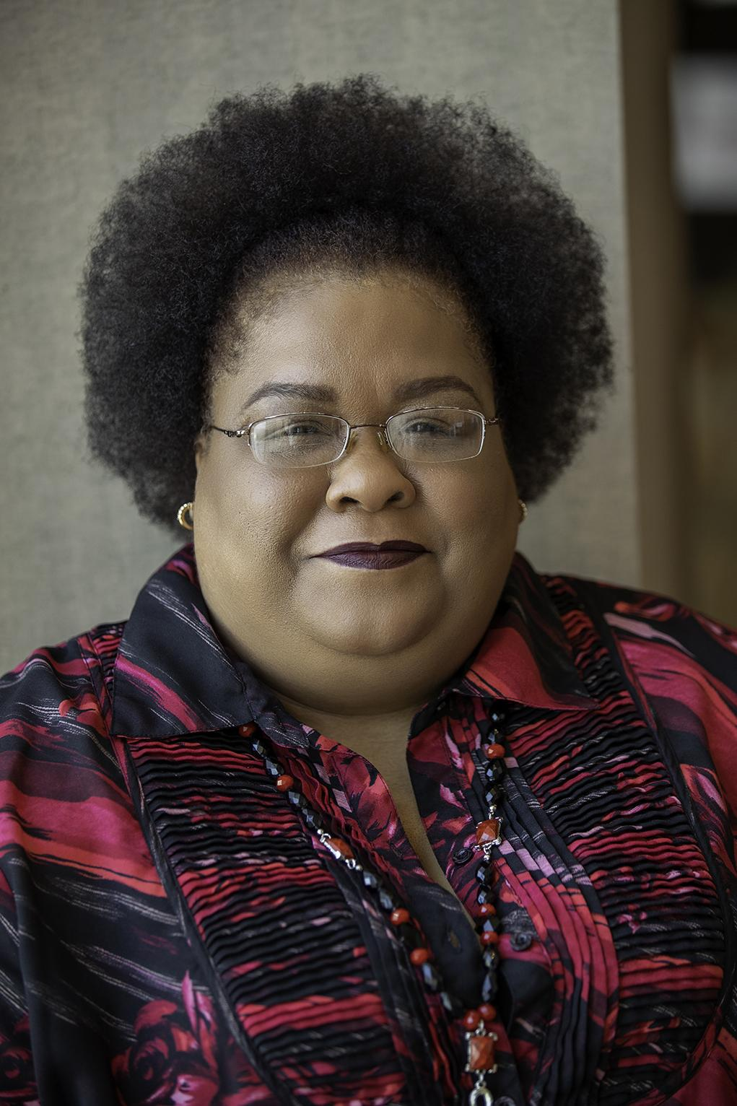



BFZ Housing Equity Strategists
Jianna Hopkins-Israel
Rachael Parker
Anderson Curtis
James Lee
Tyra Thomas
Notes:
Amber

Slide 4
Our Time Together
12
12
Welcome & Purpose
Ideal System v. Current System
3
9
3
9
How do we get to an ideal system?
What Actions Can We Take?
6
6
Notes:
Amber

Slide 5

Notes:
Anderson

Slide 6
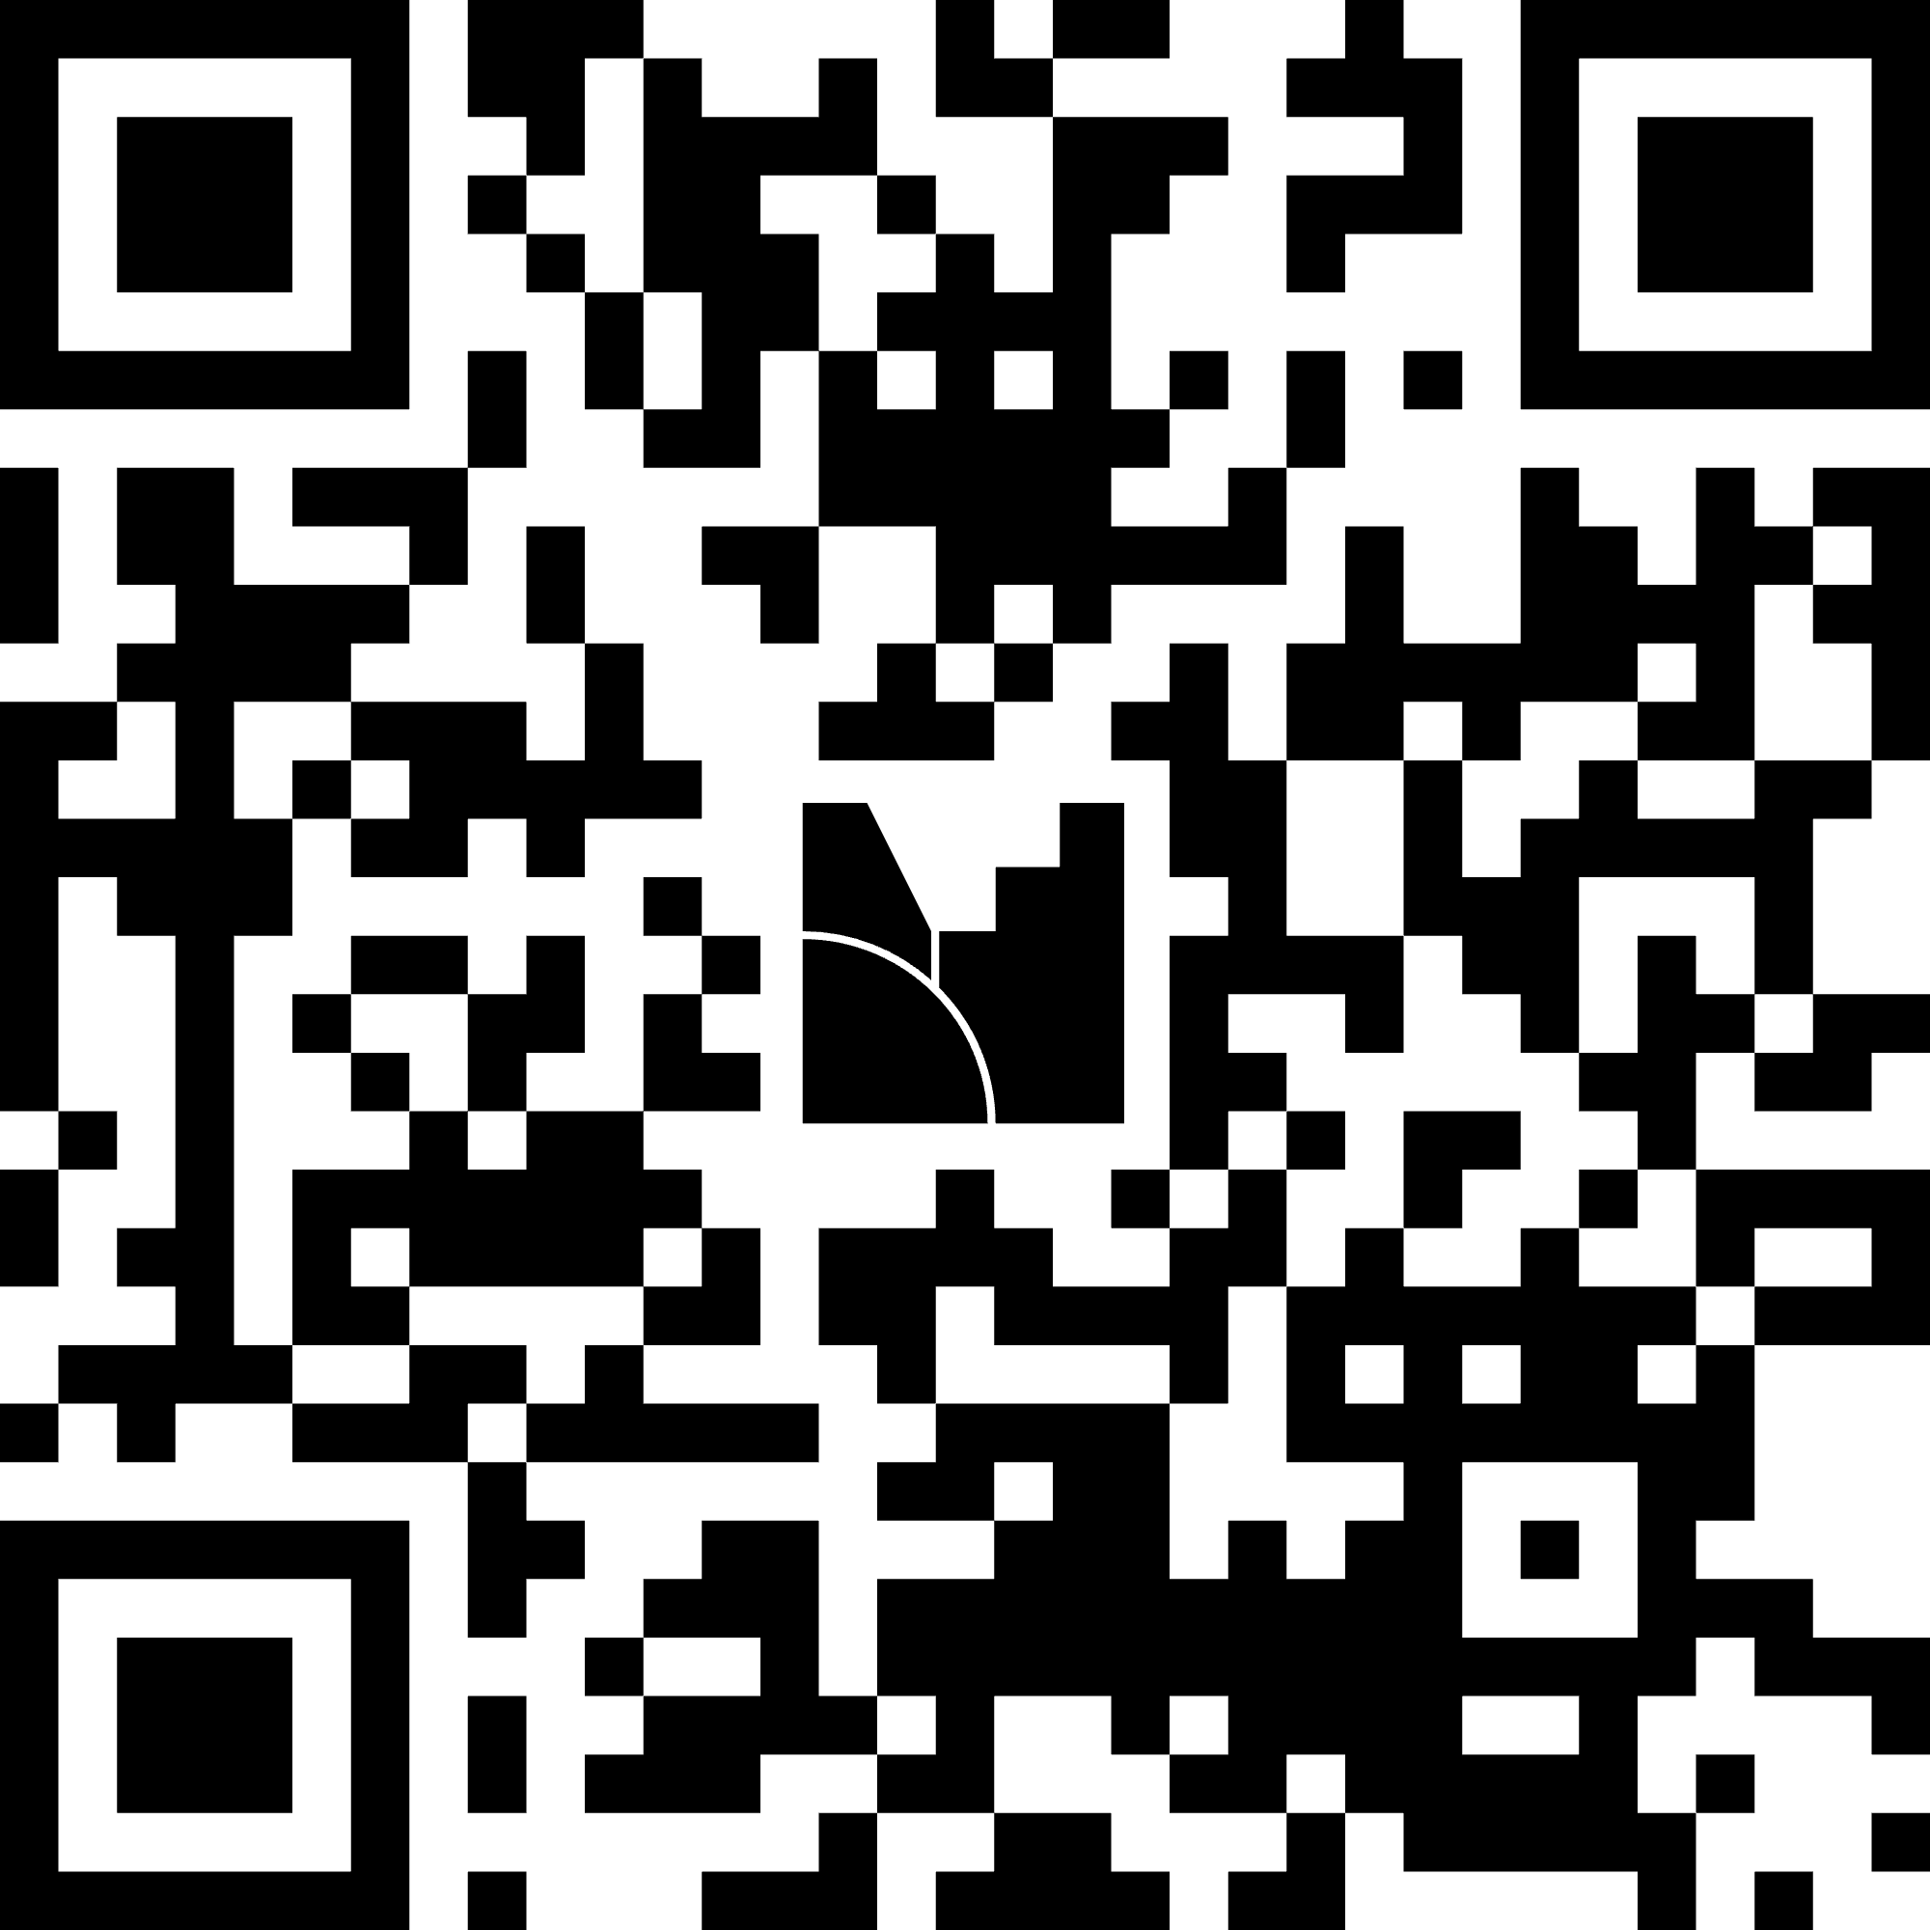
What comes to mind when you think of an ideal Homeless Response System?
Notes:
Rachael

Slide 7

Designing A System For All
Inclusive
Dynamic
Culturally Attuned utilizing an Intersectional Lens
Trauma-Informed
Trauma Responsive (Healing Aware)
Notes:
Amber
Designing a “system for all” in homelessness means creating a coordinated response that works equitably and effectively for every population — centering those most marginalized while ensuring that no one is left behind. This requires blending systems thinking, equity principles, and human-centered design.
READ THE SLIDE

Slide 8
The Current State
Referred to Outreach Worker
Unsheltered
Secondary Screening
Shelter Waitlist
Program Enrollment
Person locates AND accesses a designated Coordinated Entry System
Initial Screening
Housing (Matching)
Vulnerability Assessment
Service Requirement Enrollment
Doubled Up/Unsafe Living Conditions
Shelter Waitlist
Domestic Services
Lease Signing/Move In
Notes:
James/ Amber
Need (2 Possible Entry Points); 1 person to be the screener; 2 outreach orgs; 3 shelters; 2 programs
Coordinated Entry System (CES) Access: The individual must first locate and access a designated CES "Access Point" (shelter, drop-in center, outreach team). Access is not instantaneous; it often requires waiting, traveling, or being present when staff are available.
Initial Screening/Assessment: They are subjected to an initial screening to verify homelessness and gather basic demographic data. They must then consent to have their personal information entered into the Homeless Management Information System (HMIS).
Vulnerability Assessment: The client undergoes a formal assessment (often the VI-SPDAT) to gauge their vulnerability, service needs, and likelihood of remaining homeless. The system is often set up to prioritize the most vulnerable (e.g., chronically homeless, high service users), meaning less vulnerable individuals may be effectively placed on a "soft exclusion" list or redirected to non-system resources.
2. The Waitlist and Prioritization Maze 🚦
Once assessed, the individual enters the most confusing phase: waiting for a match.
Dynamic Prioritization: The system doesn't have a single, first-come, first-served line. Instead, the individual's name is placed on a prioritized list (or several lists, depending on their needs). Their priority score changes constantly based on:
Their vulnerability score.
How long they've been homeless.
The Racial Equity Multiplier (in equity-focused systems, their score may be adjusted up if they are a member of an over-represented group).
Specific Program Eligibility: Their placement is constrained by funding stream requirements (e.g., they might be high priority, but only for Permanent Supportive Housing, which has few openings).
The "Waitlist Cliff": Individuals with low vulnerability scores may never receive a housing match because the system prioritizes those who are medically fragile or chronically homeless. They remain documented as homeless but are perpetually stuck at the bottom of the list.
Document Retrieval: The individual must spend this waiting time gathering highly sensitive and difficult-to-obtain documents (birth certificates, social security cards, IDs, documentation of disability/chronic homelessness) that are mandatory for the eventual housing application.
A "match" is not a placement; it's an invitation to apply.
Housing Unit Offer: The client's name is pulled from the prioritization list and matched to a specific housing program (e.g., Rapid Re-Housing, HUD-VASH, PSH). The client has limited options and must accept the match to move forward.
Secondary Screening (Program Veto): The matched program conducts its own, often rigorous, secondary eligibility screening. This is where people are frequently rejected due to:
Program Rules: A program might have prohibitions on certain felony convictions, outstanding debts, or credit issues, even if the primary CES assessment did not.
"Lack of Fit": Program staff may determine the individual is not "ready" for housing or requires a level of support the specific program cannot offer, leading to a rejection back to the bottom of the prioritization list.
Service Requirement Enrollment: For Supportive Housing programs, the client must agree to, and often begin, enrolling in required supportive services (case management, behavioral health, employment services) before the housing voucher is finalized.
The final stage involves dealing with a landlord or property manager, which introduces external complexities.
Documentation Deadline: The client must now produce all previously gathered documents immediately for the formal lease application, often facing strict deadlines that are impossible to meet without intensive case management support.
Tenant Screening: The property management company or landlord conducts its final screening, often checking:
Credit history (even if subsidized rent is guaranteed).
Rental history (often leading to rejection due to previous eviction history tied to homelessness).
Criminal background checks (leading to rejection based on old or non-violent offenses).
Lease Signing and Move-In: After all screenings, fees, and inspections are cleared, the client finally signs a lease. The delay between the initial assessment and the move-in can easily span 6 to 18 months, during which the client remains highly vulnerable.
All the while you have people working to identify landlords; questioning themselves; not to mention the politics, community input and just life as a worker within the system

Slide 9

What does it mean to be an inclusive system ?
To value the unique contributions of all who are involved/participate in the system
To have adaptive and dynamic policies in addition to equitably allocating resources to serve and support those working in and experiencing the system
Incorporates and emphasizes the role of diverse perspectives and prioritizes and centers people over process
Notes:
Amber
What does it mean to be inclusive [read slide] The remarkable adaptability of Lived Experts, having navigated systems and adapted to diverse situations, underscores the importance of understanding how we can learn from these adaptations to gain profound insights.

Slide 10

What it IS . . .
✅ A COMPLETE list of everyone experiencing homelessness in a given community
✅ The UNIT OF ANALYSIS used to understand how individuals and households experiencing homelessness flow through the system
✅ A comprehensive DATASET that helps communities understand system performance
How To Get It . . .
✅ Being PEOPLE CENTERED, and inclusive of voices, especially PWLEH utilizing these perspectives in:
Data collection
Data Validation
Data Analysis
✅ Understanding what DATA IS AND IS NOT and using it effectively
✅ Applying a lens of INTERSECTIONALITY that aids in examining system performance
Notes:
Amber
Data is a collection of facts, numbers, words, or observations that can be used for calculation, analysis, or reference
When processed and analyzed, data provides insights and context, helping to inform decisions.
Quantitative Data - numerical and measurable
Qualitative data - non-numerical
Dynamic data refers to information that changes, updates, or is recalculated in real-time or near real-time. It is not fixed or static; instead, it is fluid, often reflecting the current state of a system, environment, or process.
We’re really talking about a By-Name Dataset which aims to understand the journey of everyone in the system and effectively meet their self-determined needs.
[READ The Left side of the slide]
How to Get There: First understanding
Data is not neutral/ It is not objective
Data holds immense power to uncover systemic inequalities and drive transformative change within institutions, championing racial justice. It can ignite a movement for systemic reform, foster true equality, and pave the way for a more just and equitable society for all.
So must [READ RIGHT SIDE - first bullet]
To be inclusive and people-centered you must:
Build data literacy to foster a shared understanding among organizations and community members. Understand that all data is vulnerable to data biases, inaccuracies, and missing information, and/or selection bias (confirmation bias).
Consult with data equity experts and lived experts to gain a deeper understanding of how outcomes are measured and reported, including collection, analysis, interpretation, and the story you want to tell. Additionally, consider how the findings will be communicated to leadership or the community..
Actively include voices of lived experience/ experts in the data process, and develop impactful interventions. Utilize the information provided by lived experts to prioritize what issues get addressed.
Allow for a shared commitment to telling the community’s story by engaging with individuals representing the community members to be included in the input of the direction of the goals, which will increase transparency and regain trust.
Determine who owns the data. Is the data shared on an open-source platform? Allow for redistribution of power to the community.
When we say Data is not neutral we must understand that data can be provide misinformation and misleading (PIT count v. Actual # people experiencing housing instability - due to narrow definition)
[READ SLIDE BULLET 2]
Telling the right story with the right data. - What is the story behind the data?-Using a fact-based asset framing approach with a lens toward equity.
Additionally, we must [READ SLIDE - 3rd Bullet
Disaggregate data and analyze intersectional experiences, including race by gender, disability status, nationality, income, and SES.
Identify root causes by utilizing a factor analysis to uncover the problem.
Identify issues early on and connect with organizations that can address or bridge the gap in services and supportive efforts.
Finally we need to ensure that we are using Targeted Universalism:
Tailoring issues to address both the structures and the outcome

Slide 11


Innovation: Partnerships & Funding
Notes:
Amber
No single agency or system can solve it alone
Partnerships/Collaboration creates stronger safety nets, reduces duplication while building dignity for those experiencing crisis and moving through the system
Partnerships such as:
Housing and Hospitals
Court Systems (inclusive of civil courts) and homelessness response system
Include justice based programs/organizations (carceral system)
Health Systems and Hospitals along with Homelessness Response Systems
*Amber & Tanesha to give examples
These partnerships are not only integral for ensuring people are either don’t experience crisis or have only a short stint in the crisis but can also open up funding that can ensure sustainable program/partnership
For funding we have the traditional funding sources

Slide 12


Government Relations
Federal Funding
State & Local Funding
Family Foundations
Corporate Foundations
Community Foundations
Notes:
Amber
Utilizing multiple funding sources to support your work - allowing organizations to combine different funds for a unified purpose, such as a non-profit using a mix of federal, state, and philanthropic money to provide comprehensive services, without requiring a common fund or shared costs that lose their distinct identities
State Funding - appropriations from the state - direct to organizations or grants through specific state departments
Local Funding - CDBG (HUD) - appropriated through your city council or local government
Federal Funding - NOFA (HUD) (federal grants for specific purposes ie workforce development grants)
We are not only talking about braiding by utilizing sources but through multiple jurisdictions (especially if your COC has overlapping geography) - where collaboration is key
Finally utilization of the private sector or philanthropic sector
Government relations (companies within your jurisdiction)
Family Foundations
Community Foundations
Corporate Foundations
At times even private businesses/ small to medium sized or chamber of commerce
Determine if can expand by matching funds

Slide 13


Trauma- Informed / Trauma Responsive
Healing Aware
Notes:
Tanesha
To be trauma and culturally informed means to approach and provide structures and supports that acknowledge a person, taking into account the extreme stress caused by events or circumstances and their response to the stress and events in their life that have threatened their physical or emotional health. Additionally, this approach respects and integrates cultural values, beliefs and practices.
Trauma Informed means understanding what happening / why it is occurring - the experiences or reactions that are taking place from a client
Trauma- Responsive - we also are regulated and understand our own nervous system while engaging with those we serve and or those we work with - we can be connected and calm and ensure our spaces are psychologically safe
Designing systems that make emphatic practice biological sustainable - it is all of us together and ending the idea of only caring for those experiencing homelessness - understanding we all have encountered trauma and we all need care

Slide 14
Types of Trauma
Generational Trauma
Vicarious Trauma
Stress
Trauma experienced by a specific cultural, racial, or ethnic group. This type of trauma can result in individuals being hesitant to enter into systems that have historically oppressed these populations
Experiencing trauma-related psychological and physical symptoms in response to helping or empathizing with others who have experienced traumatic events.
Stress
Complex Trauma
Pressure that life exerts on us and the way this pressure affects us. .
Repeated systematic trauma that occurs over time..
HyperStress
Stress that builds up and without release overwhelms a person’s coping mechanisms
Passive Trauma
Being overwhelmed by the emotional and disturbing event with no support that in turn can create another trauma experience.
Trauma
An emotional, distressing and disturbing event that overwhelms the person’s internal and external resources.
From the Destroying Sanctuary: The Crisis in Human Service Delivery Systems Sandy Bloom-Brian Farragher - Oxford University Press 2013
Notes:
Tanesha
Insert: The only trauma I would add to this comprehensive list is combat trauma, which is unique in its experience because one have to experience war or be within war zones and it is exclusive to military personnel. It is an acute reaction during or shortly after participating in military conflicts.

Slide 15
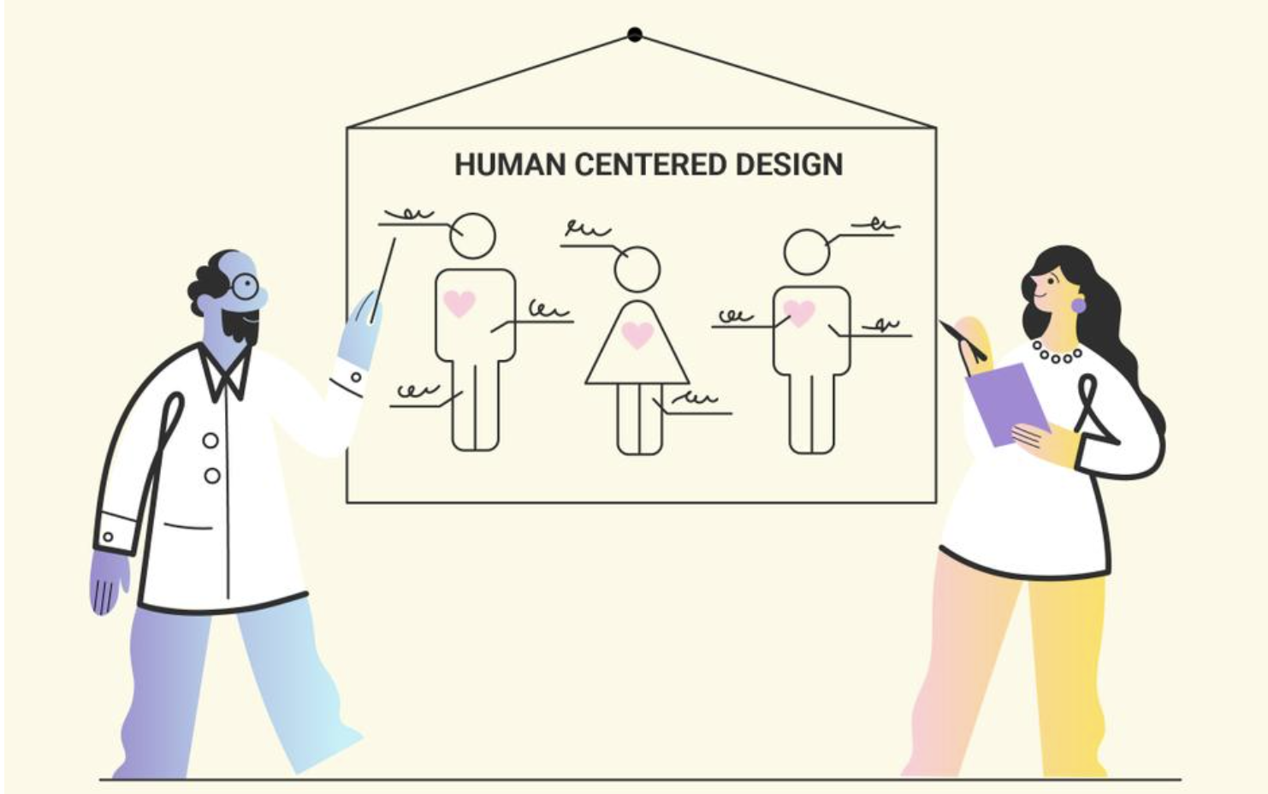
Human Centered Implementation Techniques
Be Observant and Person Centered
Allow space time for the person to be calm
Build Relationships
Provide support
Understand reciprocity in relationships (intentional listening and empathy)
Be consistent and predictable and if not able be transparent
Use Asset Based Language when speaking with others
No attribution to specifics but understand that the effect is trauma
Rid language such as ‘over-reacting’ - over anything
Utilize Crisis De-escalation and Prevention
Provide space after an issue
Active listening
Develop a safety plan
Educate and Inform
Notes:
Tanesha
Understand trauma’s effects and listen, being careful of language used ensuring that you are seeing the person experiencing the crisis and not the impact [ read slide first and sub bullet] - understanding that for those who have experienced trauma will take longer to regulate and calm
Build trust, be vulnerable and be transparent. Active listening,respect and patience assist relationships to thrive [Read Slide bullet two and sub bullet] - provide support/ treat them as you would want to be treated no matter their status
Asset focused language and narrative. Ask, “How can I support?”, Withhold judgement about behaviors and focus on how the behavior may be traumatic response
Through all this we should be identifying triggers and doing best to provide brave spaces that are psychologically safe to ensure that we are able to do our best not to traumatize

Slide 16

*Co-developed with BFZ Housing Equity Strategists, TSTJ LLC and based off guidance from USICH and HUD *conditional definition and constantly evolving
What does it mean to meaningfully engage people with lived experience of homelessness?
Communities that have meaningfully engaged people with lived experience of homelessness create an environment where people with lived experience of homelessness are able to share their truth about what is working and what is not working in the system, without fear of retaliation.
In these communities the homeless response system leaders and governing bodies have included those disproportionately represented within the system and historically underserved and excluded, particularly Black, Brown, and Indigenous people and those who have lived experience of homelessness.
People with lived experience are paid for their time and expertise and lead on decisions affecting the community. Through this meaningful engagement of people with lived experience of homelessness a community develops and sustains interventions to end homelessness.
Notes:
Jianna
Communities that have meaningfully engaged people with lived experience of homelessness create an environment where people with lived experience of homelessness are able to share their truth about what is working and what is not working in the system, without fear of retaliation.
In these communities the homeless response system leaders and governing bodies have included those disproportionately represented within the system and historically underserved and excluded, particularly Black, Brown, and Indigenous people and those who have lived experience of homelessness.
People with lived experience are paid for their time and expertise and lead on decisions affecting the community. Through this meaningful engagement of people with lived experience of homelessness a community develops and sustains interventions to end homelessness.

Slide 17

Road to Meaningful Engagement
Your leadership and expertise are critical to how we
address the issue
Activity: Co-creation of programs and presentations
PWLEH lead and decide on initiatives
Activity: Advisory Group that leads projects (ie Public Health Initiative)
Power Share
Defer To
Collaborate
Delegated
Power
Ensure community
needs and assets
are integrated into
process & inform
Planning
Activity: Attendance at Conferences
Voice
Involve
Tokenize
We will keep you
Informed
Activity: community presentation
Consult
Inform
We will keep you
Informed
Activity: community presentation
Placate
Your voice, needs & interests do not matter
Activity: Closed Door Meeting
Ignore
Marginalize
Notes:
Jianna/Tanesha
Our goal in this work is to move from transactional to transformational. Move from relationships and work that are task oriented which usually removes the person from the situation. We want us to grow through this work and in turn have a community which is stable and supportive.
Tanesha
Adapted from the Spectrum of Community Engagement to Ownership from Facilitating Power
The concept of a "spectrum of community engagement to ownership" typically refers to a range of strategies or levels at which communities can be involved in decision-making, planning, and actions, starting from ignore to passive involvement (like consultation) and moving towards down the spectrum to active participation (like involve) and eventual community ownership (community-driven planning or leadership of projects and initiatives).
Phase: [Read out the road/phases]
Ignore
(Marginalization)
Providing the community with relevant information. Breaking down existing barriers to participation. Excluding marginalized populations.
Inform
(Placation)
One way is information sharing. Gather input from the community
Involve
Consult
(Tokenization)
Offering input into already constructed plans. Ensure community news and assets are integrated into the process and inform planning
Involve (Voice & Power Shift)
Power building. Addressing uneven power imbalance.
Collaborate
(Delegated Power)
Play a lead role in implementation and decisions
Defer to
(Ownership)
Community driven decision making

Slide 18

Successful Exits From Homelessness
Culturally Attuned to what clients need to be stably housed (intergenerational housing, allowing for roommates, ability to be in community)
Actively Listening/ Intentional Listening
Trauma informed/ trauma responsive
Building Relationships with Landlords
Training landlords to understand
Support for caseworkers to ensure you have supportive caseworkers who have the bandwidth
Notes:
Tyra
Goal is to get those experiencing homelessness or housing insecurity to become safe and stable in housing
As we know stable housing is a part of health - one of the social determinants of health
So how do we get there
This is important because --- add in a anecdote/story that underscores

Slide 19

Actionable Next Steps
Where is collaboration working well? Can it be replicated ?
Is our data dynamic? How can we make it dynamic
Are those that are included feel empowered? Are they supported?
What supports are needed to be inclusive? Trauma-informed? trauma-responsive?
How can we share information or resources better ?
Who is not at our table? Who do we need or want to be at the table?
Notes:
So we can’t do everything but we can do something
We don’t want to be prescriptive because every community has its nuances however we want you to begin thinking about taking Meaningful Actionable steps - even if you consider them small

Slide 20

Questions & Answers

Slide 21

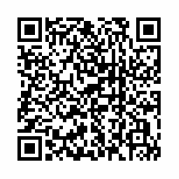

Slide 22


Thank You
Questions or Comments please send them to:
aelliott@community.solutions
pwleh@community.solutions

