Slide 1
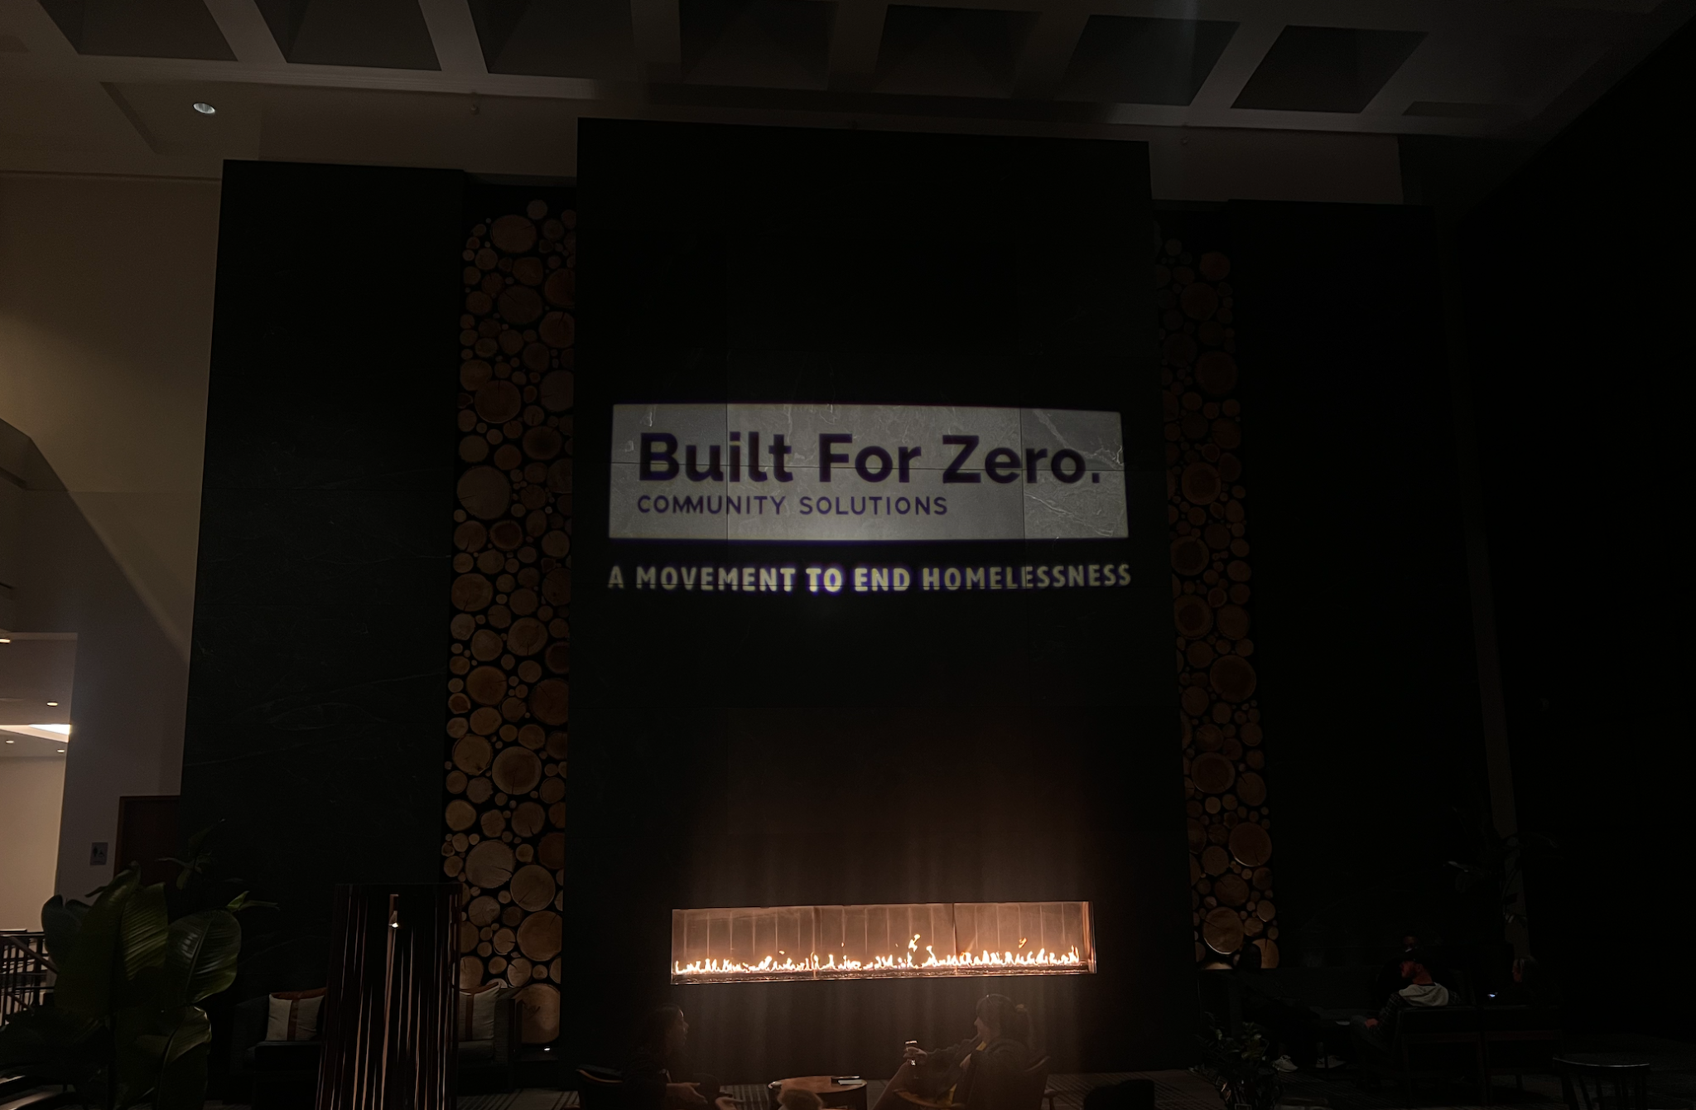

CREATING VISIBLE WINS: REDUCING ENCAMPMENTS AND UNSHELTERED HOMELESSNESS ATLANTA CASE STUDY
Notes:
TO FORMAT TITLE: Make sure the is a space ( ) at the beginning of each line, and a purple period (.) at the end of each line.
TO CHANGE IMAGE: Delete current image, then Insert>Image, resize it to fit slide, then Arrange>Order>Send to Back.

Slide 2

Agenda
1
2
3
4
5
Welcome and Introductions
Direct to Housing Overview
Atlanta Downtown Rising Overview
Panelist Q&A
Audience Q&A

Slide 3



PRESENTERS .
ANNIE HYRILA .
Chief Program Officer, Partners for HOME
TAMMY MAULDIN . Homeless Response Manager, Community Solutions. .
ALLISON WINSTON
Homeless Response Specialist, Community Solutions .

Slide 4
1
1
Direct to Housing
Notes:
TO FORMAT TITLE: Make sure the is a space ( ) at the beginning of each line, and a green period (.) at the end of each line.
TO CHANGE IMAGE: Delete current image, then Insert>Image, resize it to fit slide, then Arrange>Order>Send to Back.

Slide 5
Goals of Direct to Housing (D2H)
Sustain an end to unsheltered homelessness.
Decrease the number of people living unsheltered.
Offer individuals safe, permanent housing solutions prior to closing or reactivating an area.
Increase system flow and housing capacity.
Create visible, lasting results.
Notes:
Allison & Tammy

Slide 6
How does D2H work?
Start in one encampment or zone at a time
Uses a site-specific By Name List (BNL)
On site everyday for the duration of the closure
Meet everyday with frontline team to review the BNL-daily huddles
Every person offered housing, regardless of chronic status and vulnerability score
Specific units and housing program enrollment offered to people on-site
Flex funding removes barriers quickly
Move in with a Welcome Home Kit and furniture on day 1
Closure planning and site monitoring post closure
Notes:
Allison & Tammy

Slide 7
Where can the model be applied?
Downtowns
Encampments
Emergency Shelters
Notes:
Allison & Tammy

Slide 8
Team Structure
Project Management/Lead
Technical Assistance
Street Outreach
→ Outreach
→ Document Specialists
→ Healthcare Providers
→ Complex Care Team
Unit Team
→ Dedicated Unit Locators
→ Unit Inspectors
Housing Team
→ Housing Subsidy Providers
→ Housing Case Managers
→ Furniture/ Welcome Home Kit/Move-In Coordinators
Closure Maintenance Team
→ Municipal Services
→ Patrol (police, private security)
→ Private Property Owners
Other Community Resource Partners
Leadership & Communications
Notes:
Allison & Tammy

Slide 9
D2H Process
Typically 4-6 week cycle per encampment area- size and housing availability will dictate timeline.
Identify Encampment/Zone
Identify Housing
Housing
Close Encampment
Assess site (map, size)
Engage Residents
CE assessments
Finalize BNL
Collect documents
Enroll in program
Apply for units
Move in
Weekly-monthly case management
12 month transition plan
Post notices
Clean up and secure site
Monitor site
Law enforcement patrols
Engage landlords
Identify units
Secure and inspect units
Notes:
Allison & Tammy

Slide 10
Closure & Space Management
Develop closure processes and procedures
Define all mitigation measures to be implemented
Client notification plan
Management of personal belongings
Site inspection and cleaning
Monitor closed sites for 30-60 days, with first week being the most critical
Rapid-response protocol if new tents/re-population appear

Slide 11
D2H Planning Process
Assess Readiness
Secure Critical Resources
Launch a Pilot
Prepare to Scale
Scale
1
2
3
4
5
Notes:
Allison & Tammy. Highlight each step.

Slide 12
2
Atlanta Downtown Rising Initiative
Notes:
TO FORMAT TITLE: Make sure the is a space ( ) at the beginning of each line, and a blue period (.) at the end of each line.
TO CHANGE IMAGE: Delete current image, then Insert>Image, resize it to fit slide, then Arrange>Order>Send to Back.

Slide 13
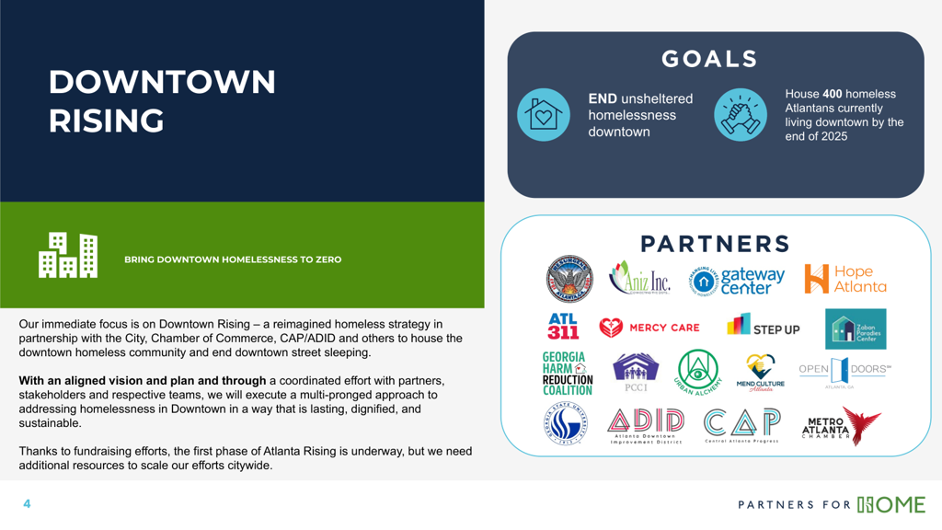
Atlanta Downtown Rising

Slide 14
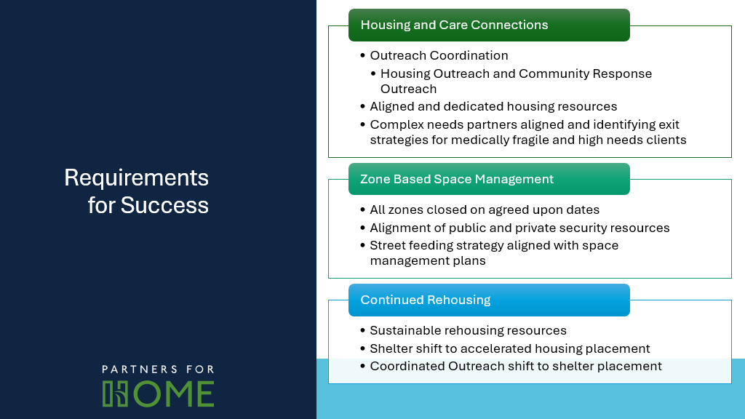
Atlanta Downtown Rising

Slide 15
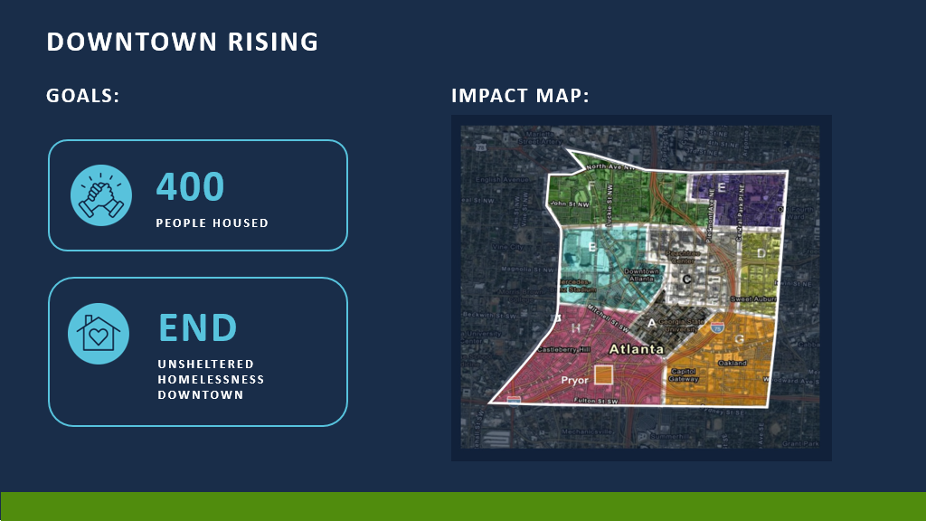

Slide 16
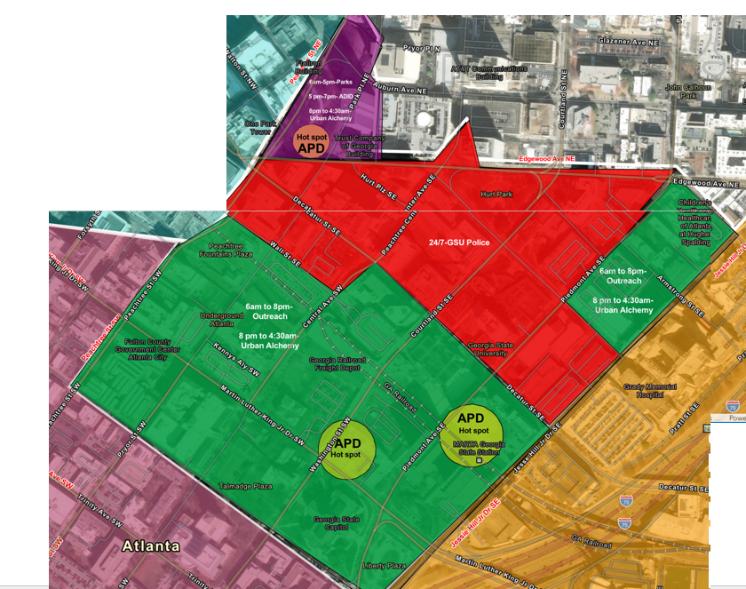
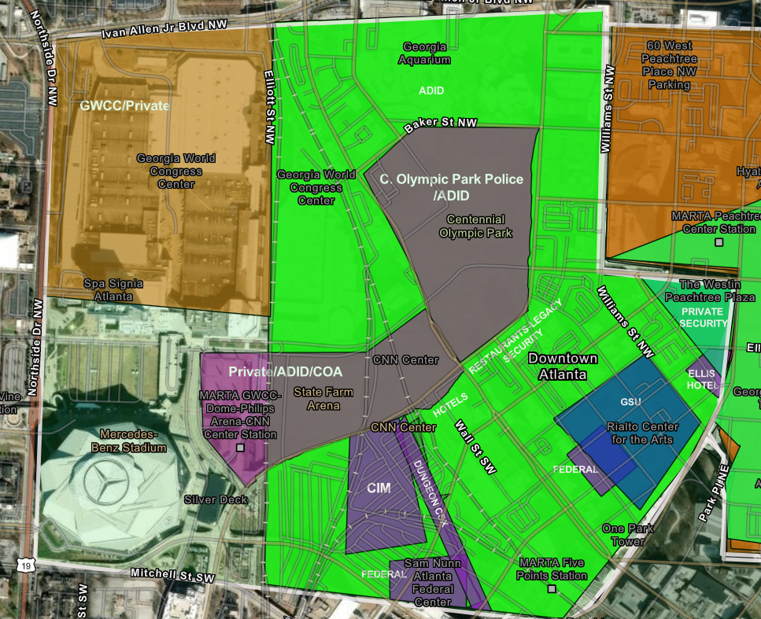

Slide 17

Closure Operations Engagement Partners must engage people seen sleeping, lying down, in crisis, or erecting structures every time. Follow this structured response process below.
Scenario | Required Action | Reporting
Person is sleeping, lying down, or setting up camp | Engage and say: “Hello there. This area is closed to sleeping. Are you interested in staying at emergency shelter overnight? | Engagement Report Form
Individual accepts shelter offer | Transport person and their belongings | Engagement Report Form
Individual refuses shelter but leaves the area | No action required | Engagement Report Form
Individual refuses shelter and does not comply | Contact DTR Dispatch Number | Engagement Report Form
Aggression, property crime, or medical/mental health crisis | Contact 911/ Police Dept Dispatch (for law enforcement) | Engagement Report Form
Important Contact | Engagement Report Form
Gateway Phone number: 770-655-3312 Salvation Army Phone Number: 404-486-2701 DTR Dispatch Number Phone Number: 470-300-5233

Slide 18
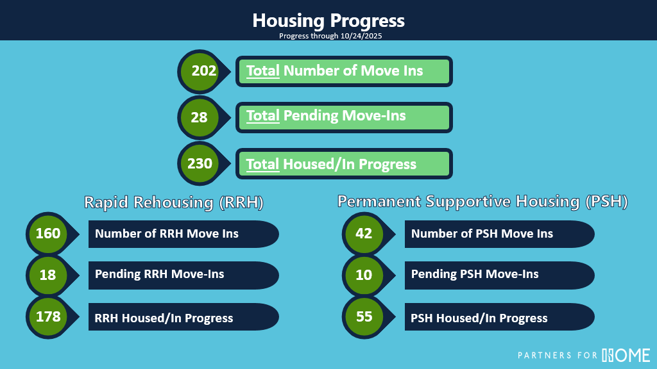

Slide 19
Panel Q&A
Notes:
- What has inspired this level of investment across so many funding partners? What non-traditional partners have you been able to bring to the table?
- How has your past work on unsheltered informed your current strategy?
- What are some of the challenges you're wrestling with in the street to housing process? In the public space management process?
- What are you learning and what kinds of adjustments and changes are you considering or adopting?
- What communication strategy is being used to change public perception and lift up successes?

Slide 20
Audience Q&A

Slide 21
Thank You!

