Slide 1


COORDINATED HOUSING SURGES: DETROIT CASE STUDY ON ENDING VETERAN HOMELESSNESS
Notes:
TO FORMAT TITLE: Make sure the is a space ( ) at the beginning of each line, and a purple period (.) at the end of each line.
TO CHANGE IMAGE: Delete current image, then Insert>Image, resize it to fit slide, then Arrange>Order>Send to Back.

Slide 2

Agenda
1
2
3
4
5
Welcome and Introductions
What is a housing surge?
#75ZeroExcuses Overview
Panelist Q&A
Audience Q&A

Slide 3



PRESENTERS: DETROIT VETS CORE TEAM.
JENNIFER TUZINSKY Veterans System Lead..
RHI MCGARRY .
Veterans Data Lead
DANILO TUAZON
Program Manager, SSVF
Volunteers of America MI
Notes:
Tammy to tee it up, add April and Danilo

Slide 4



PRESENTERS: COMMUNITY SOLUTIONS .
APRIL MCKIE
Systems Coach
TAMMY MAULDIN
Homeless Response Manager
ALLISON WINSTON
Homeless Response Specialist
Notes:
Tammy to tee it up

Slide 5
Housing Surge Overview

Slide 6
Housing Surge Components
Keys to Success
Landlord Engagement & Unit Identification
Unit Tracker Spreadsheet
Flex Funds
Site-Specific By Name List
Daily Case Conferencing
Move-In Coordination With Furniture & Welcome Kits

Slide 7
Cultural Shift
Shifting the Culture
From “This Is How It’s Always Been” to “Home in 75”
Before
Working in silos
Limited shared accountability & communication across programs
Clients set the pace of their housing process
Progress slowed by “this is how we’ve always done it” thinking
Hesitancy to try new approaches
After
One coordinated team with shared sense of urgency
Daily case conferencing and transparent communication
Clients engaged as partners with clear next steps
Creative problem solving to get to yes
Accountability for outcomes across all programs and partners

Slide 8

#75ZeroExcuses Overview
Notes:
April

Slide 9
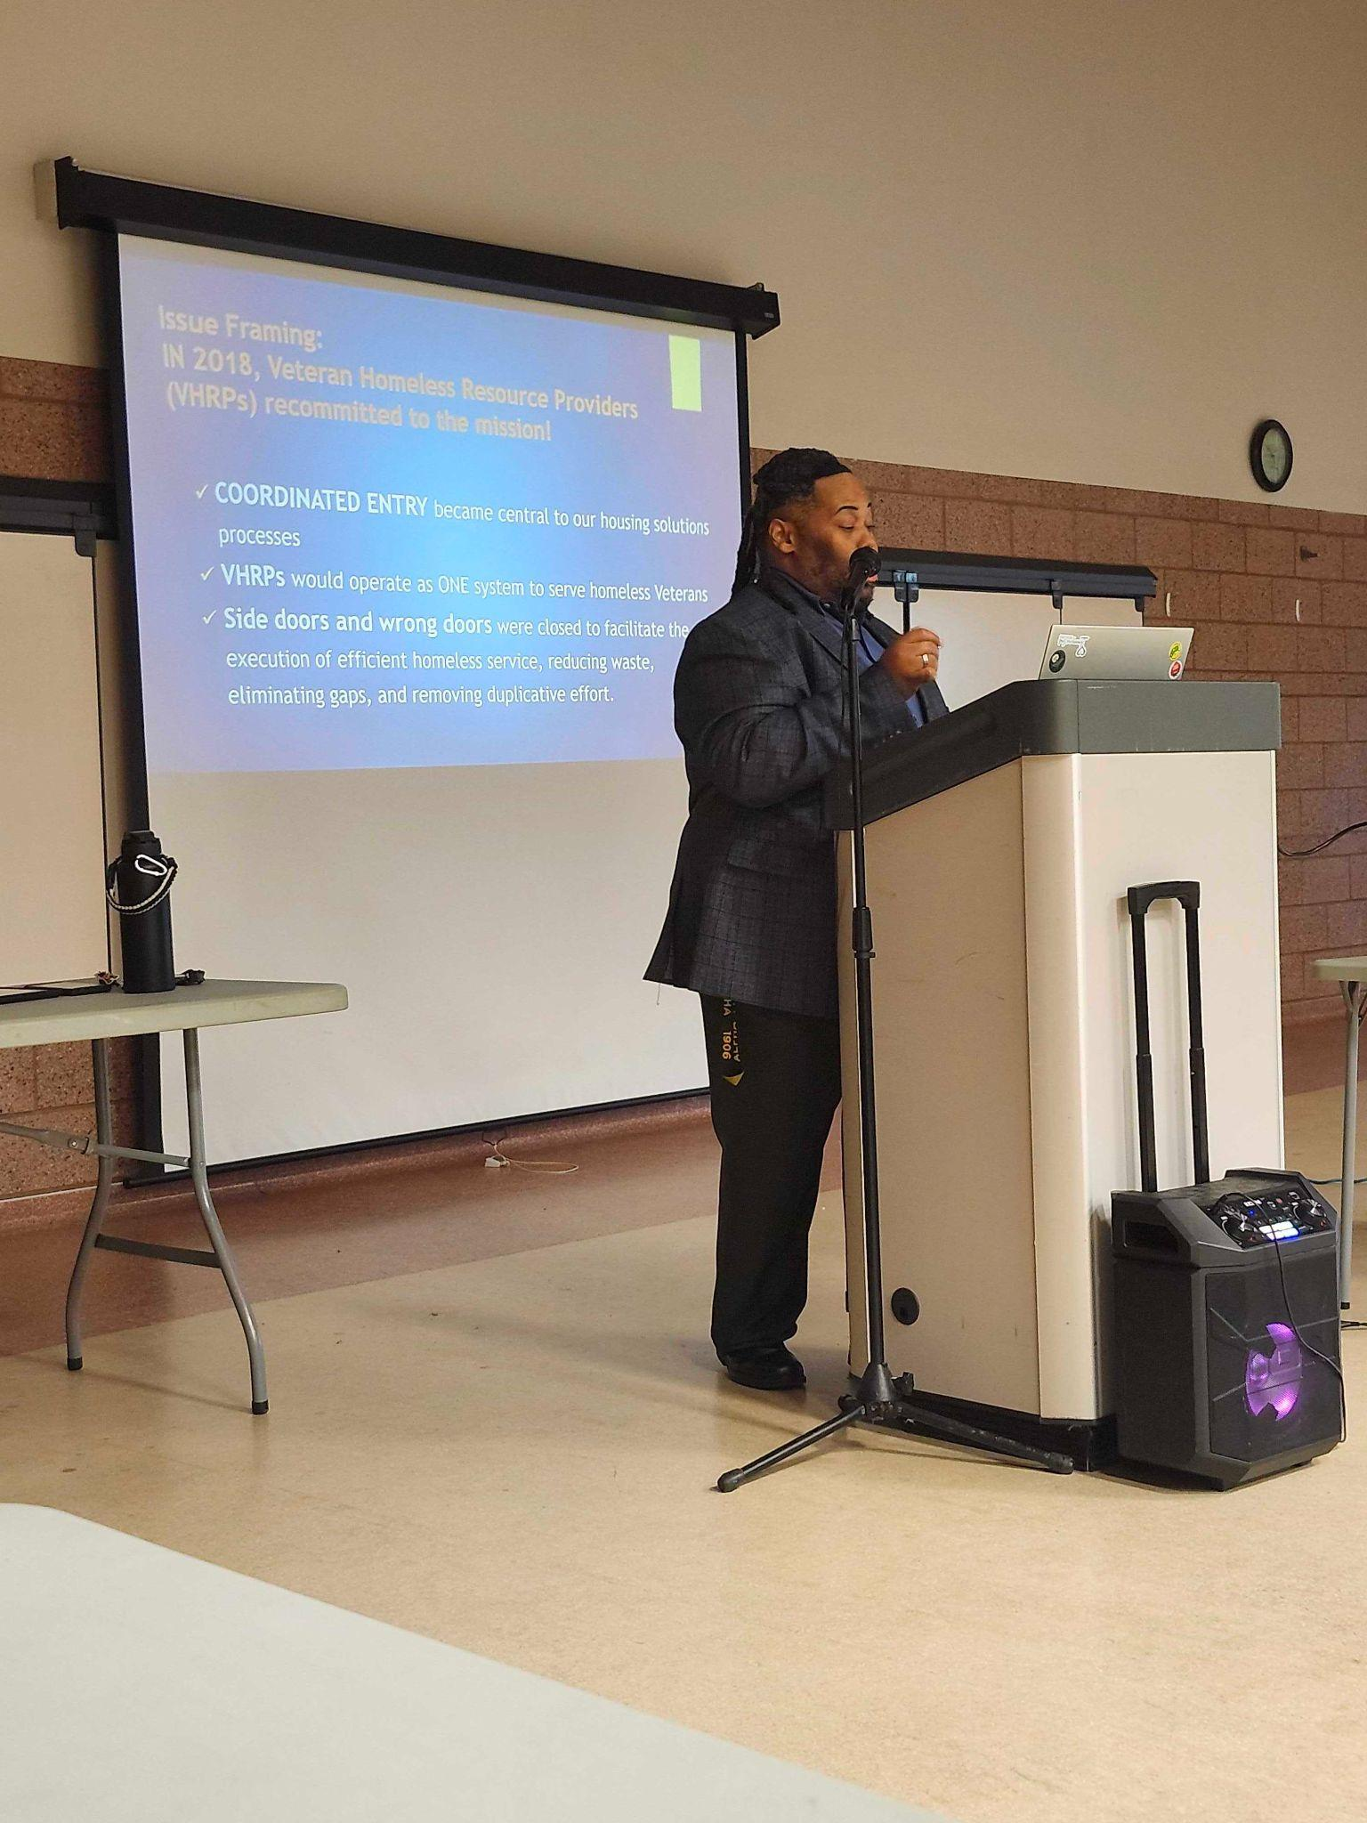
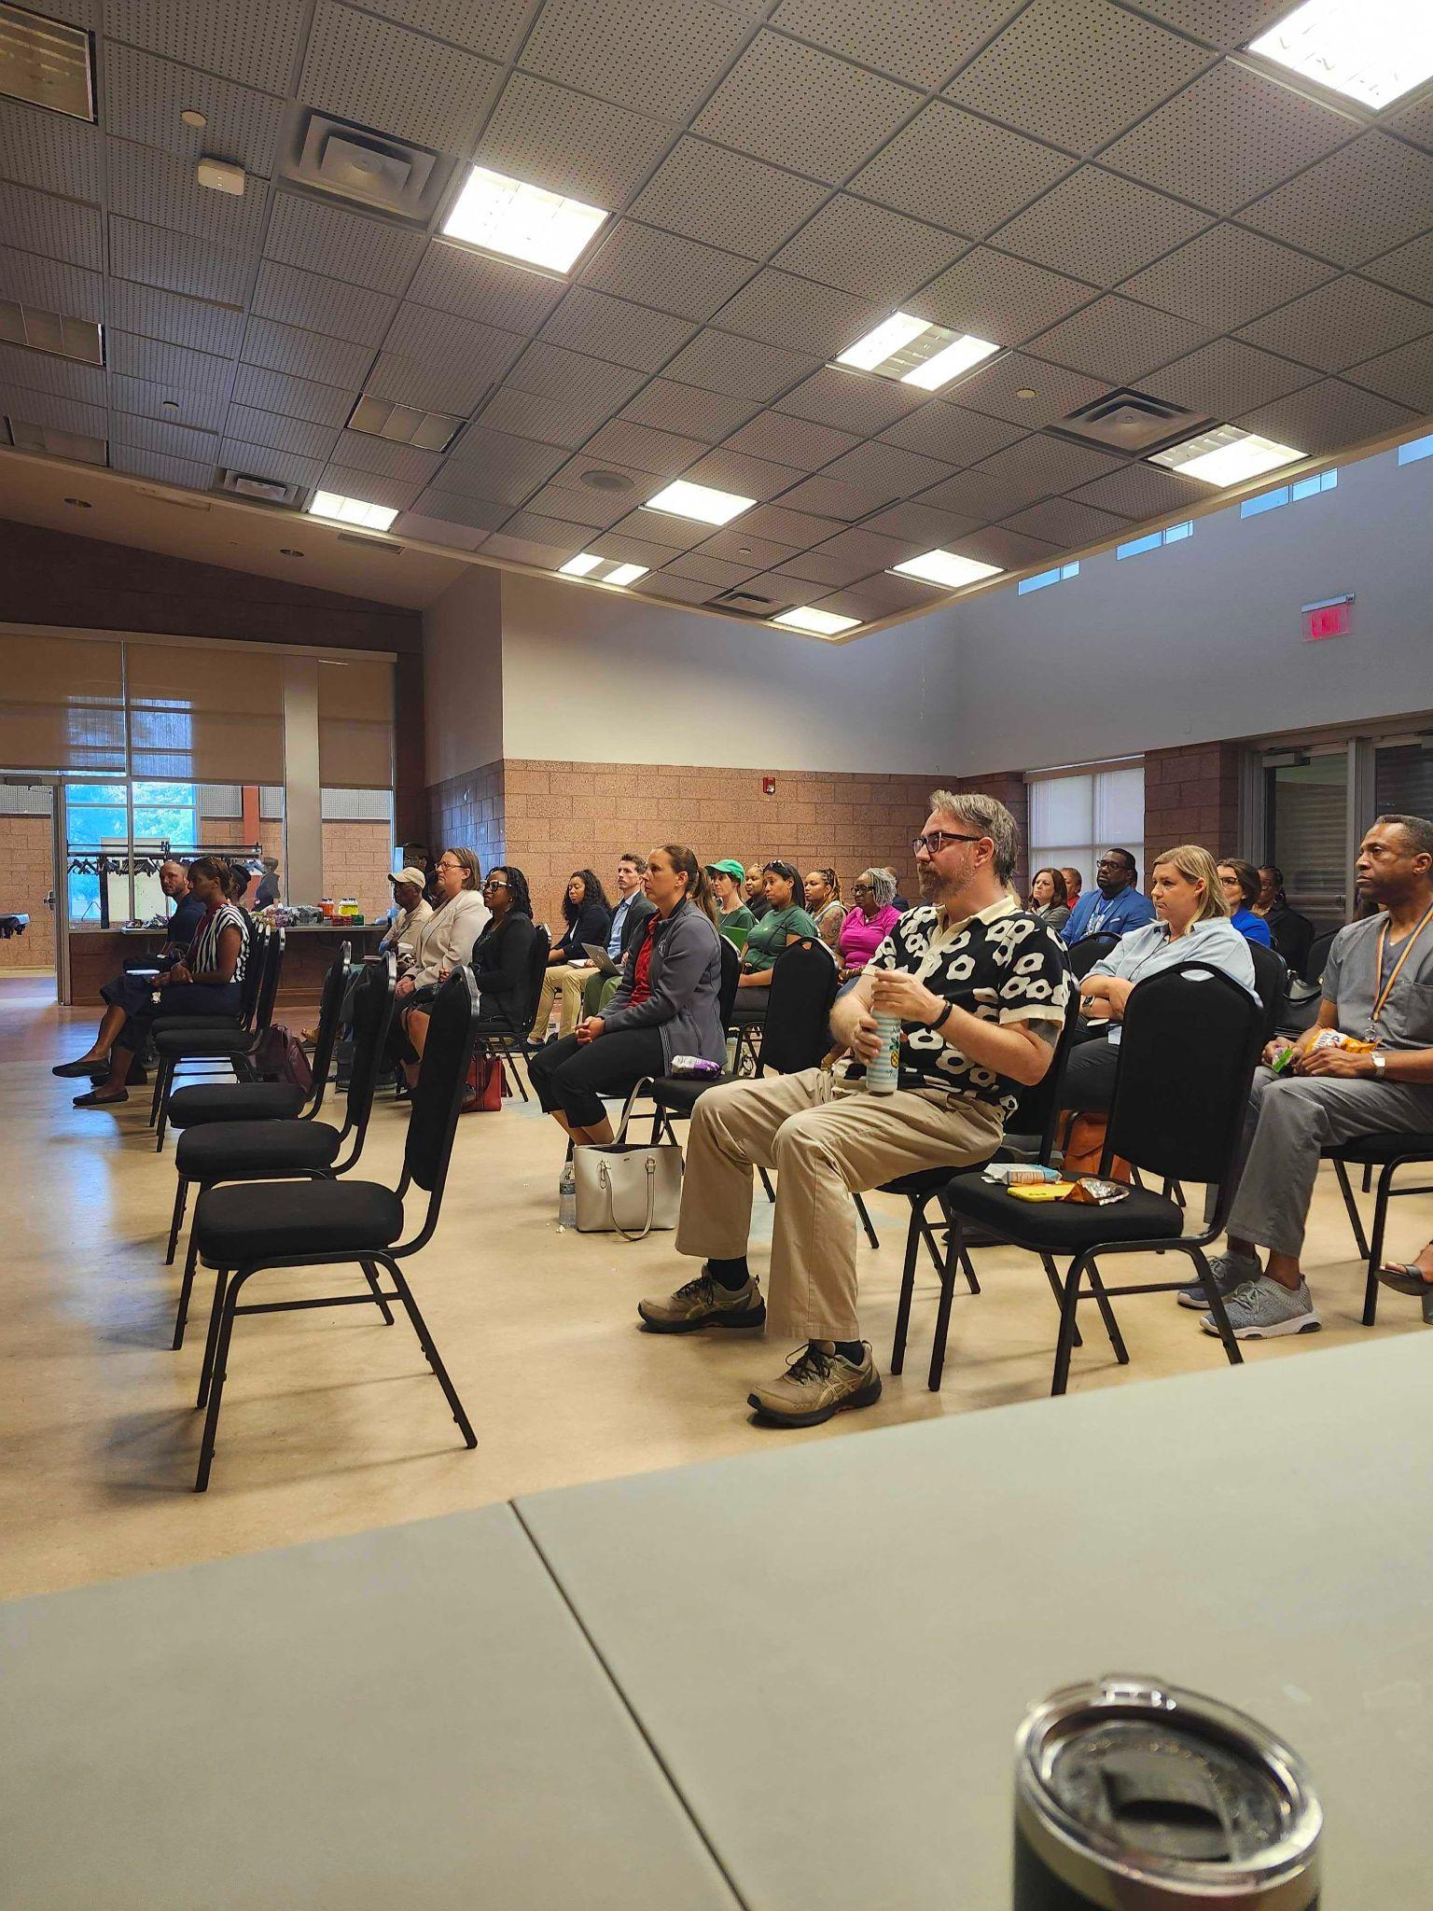
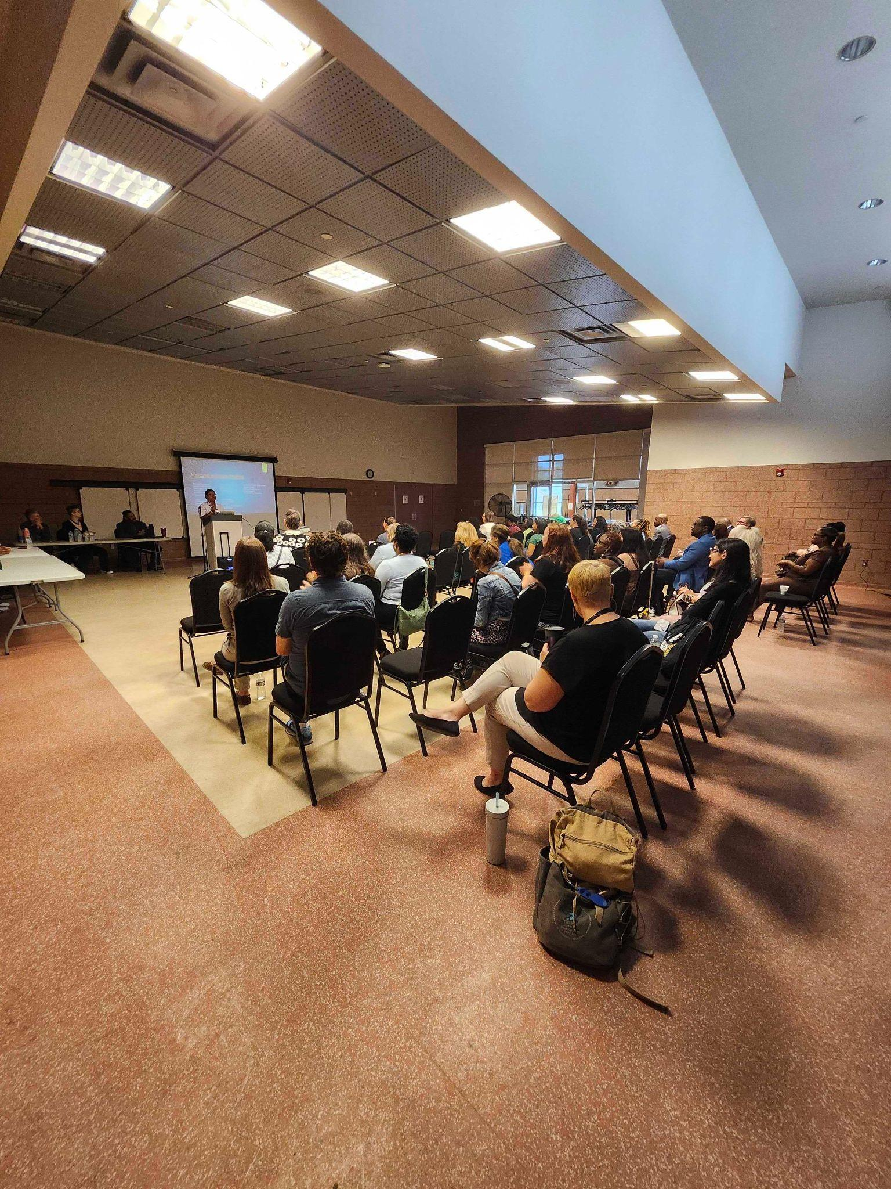
Detroit Veteran Housing Surges
Notes:
April

Slide 10
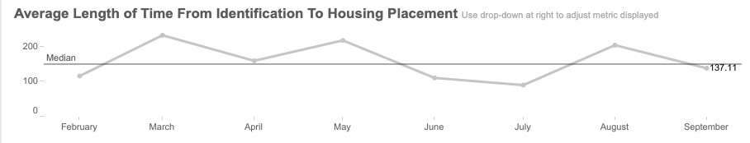
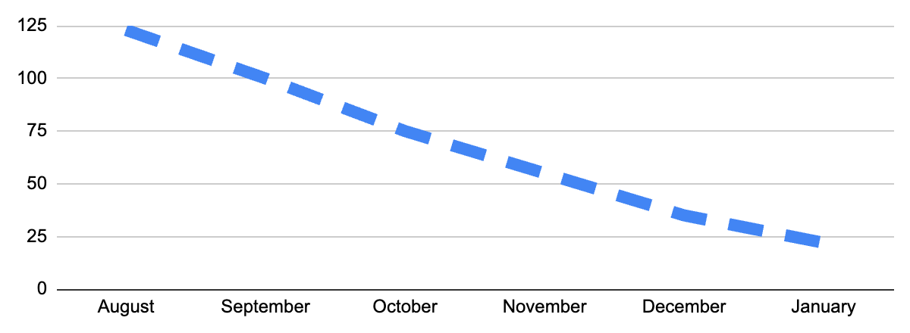
Detroit Veteran Housing Surges
Goals
Decrease length of time to housing from 152 to 75 days
Reach functional zero by January 2026 (22 veterans)
123
22
Notes:
April

Slide 11
Detroit Veteran Housing Surges
Roles of Leadership
Site Lead
SSVF Lead VASH Lead
Case Conference
Lead
Project Lead
Unit Acquisition Lead
Flex Funds Lead
- Coordinate logistics
- Spearhead process improvements in Program
- Communicate with staff
- Communicate with veterans, as needed
- Coordinate case coverage if staff are out of office
- Ensure staff are prepared for Daily Briefing updates
- Identify and Secure Units
- Manage large-scale landlord relationships
- Manage unit tracking spreadsheet
- Process landlord incentive requests
Process flex funds requests
-Coordinate workflows
- Manage By Name List
- Lead weekly goal setting and tracking
- Elevate stuck points to leadership
-Run daily briefings
- Send daily updates to unit tracking sheet
- Discuss progress on weekly and surge-long goal setting and tracking
Notes:
April

Slide 12
Detroit Veteran Housing Surges
Steps in Surge Process for Veterans
Member of core leadership team will meet individually with veterans to explain the Home in 75 and gather buy-in for the event. We will give them their packet, then walk them to their next station based on what they need.
1
Veteran “Check-in”
Applications for birth certificates and DD-214s will be printed and available for immediate completion. Secretary of State ID appointments will be scheduled with transportation provided or arranged for by case manager.
2
Vital Document Applications
Veterans on track to be enrolled in SSVF will be walked to their SSVF coordinator to enroll with the program.
3
SSVF Enrollment
Veterans will be walked through available housing units through the Unit Tracker Sheet. If a unit is selected, veteran will apply for it. If no units on the sheet meet the veteran’s needs and preferences, their needs will be written down and passed to the unit acquisition team for further research.
4
Digital Unit Viewings
Notes:
April

Slide 13
Detroit Veteran Housing Surges
Steps in Surge Process for Veterans Continued
Veterans that need to view their units in person before making a decision will be scheduled for a time to go view the unit, with transportation provided or arranged by the case manager.
5
In-Person Unit Viewings
Any veterans that are hesitant about the process, stuck at a given step, or need additional support can be brought down to the “leadership room” to discuss the barriers with the leadership team and problem solve with the veteran.
6
Motivational Interviewing / Case Conferencing
If there are other case management needs that are required to allow the client to move into housing (signing documents, income statements etc), the case manager will be able to grab the veteran and bring them to a private office to facilitate that conversation.
7
Case Management
Notes:
April

Slide 14
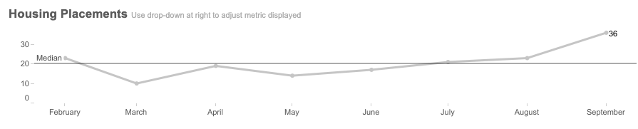
Detroit Veteran Housing Surges
Outcomes
Add info on outcomes

Slide 15
Panel Q&A
Notes:
What role did each of you play in the surges?
What were the most successful strategies used to recruit new landlords, and what tools did you use to identify potential new properties and landlords?
Daily case conferencing was new to this team. What worked about doing case conferencing daily and were there any challenges?
How can we keep veterans motivated and engaged from start to finish? What strategies worked? What challenges did you face around this?
How did having access to flex funds help? How was it used?
Looking back on the first veteran housing surge, what are you most proud of as a team?
What would it take to sustain surge-level momentum as an everyday way of working?

Slide 16
Audience Q&A

Slide 17
Thank You!

