Slide 1


CoC Financial and Scenario Planning in Uncertain Times
Notes:
TO FORMAT TITLE: Make sure the is a space ( ) at the beginning of each line, and a purple period (.) at the end of each line.
TO CHANGE IMAGE: Delete current image, then Insert>Image, resize it to fit slide, then Arrange>Order>Send to Back.

Slide 2

CoC Financial and Scenario Planning
1
2
3
Best Practices for Financial and Workflow Management.
Compliance with Regulations to Keep the Cash Flowing.
Strategies for Diversifying Funds.

Slide 3
CoC Financial and Scenario
Planning in Uncertain Times
Presenters: Jean Field, Director of Policy and Implementation, Homebase
Mary Simons, Senior Directing Analyst- Contract Lead, Homebase

Slide 4
CoC Financial and Scenario Planning,
1
1
Best Practices for Financial and Workflow Management.
Notes:
TO FORMAT TITLE: Make sure the is a space ( ) at the beginning of each line, and a green period (.) at the end of each line.
TO CHANGE IMAGE: Delete current image, then Insert>Image, resize it to fit slide, then Arrange>Order>Send to Back.

Slide 5
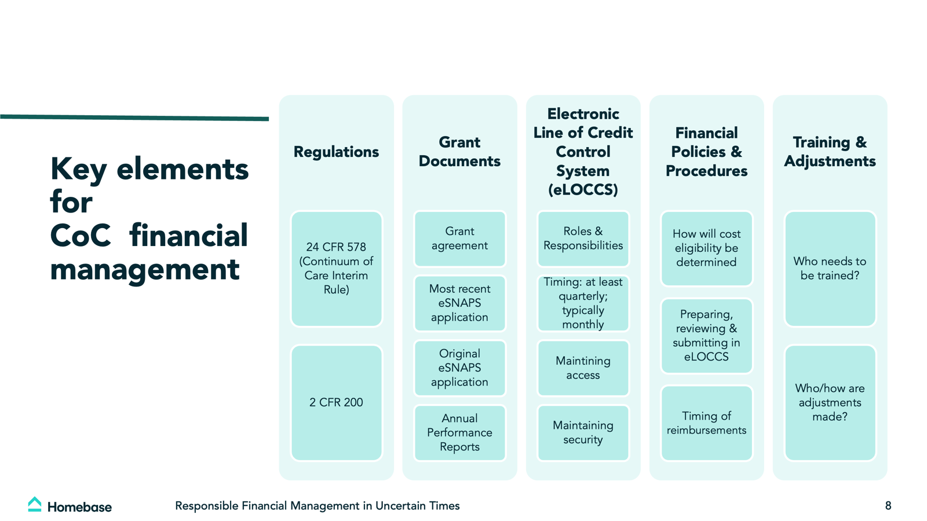

Slide 6


Slide 7
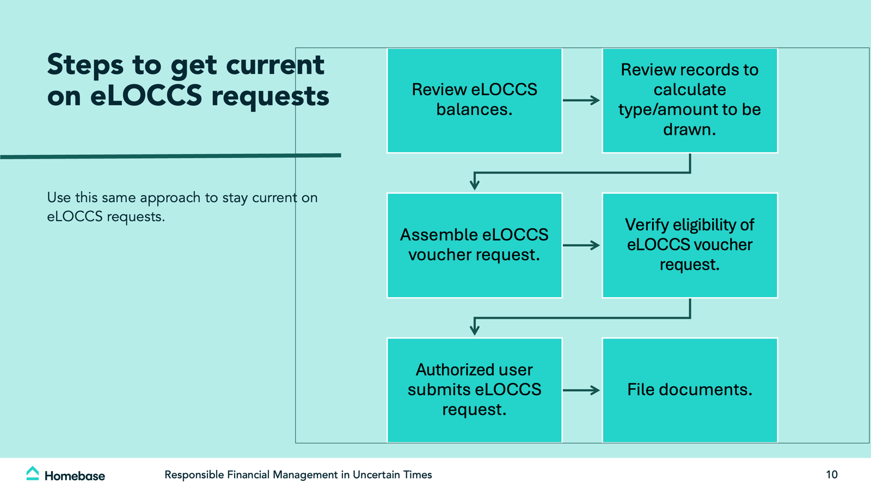

Slide 8


Slide 9


Slide 10
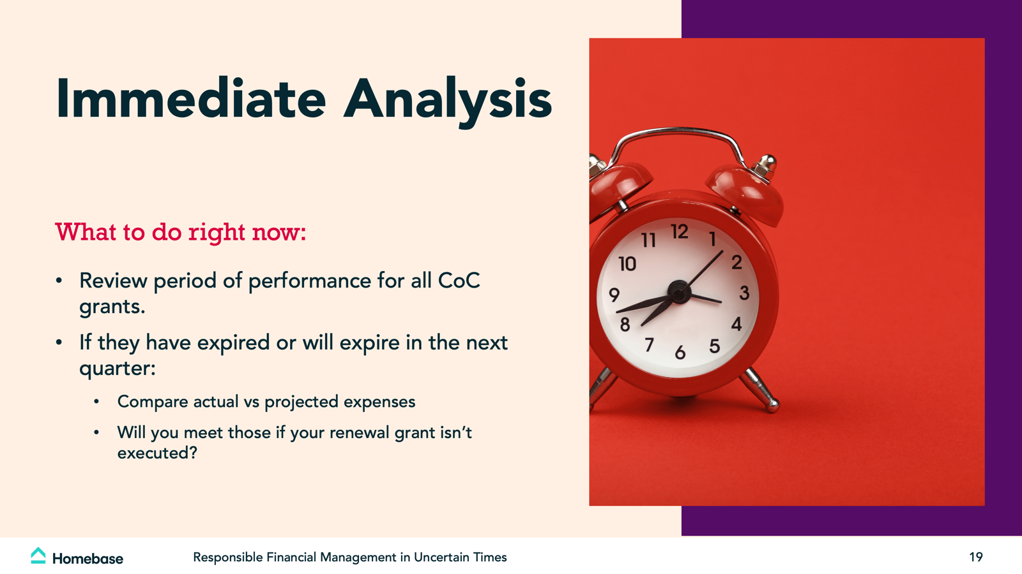

Slide 11
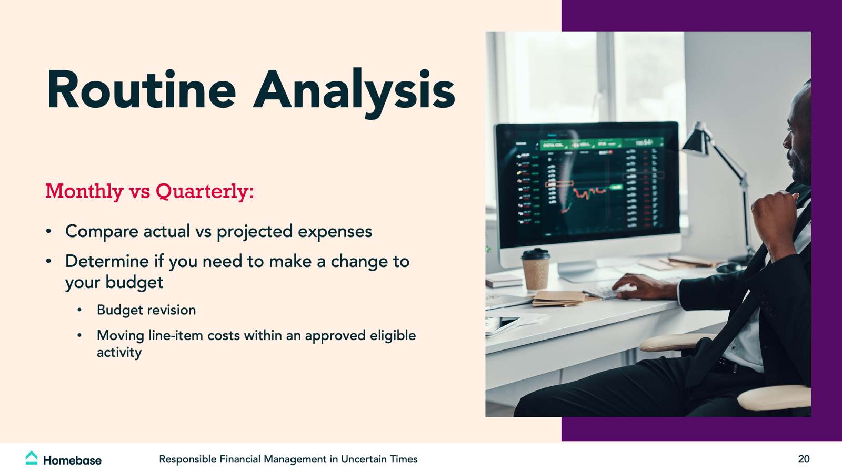

Slide 12
CoC Financial and Scenario Planning ,
2
Compliance with Regulations to Keep the Cash Flowing.
Notes:
TO FORMAT TITLE: Make sure the is a space ( ) at the beginning of each line, and a blue period (.) at the end of each line.
TO CHANGE IMAGE: Delete current image, then Insert>Image, resize it to fit slide, then Arrange>Order>Send to Back.

Slide 13


Slide 14
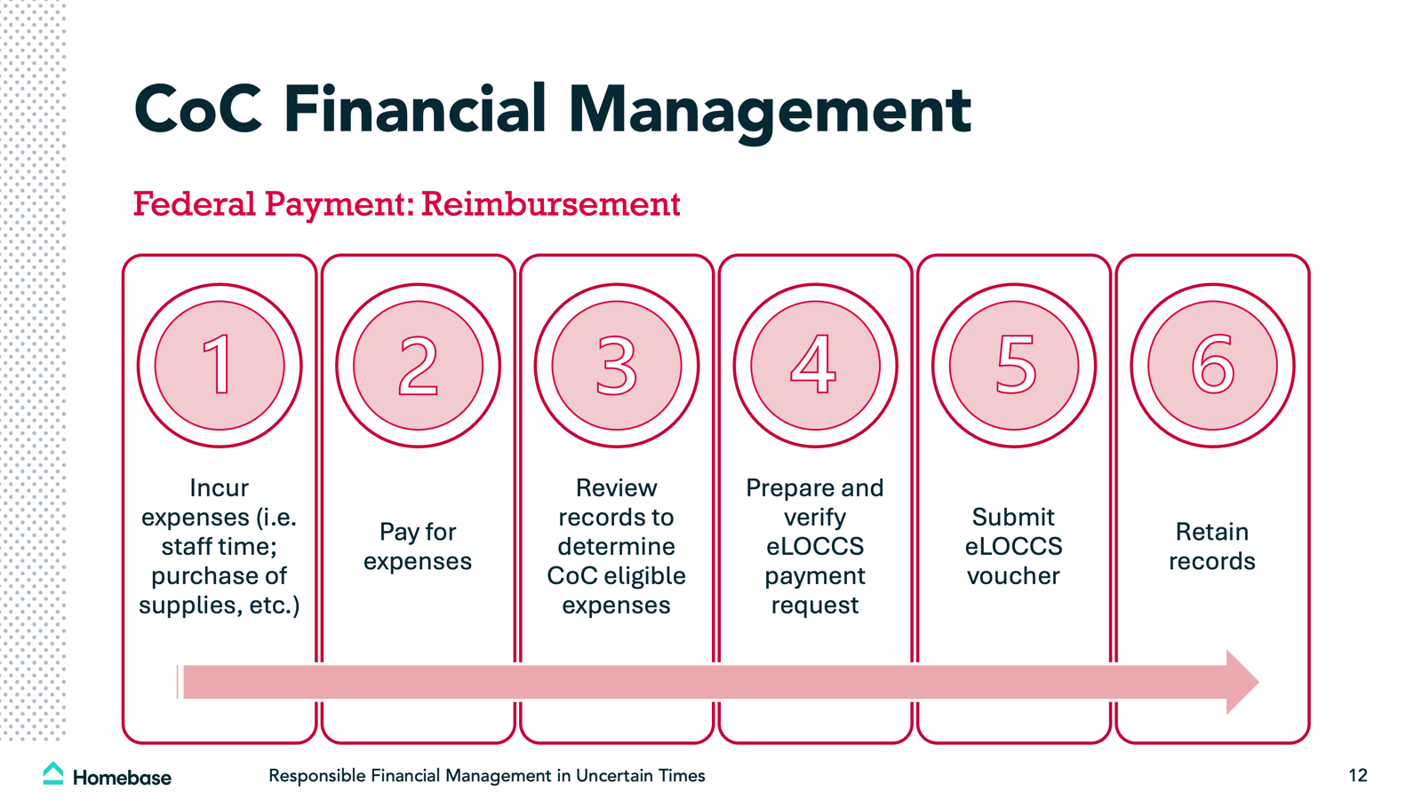

Slide 15
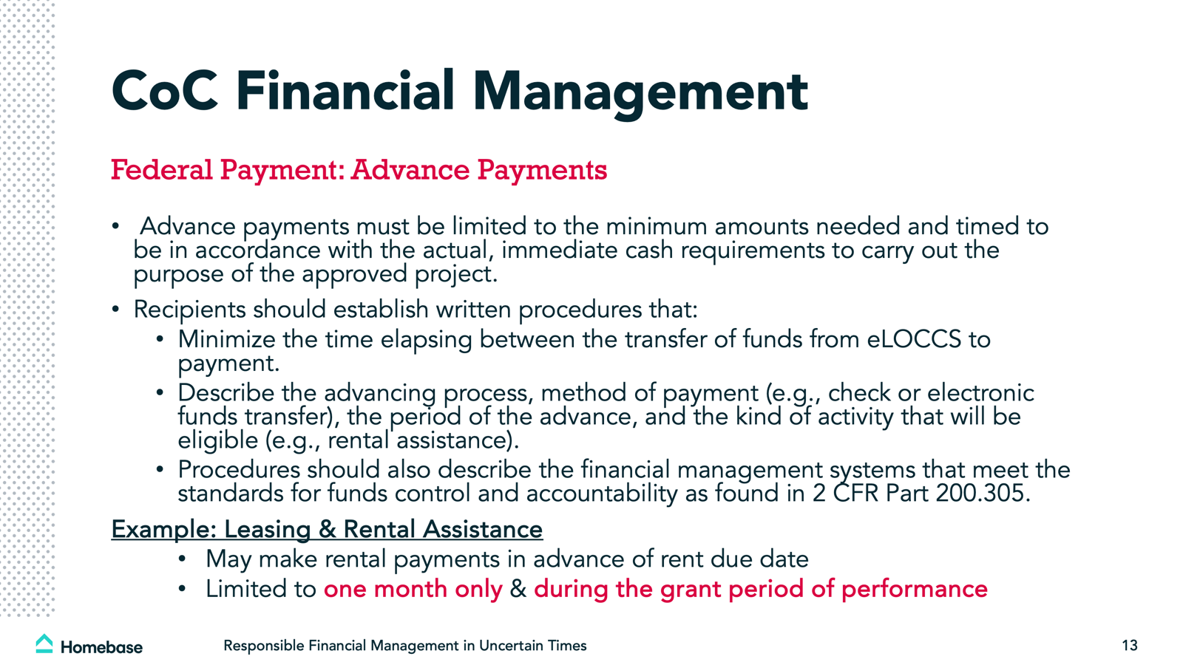

Slide 16
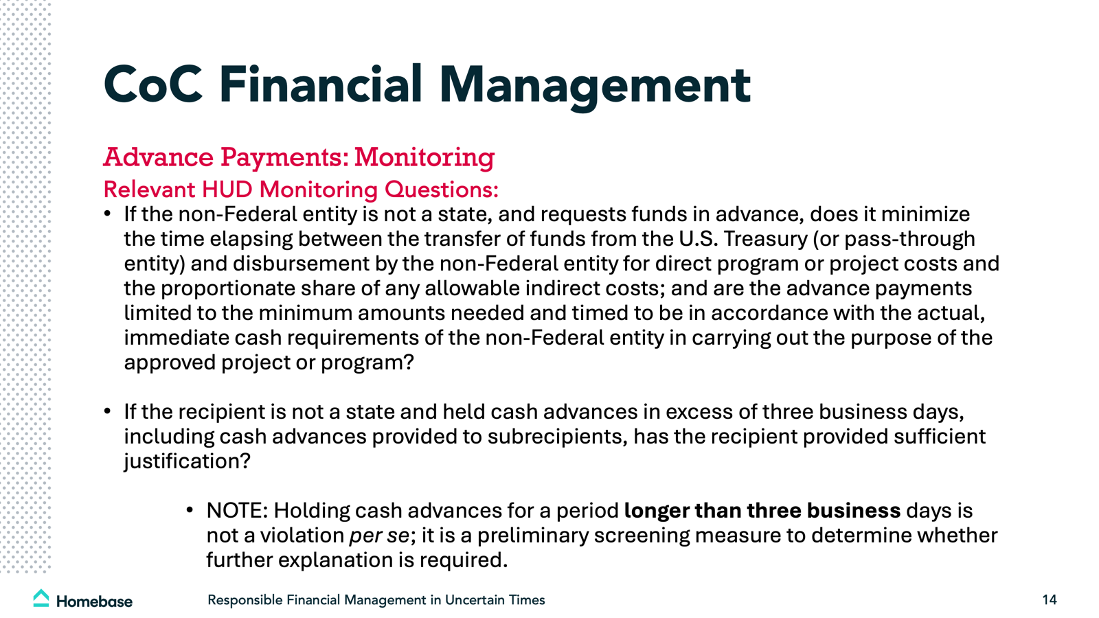

Slide 17
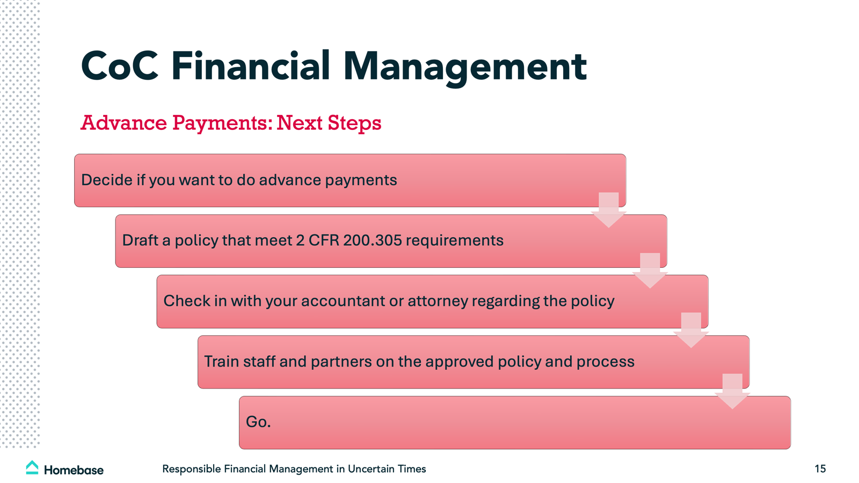

Slide 18
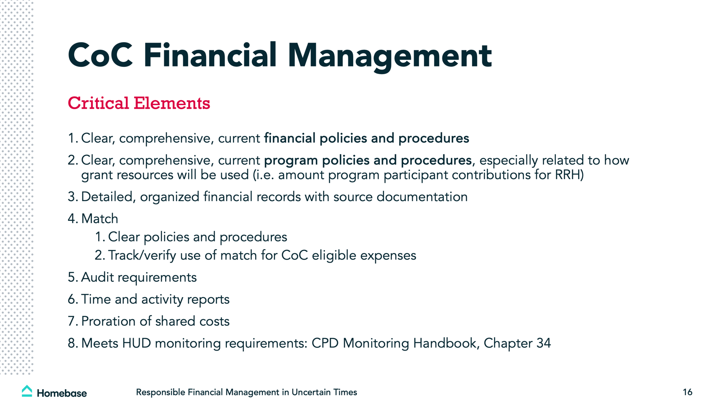

Slide 19
Questions

Slide 20
CoC Financial and Scenario Planning,
3
Strategies for Diversifying Funds.
Notes:
TO FORMAT TITLE: Make sure the is a space ( ) at the beginning of each line, and a blue period (.) at the end of each line.
TO CHANGE IMAGE: Delete current image, then Insert>Image, resize it to fit slide, then Arrange>Order>Send to Back.

Slide 21
Diversifying Funds
Funding Sources
Activities,
Tell Your Story to Faith Based Groups
Present to Community Groups
Invite Volunteer Participation
Conduct Tours for Local Philanthropy
Invite Local Politicians to Visit
Visit School Groups
Add Housing Development Activities
Collect Rents
Build Equity in the Asset
Add Enterprise
Add Earned Unrestricted Funds
Share Revenue with Participants

Slide 22
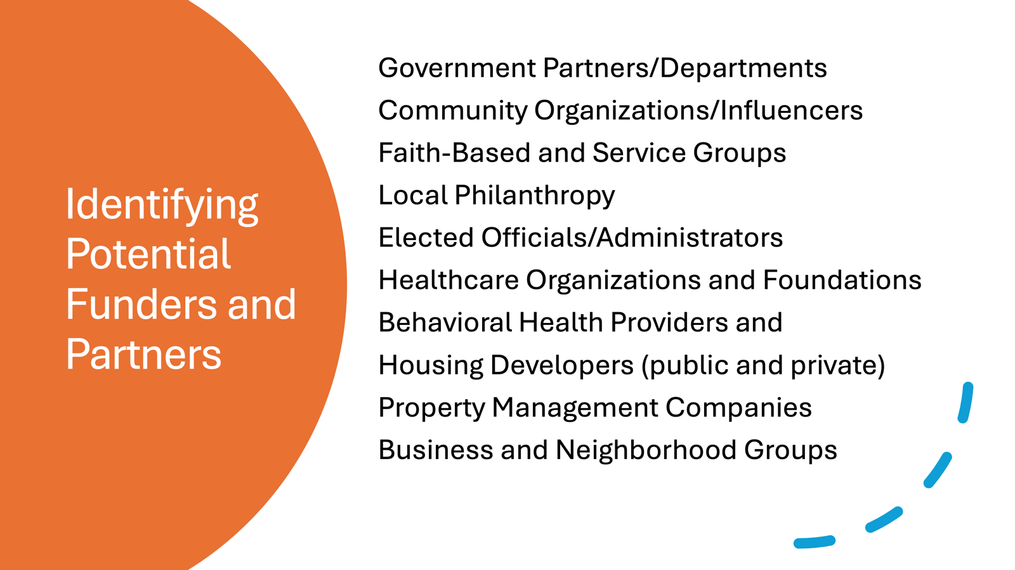

Slide 23
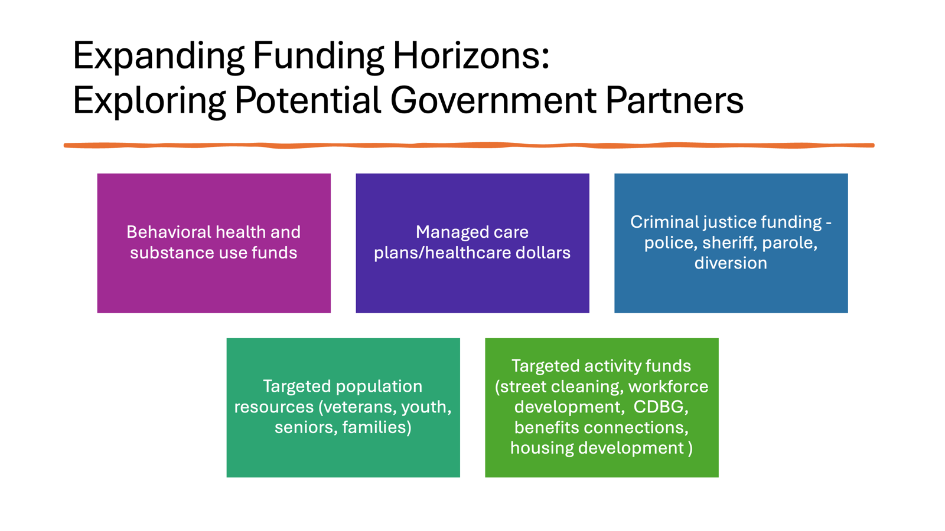

Slide 24
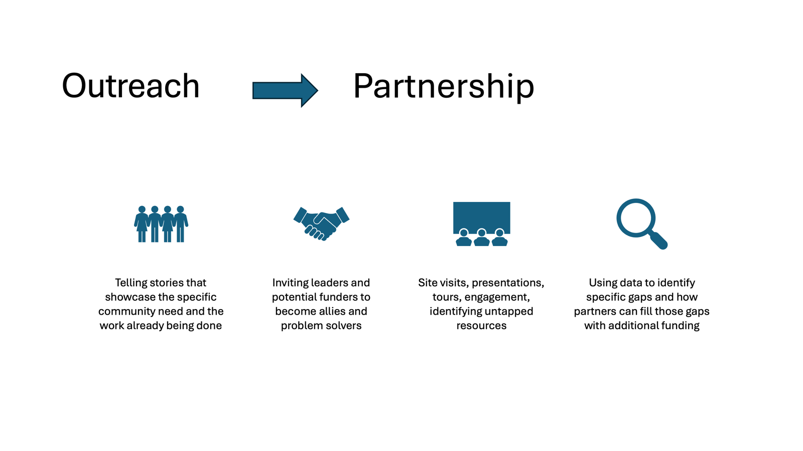

Slide 25
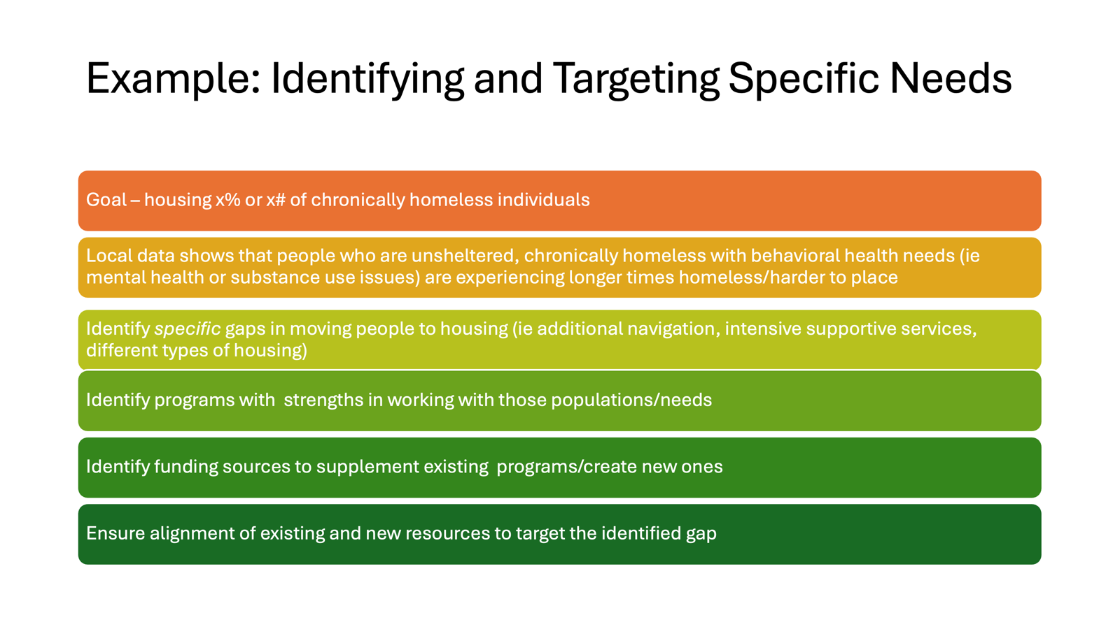

Slide 26
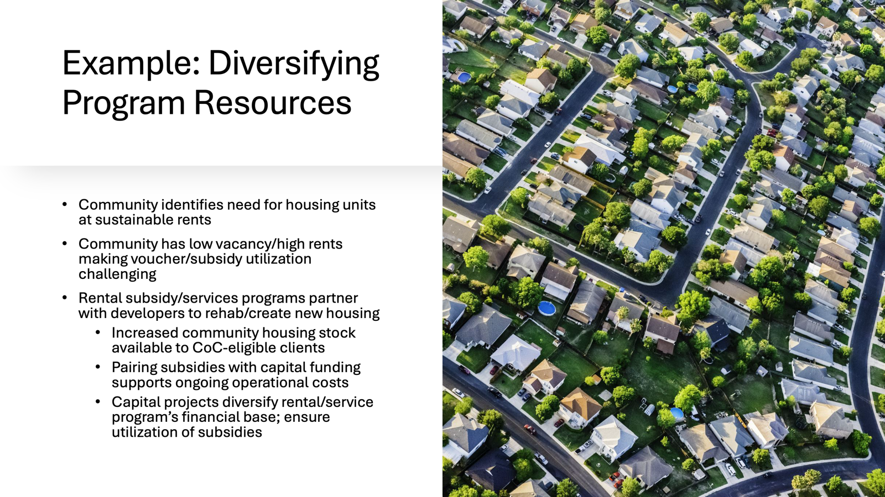

Slide 27
What Has Worked for You?

