Slide 1
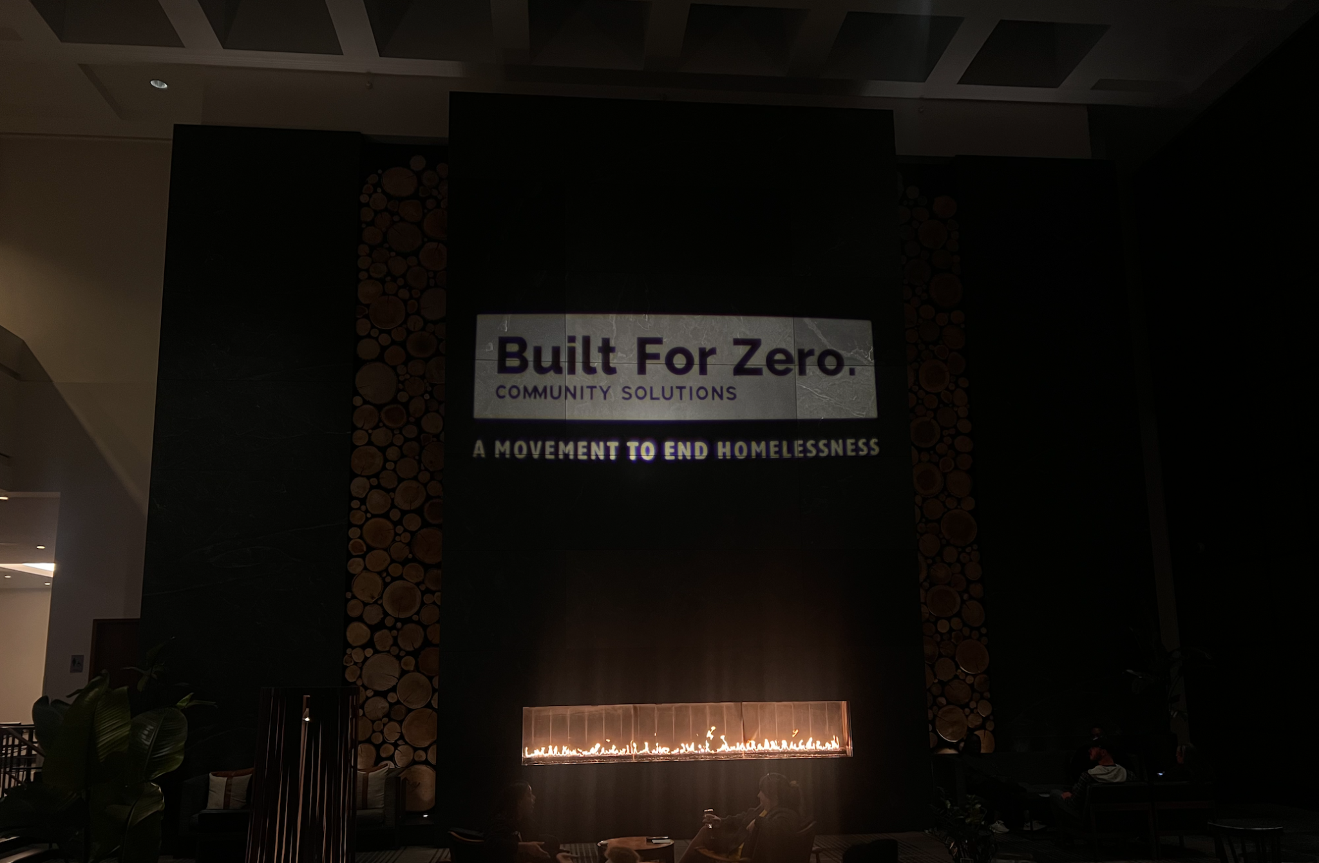

Building Strong Governance & Implementation Structures
Notes:
TO FORMAT TITLE: Make sure the is a space ( ) at the beginning of each line, and a purple period (.) at the end of each line.
TO CHANGE IMAGE: Delete current image, then Insert>Image, resize it to fit slide, then Arrange>Order>Send to Back.
Building Strong Governance & Implementation Structures

Slide 2

Building Strong Governance & Implementation Structures
1
2
3
Participants will learn about the importance of having clear decision-making and governance practices for achieving community-wide outcomes.
The session will emphasize practical, real-world examples, allowing attendees to understand how successful governance frameworks are designed and implemented in diverse community settings.
Understand the critical elements for designing robust governance structures and essential components that contribute to strong and resilient governance, including exploring decision-making processes, accountability mechanisms, and transparent partner engagement strategies.

Slide 3
.Framework for Community Theory of Change.
Setting the Foundation
Establishing the foundational conditions and new ways working across the system ready the environment for effective implementation of key strategies
Implementing Strategies to Achieve and Sustain Reductions
Iterating data driven strategies to influence enabling conditions in the ecosystem and to reduce homelessness leads to an improved system.
Desired System and Population Change
Strategies drive measurable outcomes to enable change in the system conditions and to achieve equitable housing outcomes
North Star
A changed environment and improved outcomes results in achieving the north star aim:
Sustainable, equitable reductions in homelessness. Homelessness is rare and brief for all.

Slide 4
.Setting the Foundation.
Foundations: System Conditions
System commitment to work toward a shared goal
Broad and diverse partnerships
Leadership and staff capacity/capability for system improvement
Implementation, accountability, and decision-making mechanisms for system change work
Quality data and infrastructure
Knowledge of available system resources, funding, partners, policies, and housing
INPUT
Intermediary supports and resources
help build system capacity and new ways of working
Community inputs
include readiness to engage, participation, and local context
Foundations: Effective Ways of Working
Partnerships and collaboration to build trust and deepen relationships
Coordination and alignment of programs, practices, and measures
Evidence-informed practice and ongoing learning
Equitable and person-centered approach
Testing and refining strategies

Slide 5
SAMPLE Shared Implementation Structure.
Executive Level Leadership Group
Backbone Leadership
Policy + Funding Changes
Barriers to be Cleared
People In Housing
Decision-Making Authority
Improvement Structure + Target Priorities
Improvement Team
Common Barriers to Housing
Front Line Case Coordination + Regional Leadership
Other Working Groups
(i.e. Data quality, Data analysis & research, hot spot or sector based issues)
Notes:
Connect the case conferencing box to regions:

Slide 6
Thank You!

