Slide 1
[Community Name]
Lived Experience Descriptions
A window into how people experience the system to prevent homelessness
[DATE]

Slide 2
Conversations with Leaders with Lived Experience
Team/Lived Experience Lead held X# 1:1 conversations to bring in these critical perspectives
Based on these conversations, we developed the following slides:
To reflect some insights about how people experience our Homelessness Prevention System
To reflect, based on these perspectives and knowledge more broadly of people experiencing homelessness, how to guide someone through the current system, based on
As well as a reflection on common challenges and priority focus areas
Notes:
\

Slide 3
Did the person see their experience as typical (this is what lots of people experience with the homelessness prevention support system) or unusual? Why?
Was there something that they were seeking that they could not get? Do they know why? Was other help offered & useful?
Was there something/someone that was really helpful to prevent homelessness?
Why was that helpful?
In this experience, what was the final “result”? Was support and/or housing provided by the system? Was it “successful” (from the perspective of the person)
When/What type of system failure(s) led to the person needing to leave their housing? (e.g. non-renewal of lease, cost, death, loss of job/income, eviction, discrimination, health issue)
How much time did they have?
What happened next? How long did it take? Did they need go to an emergency shelter, motel or street?
How did they feel?
To get support to prevent homelessness, what did the person do first? What type of response did they get?How long did it take?
How did they feel?
Was this the first time they faced homelessness? Did that effect the response they received?
What were they told to do next? Did it prevent them from becoming homeless?
(or entering an emergency shelter, motel, car, outside)
How did they feel?
Was there a system (doctor, school, housing) that previously asked them about their housing security and provided support? When was that? Was it helpful?
Notes:
From interviews with people who have recently become homeless (motel, shelter, outside, car, transitional housing), create 3 scenarios that reflect some common or typical experiences of what happened when/how they sought support to prevent homelessness

Slide 4
Notes:
TO FORMAT HEADER: Make sure the is a space ( ) at the beginning of each line, and a white period (.) at the end of each line.

Slide 5
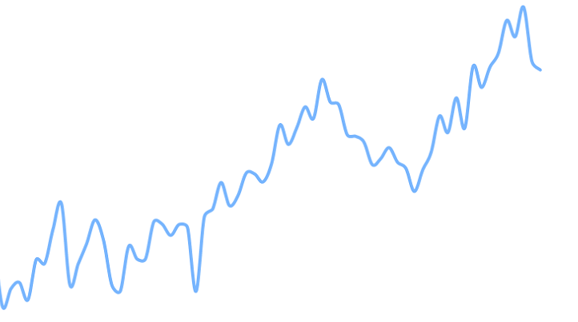
How does the system work to support people to prevent homelessness?
What does a person typically do first? What type of support are they seeking? What is the first response? [Where do they go/look/call?]
And then what happens? What are the typical responses?
And IF the system does NOT provide support to prevent homelessness, then what happens?
[Example Answer] Calling VA:
And IF the system provides support to prevent homelessness, THEN what does that look like?
Does the system support typically involve entering an emergency shelter, motel or transitional housing?
[Example Answer] Calling 211
[Example Answer]Going to Shelter/Resource Center
What does it typically take to access that support? How long does it take? What does a person need to do?
[Example Answer] Doing Research at Library
Notes:
TO FORMAT HEADER: Make sure the is a space ( ) at the beginning of each line, and a white period (.) at the end of each line.

Slide 6
Common Challenges
List 3-5 top challenges experienced accessing Homelessness Prevention Support
Notes:
\

Slide 7
Priority Focus Areas
List 1-3 priority focus areas to improve system response to preventing homelessness?

